Slide 1
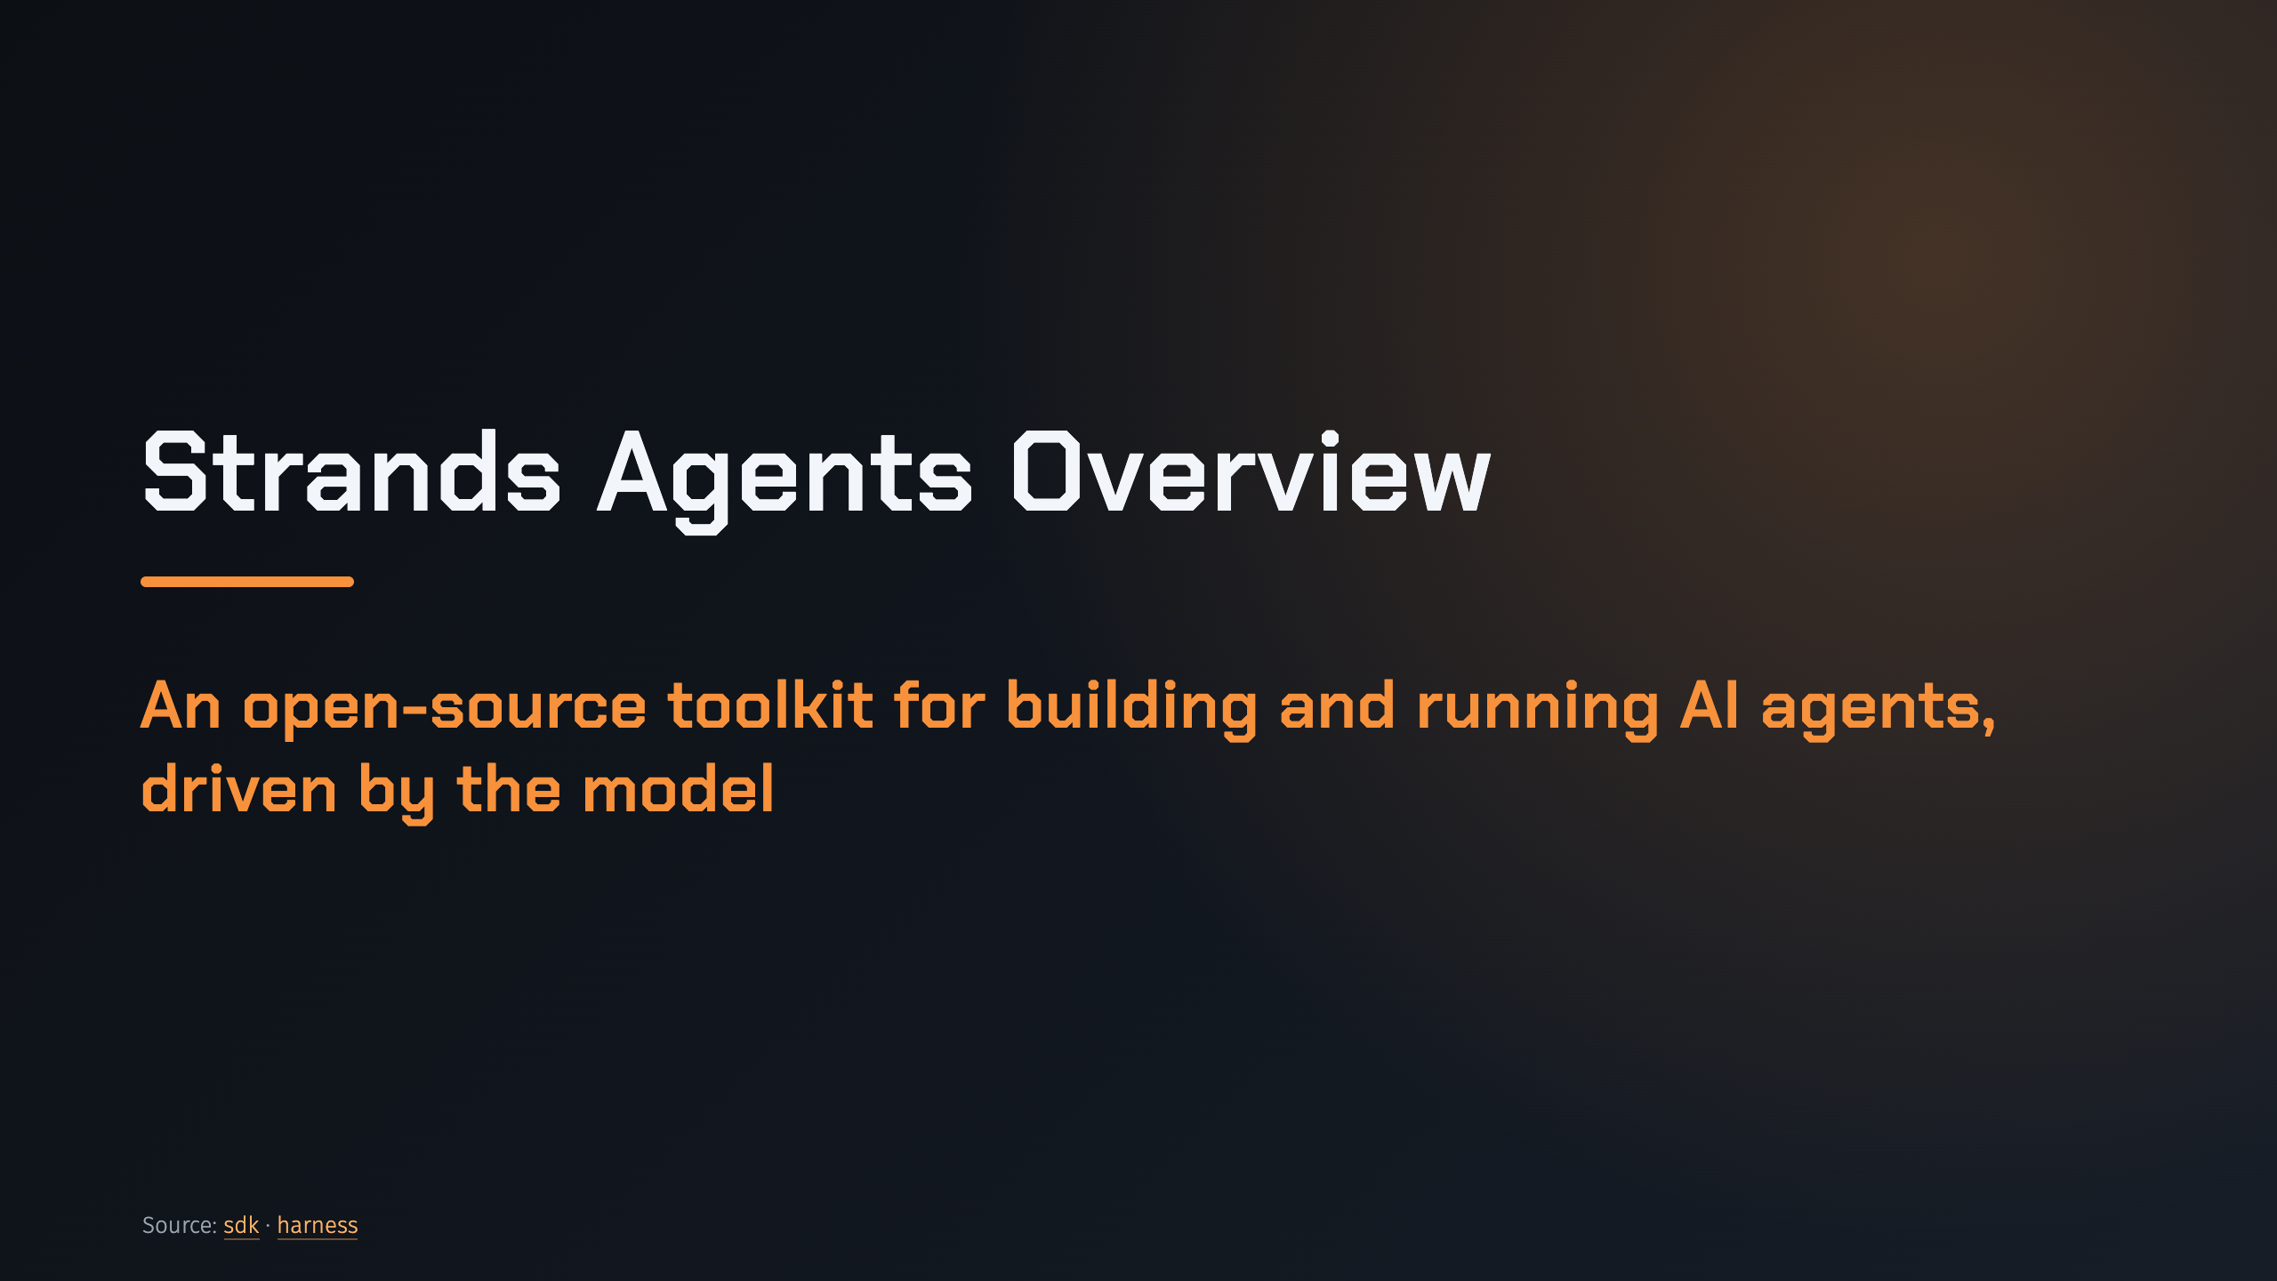
Notes:
_transition: cover
Notes: This deck is the map for the whole series: what Strands is, the model-driven approach, the four parts of the toolkit, and a quick tour of every topic the later decks cover. Source: pages/docs/user-guide/sdk/index.md, pages/docs/user-guide/harness/index.md

Slide 2
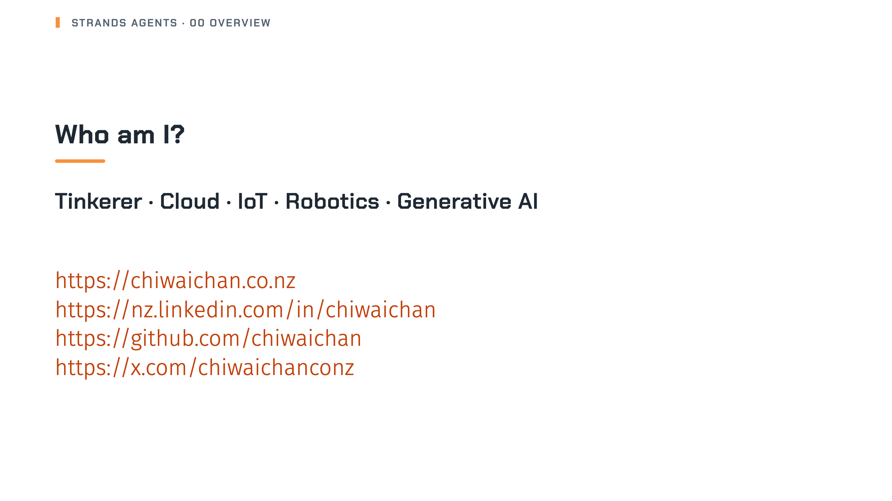
Notes:
Notes: Quick hello before we start. Source: src/pages/cv.md, docusaurus.config.ts (site links)

Slide 3
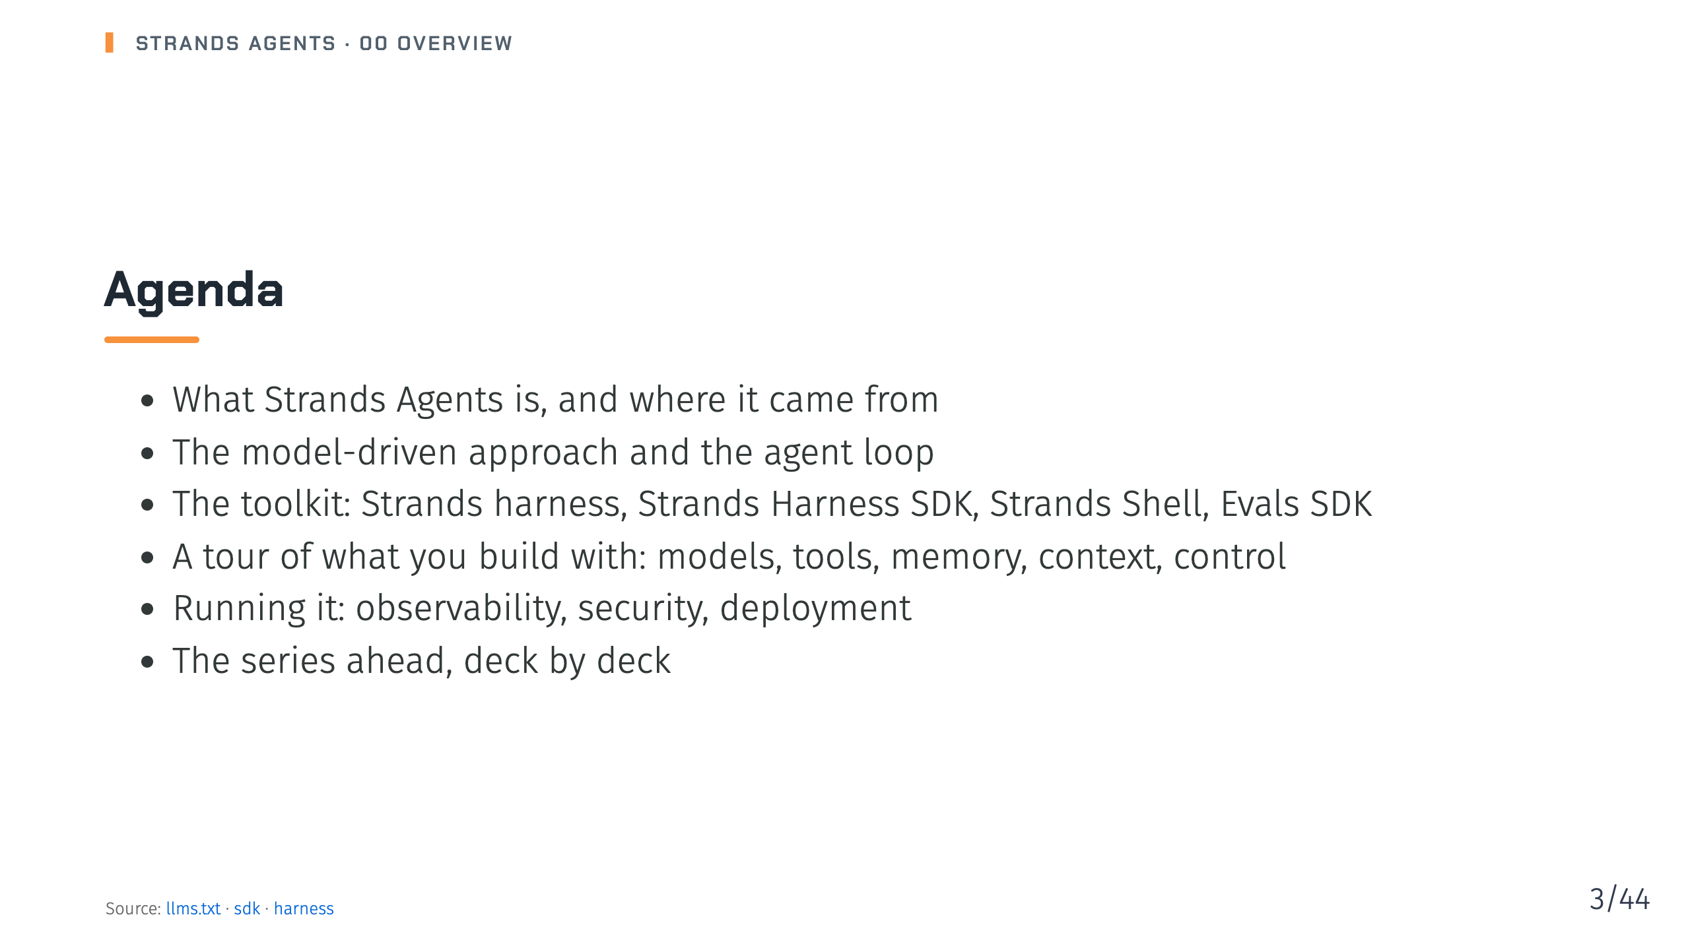
Notes:
Notes: The order follows the docs map: the four products first, then the build guides, then the run guides. Source: llms.txt, pages/docs/user-guide/sdk/index.md, pages/docs/user-guide/harness/index.md

Slide 4
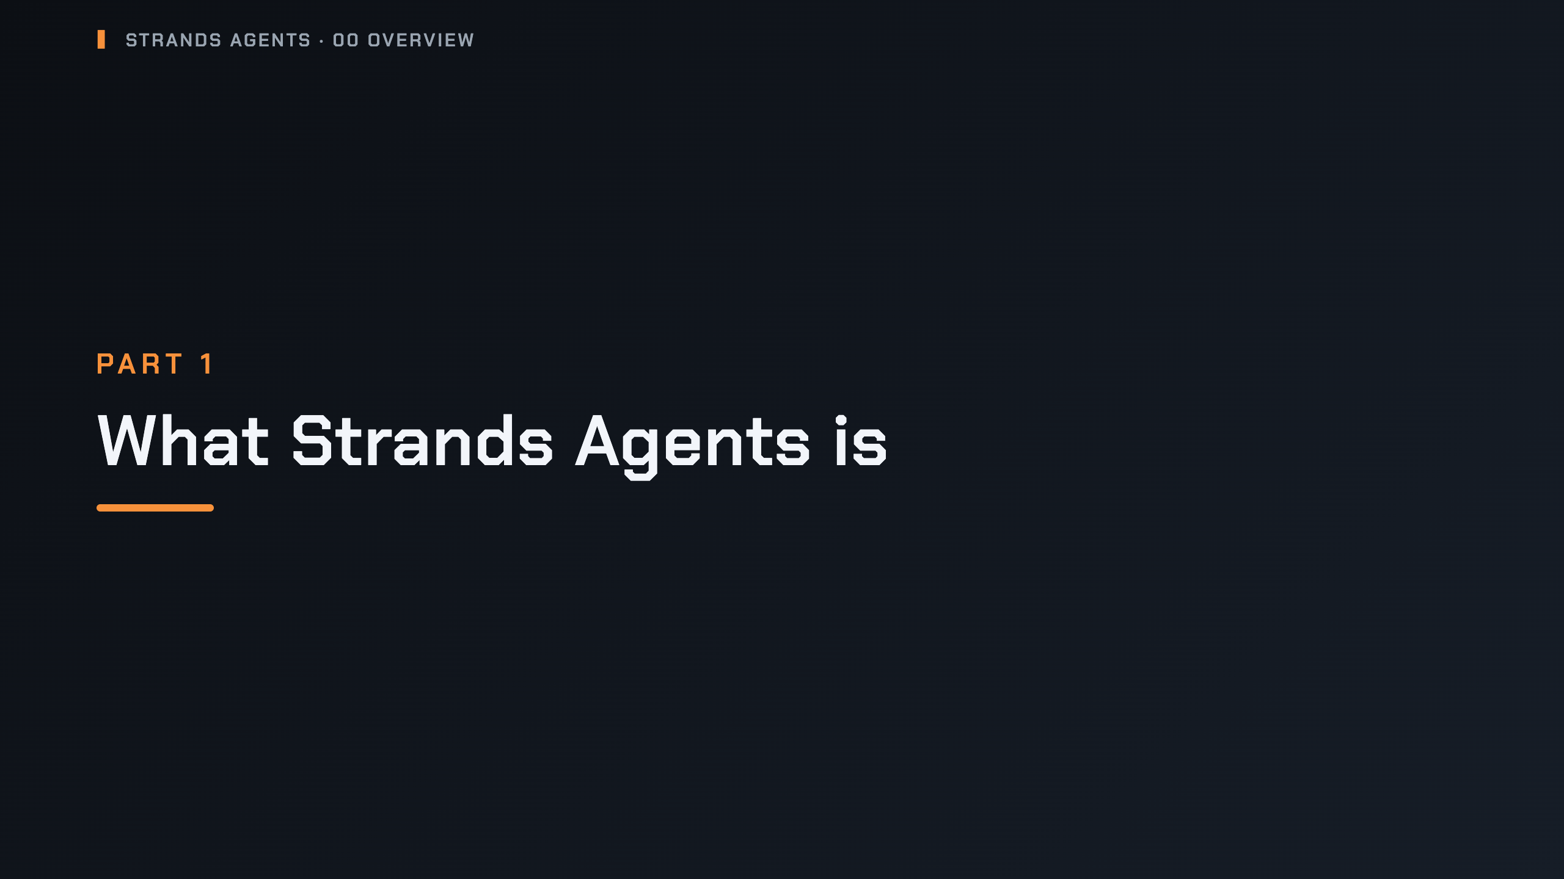
Notes:
_transition: cover
Notes: Section break: the one-paragraph definition, the library shape, and the product map.

Slide 5
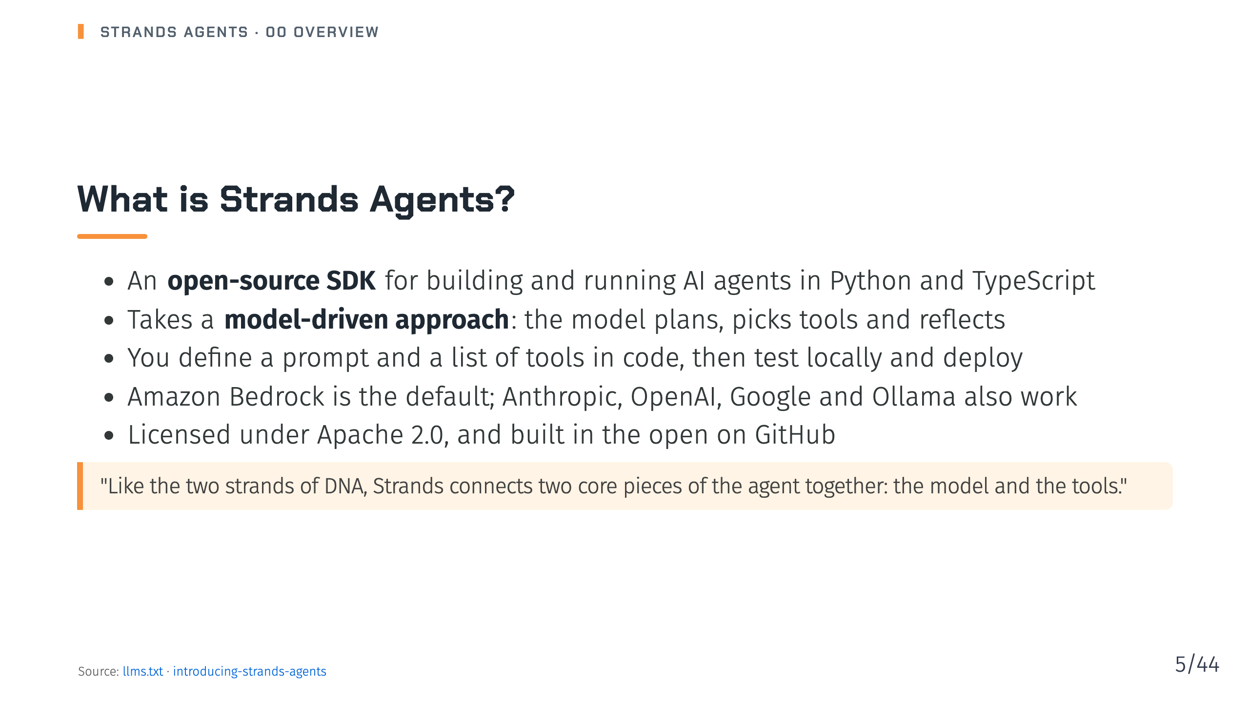
Notes:
Notes: The launch post says AWS teams such as Amazon Q Developer, AWS Glue and VPC Reachability Analyzer already used Strands in production before the public release. Source: llms.txt, pages/blog/introducing-strands-agents/index.md

Slide 6
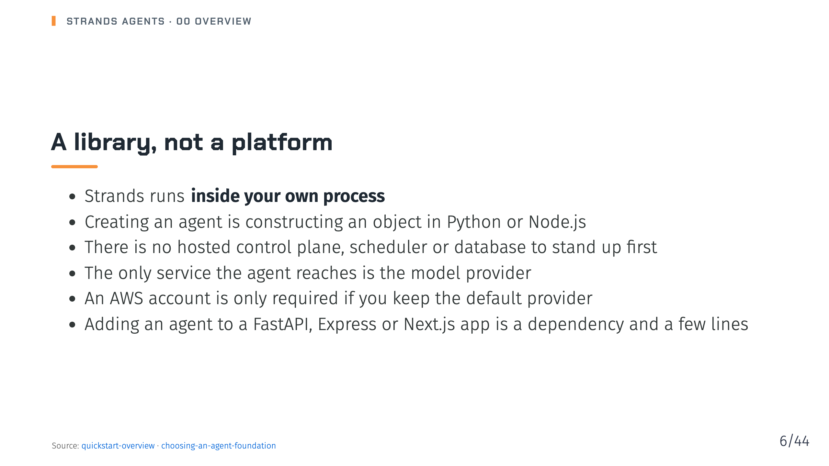
Notes:
Notes: The docs are explicit about what Strands does not add: a platform. That is the main difference from a managed service such as the AgentCore harness in the previous series. Source: pages/docs/user-guide/sdk/quickstart/overview/index.md, pages/docs/user-guide/migrate/choosing-an-agent-foundation/index.md

Slide 7
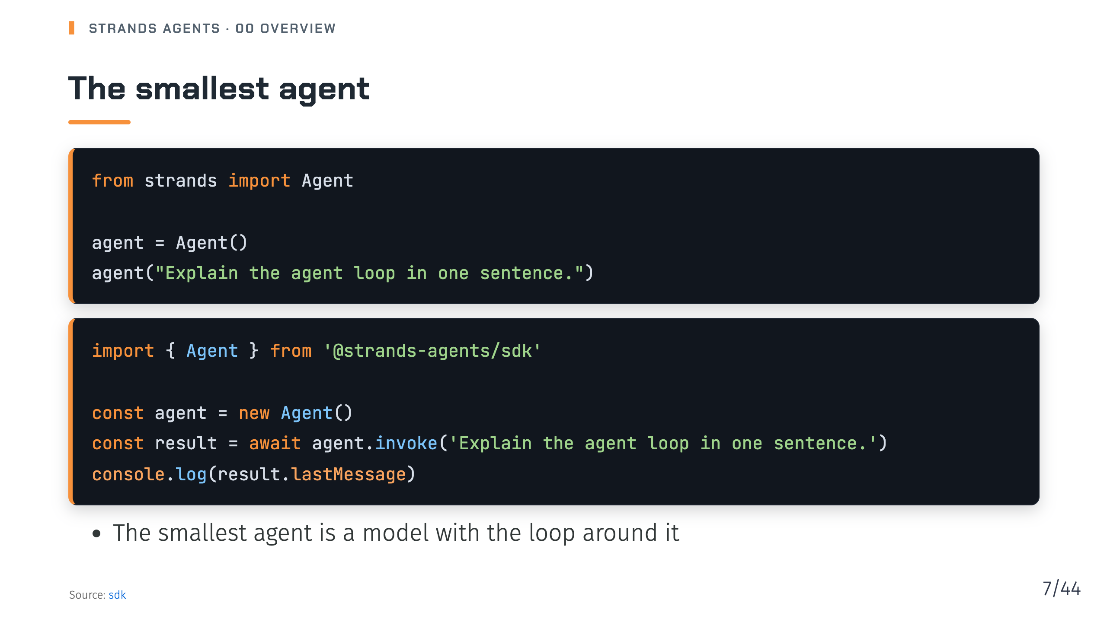
Notes:
Notes: Both snippets are from the Harness SDK overview page. No model is passed, so the agent uses the default provider, Amazon Bedrock. Source: pages/docs/user-guide/sdk/index.md

Slide 8
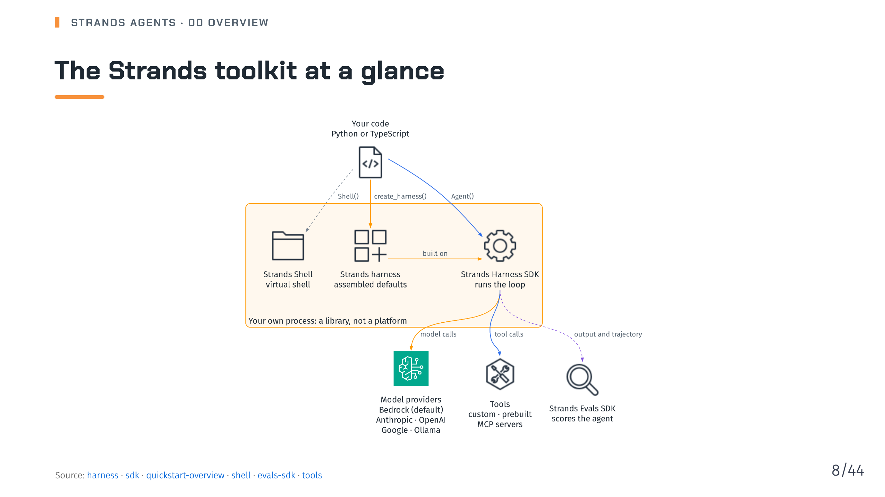
Notes:
Notes: Walk it top to bottom. Your code calls create_harness for an assembled agent or Agent for one you build yourself. The harness is built on the Harness SDK. The SDK runs the loop and calls model providers and tools. Strands Shell is a separate in-process virtual shell, and the Evals SDK scores what the agent produced and how it got there. Source: pages/docs/user-guide/harness/index.md, pages/docs/user-guide/sdk/index.md, pages/docs/user-guide/sdk/quickstart/overview/index.md, pages/docs/user-guide/shell/index.md, pages/docs/user-guide/evals-sdk/index.md, pages/docs/user-guide/sdk/tools/index.md

Slide 9
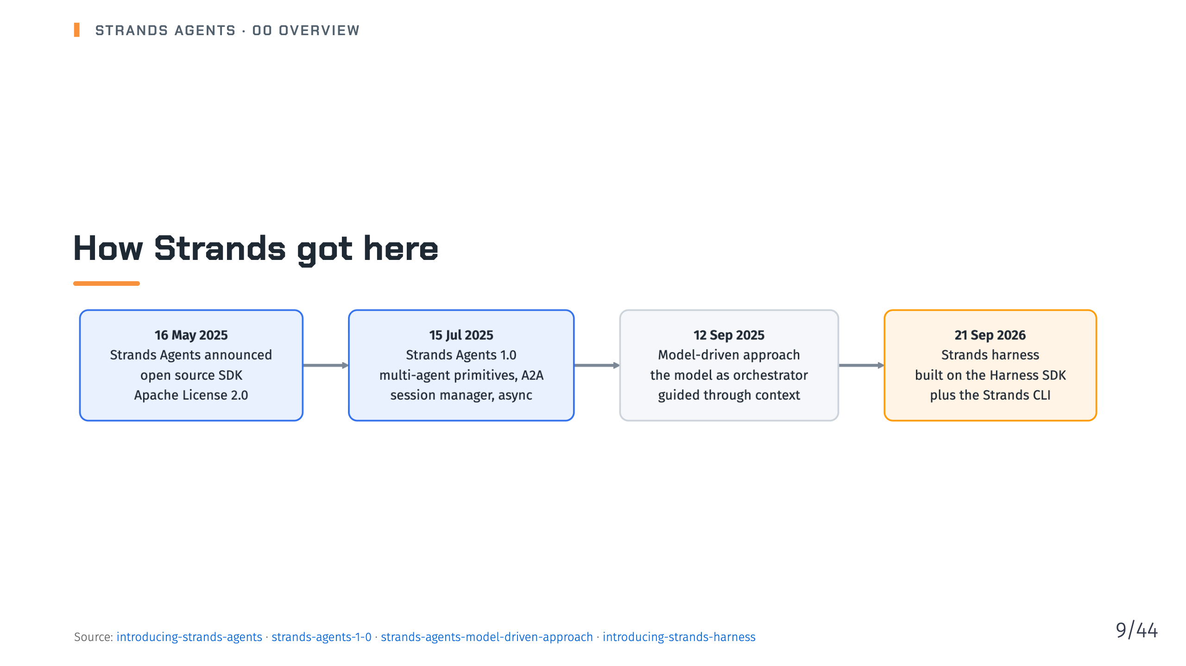
Notes:
Notes: The dates are the publish dates of the four posts on the Strands blog. 1.0 added four multi-agent primitives, A2A support, a session manager and async support. The harness post introduced the assembled Strands harness on top of the Strands Harness SDK, and the Strands CLI. Source: pages/blog/introducing-strands-agents/index.md, pages/blog/strands-agents-1-0/index.md, pages/blog/strands-agents-model-driven-approach/index.md, pages/blog/introducing-strands-harness/index.md

Slide 10
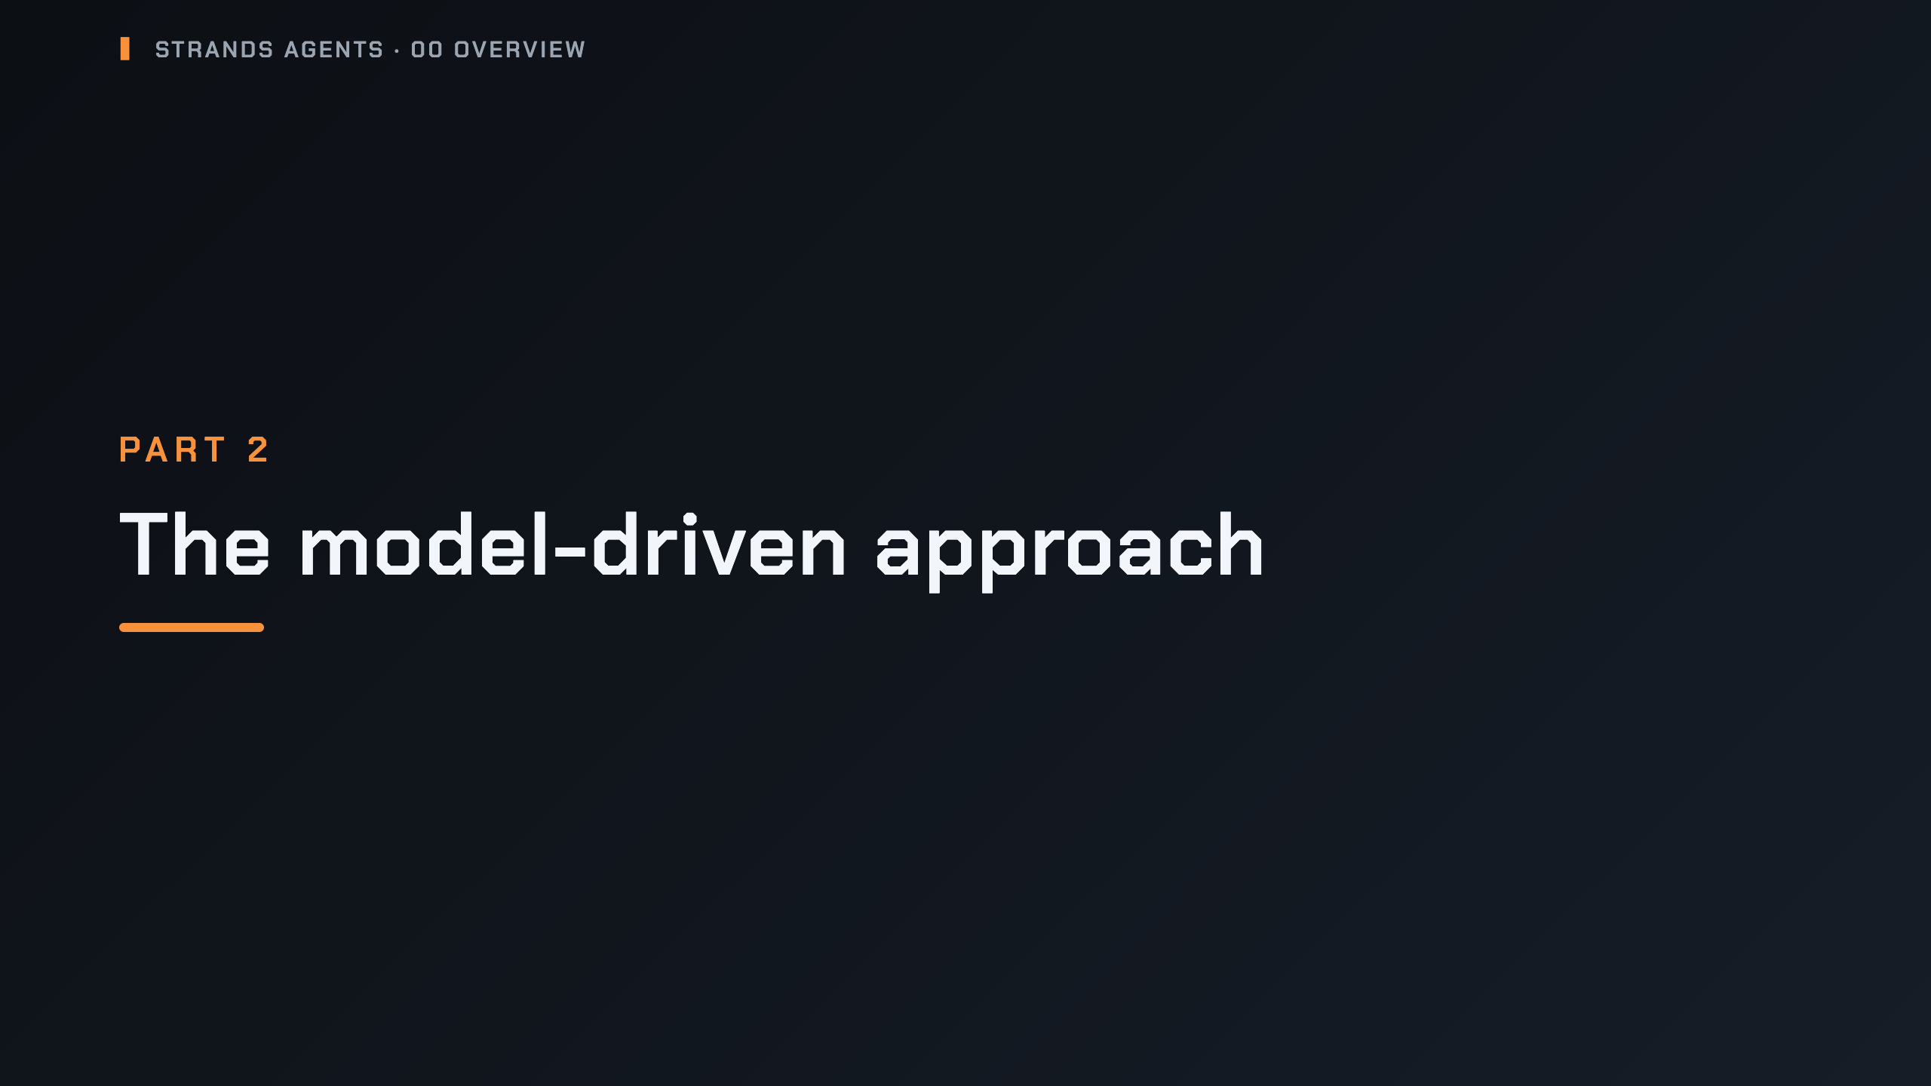
Notes:
_transition: cover
Notes: Section break: why Strands lets the model drive, and what the loop looks like.

Slide 11
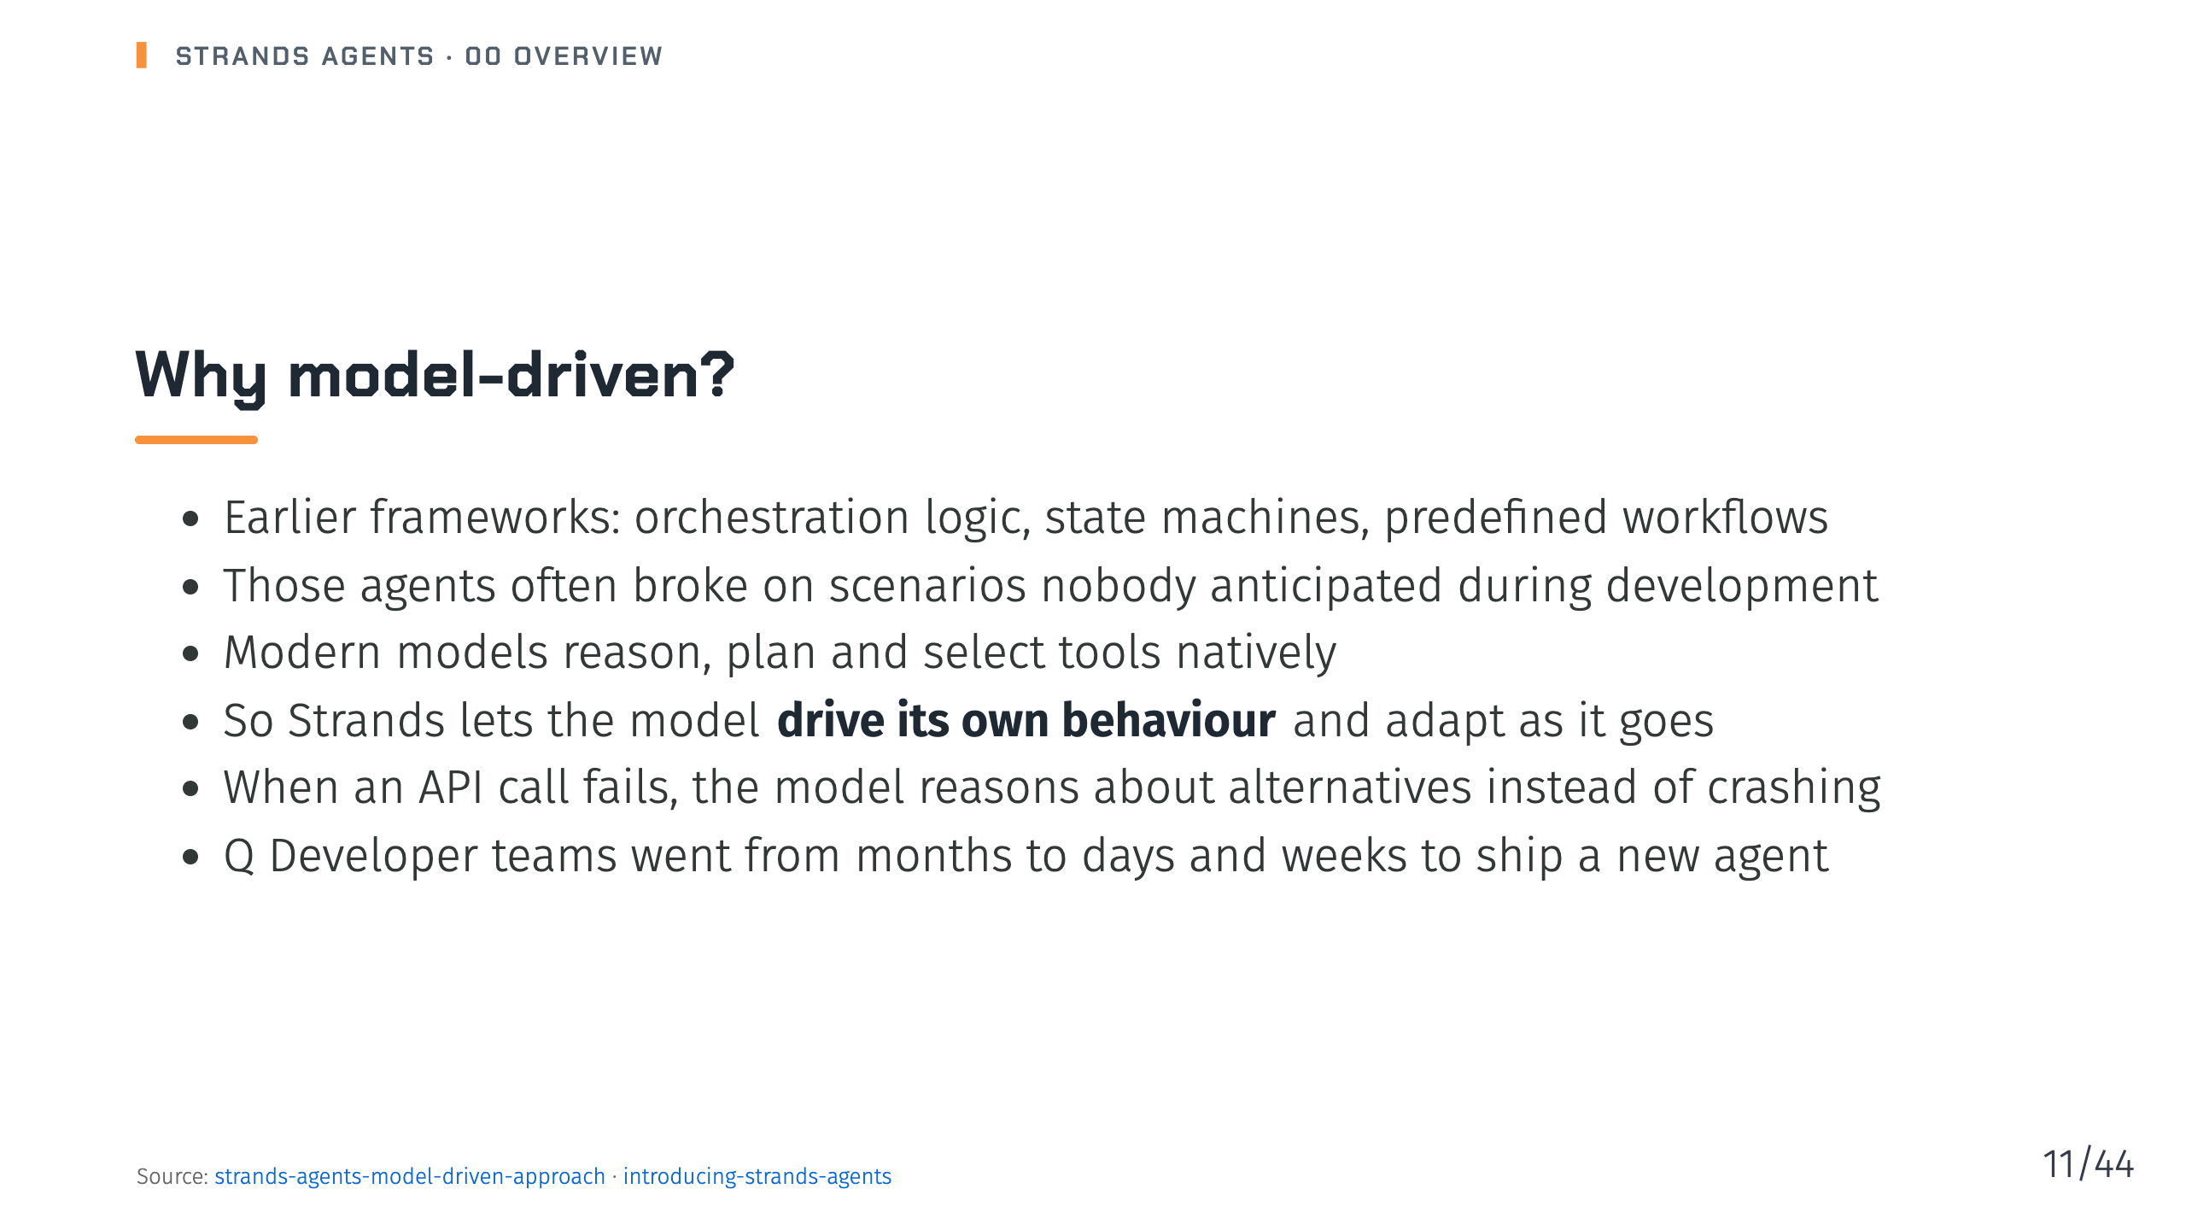
Notes:
Notes: The story in the launch post: the frameworks built for earlier models started to get in the way of what newer models could do on their own. Using the model as orchestrator does not mean giving up developer control. Source: pages/blog/strands-agents-model-driven-approach/index.md, pages/blog/introducing-strands-agents/index.md

Slide 12
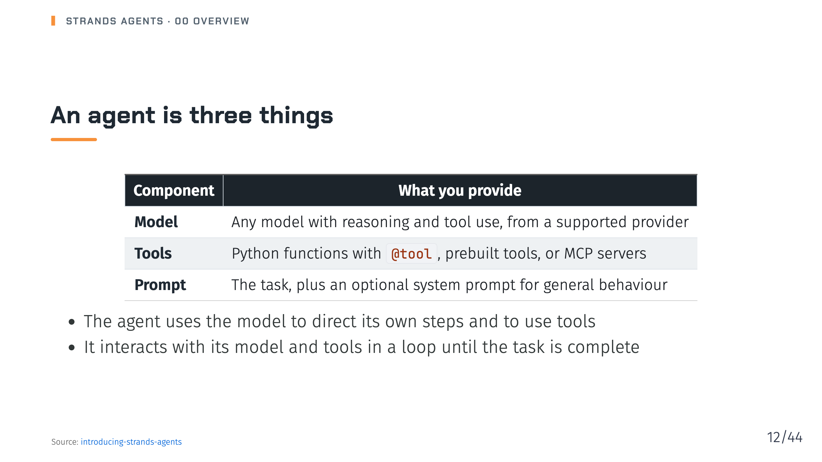
Notes:
Notes: This is the simplest definition from the launch post: a model, tools and a prompt. Everything else in the series is a way of shaping or controlling those three. Source: pages/blog/introducing-strands-agents/index.md

Slide 13
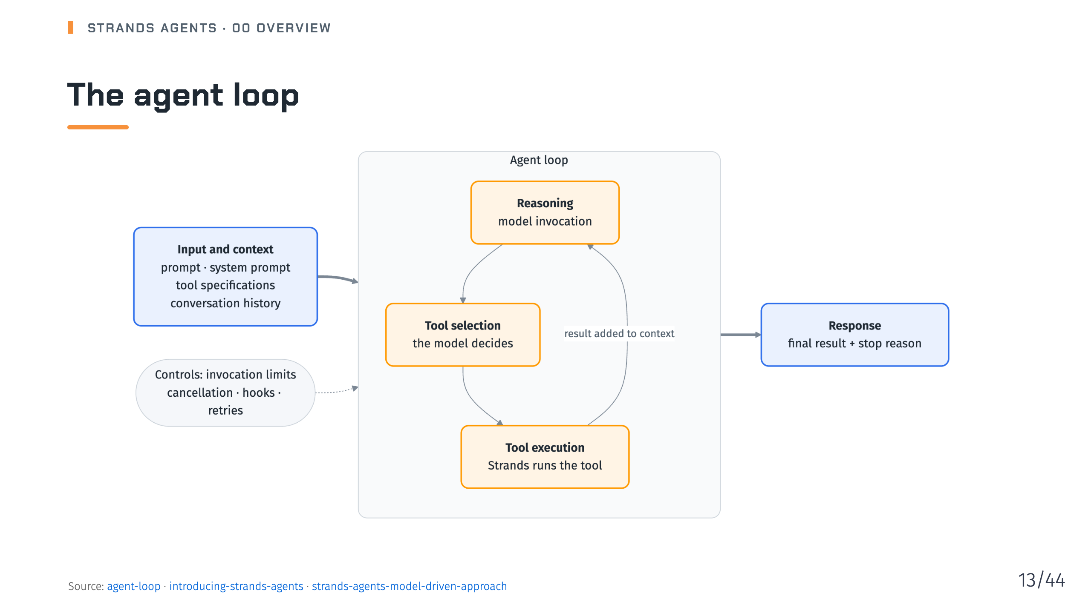
Notes:
Notes: Invoke the model, check whether it wants a tool, run the tool, then invoke the model again with the result. Context accumulates each iteration. The loop ships with invocation limits, cancellation, stop reasons, hooks and retry strategies. Deck 02 covers all of these. Source: pages/docs/user-guide/sdk/agents/agent-loop/index.md, pages/blog/introducing-strands-agents/index.md, pages/blog/strands-agents-model-driven-approach/index.md

Slide 14
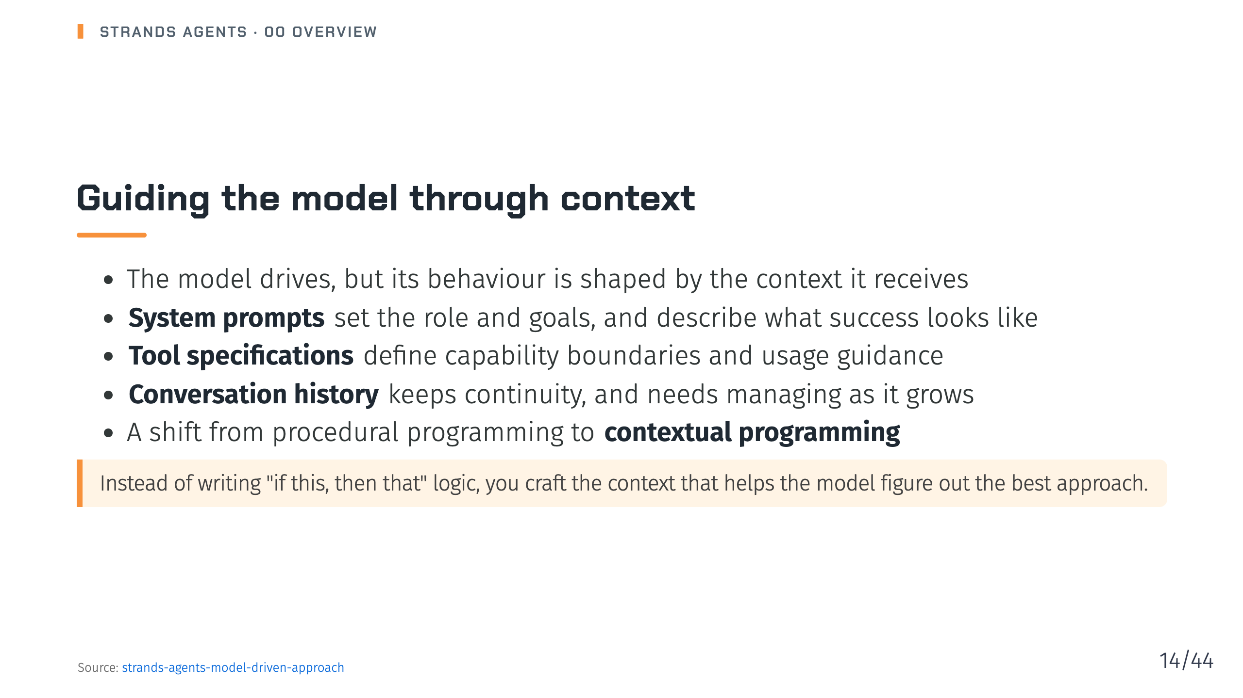
Notes:
Notes: These three levers map to later decks: prompts in deck 02, tools in deck 04, and conversation and context management in deck 07. Source: pages/blog/strands-agents-model-driven-approach/index.md

Slide 15
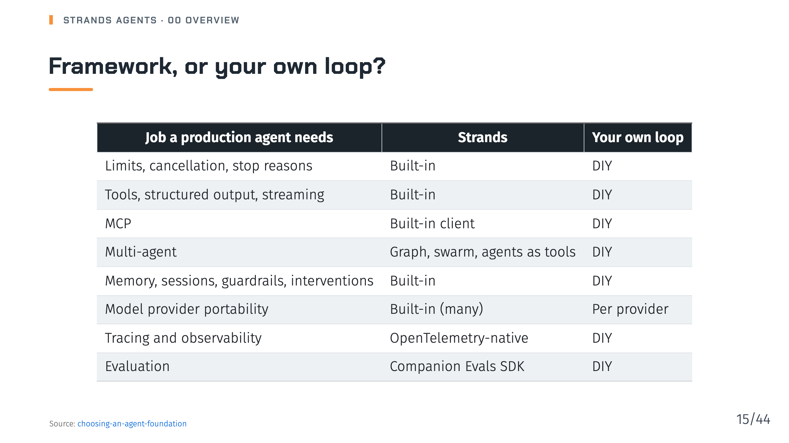
Notes:
Notes: The docs page also compares the OpenAI Agents SDK, LangGraph, the Vercel AI SDK and Pydantic AI, and says to treat the table as a starting map, not a scoreboard. It says to keep your own loop for one model, a handful of tools and short, tightly scoped runs. The trap it warns about is quietly rebuilding a framework inside your own loop. Source: pages/docs/user-guide/migrate/choosing-an-agent-foundation/index.md

Slide 16
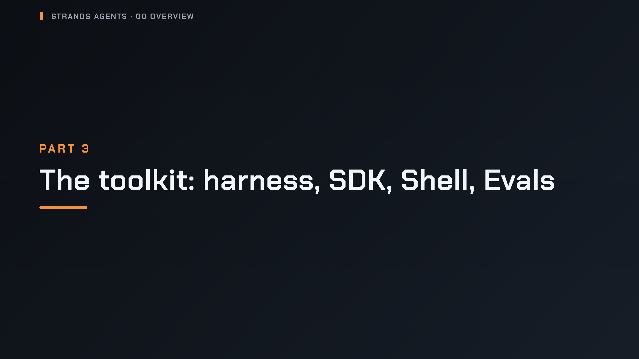
Notes:
_transition: cover
Notes: Section break: the four products in the docs map.

Slide 17
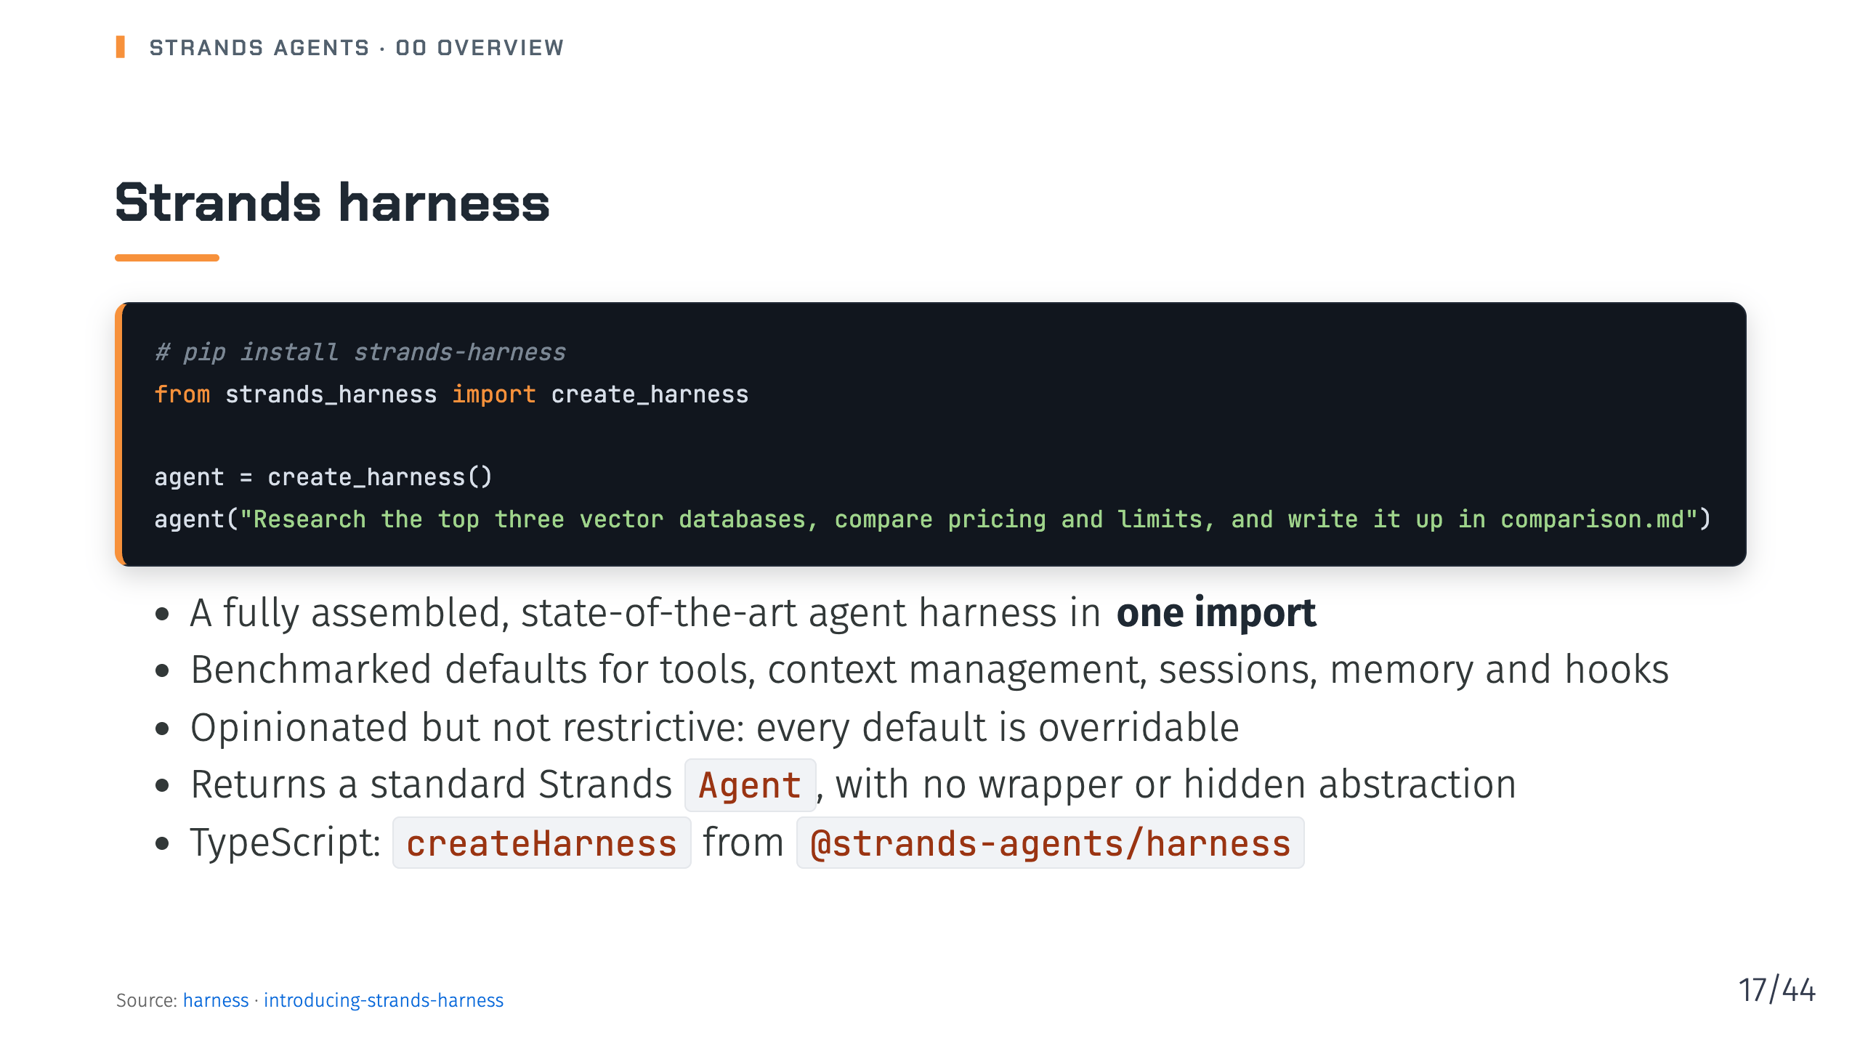
Notes:
Notes: An agent harness is the software around a model that turns it into an agent. The launch post positions the Strands harness as a general-purpose agent rather than a coding agent, and also introduces the Strands CLI, installed with npm install -g @strands-agents/cli. Source: pages/docs/user-guide/harness/index.md, pages/blog/introducing-strands-harness/index.md

Slide 18
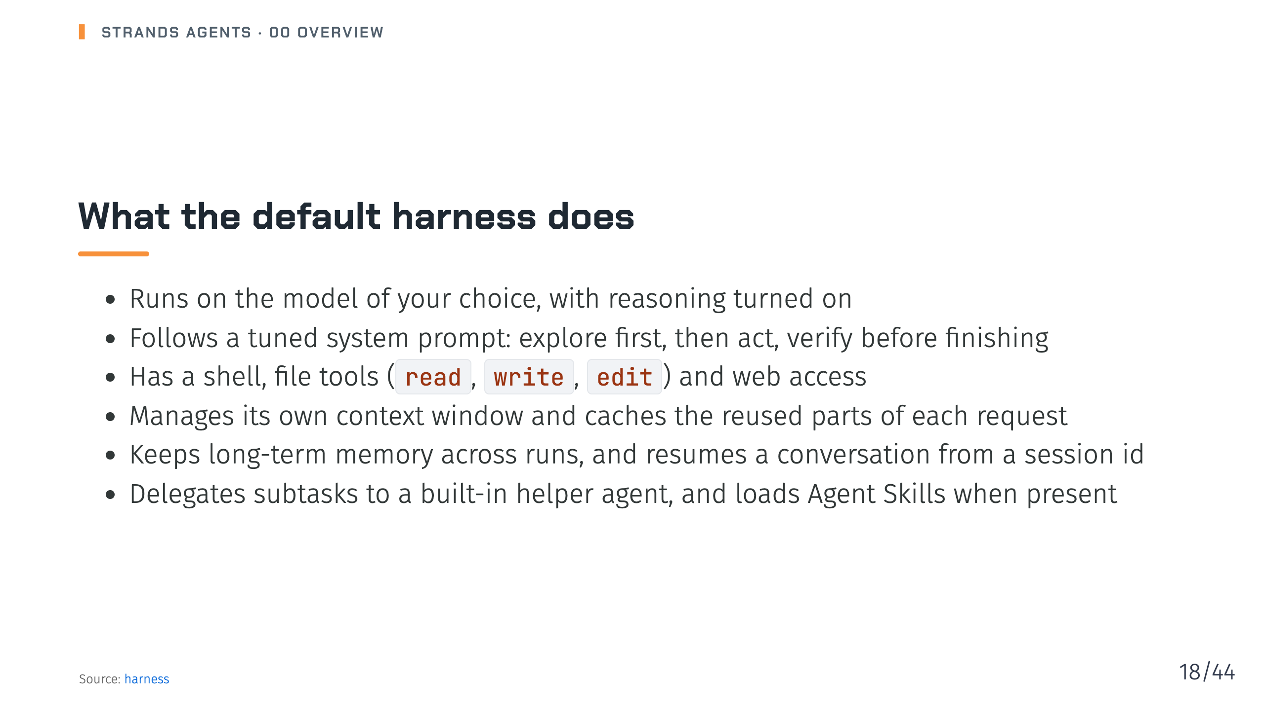
Notes:
Notes: Every one of these defaults can be narrowed, swapped or turned off. The harness also tracks multi-step work with a checklist and lets the model orchestrate its own tools in code. Deck 12 goes through each of them. Source: pages/docs/user-guide/harness/index.md

Slide 19
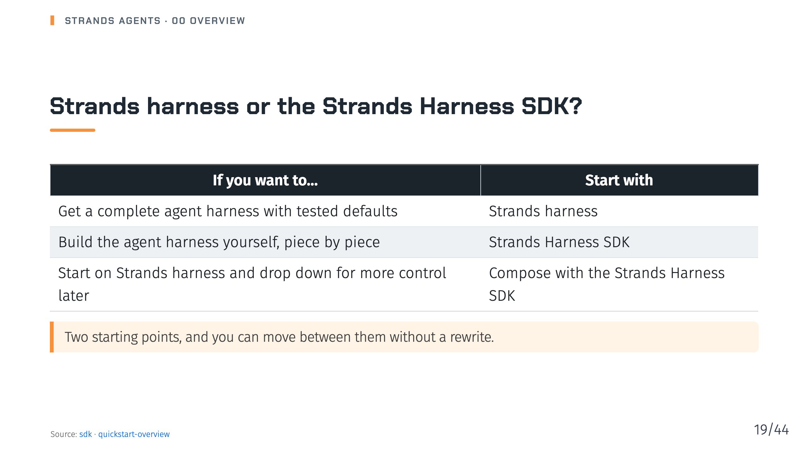
Notes:
Notes: Strands harness is built on the Strands Harness SDK, so starting on one does not lock you out of the other. The SDK is the layer this series spends most of its time on, decks 01 to 11. Source: pages/docs/user-guide/sdk/index.md, pages/docs/user-guide/sdk/quickstart/overview/index.md

Slide 20
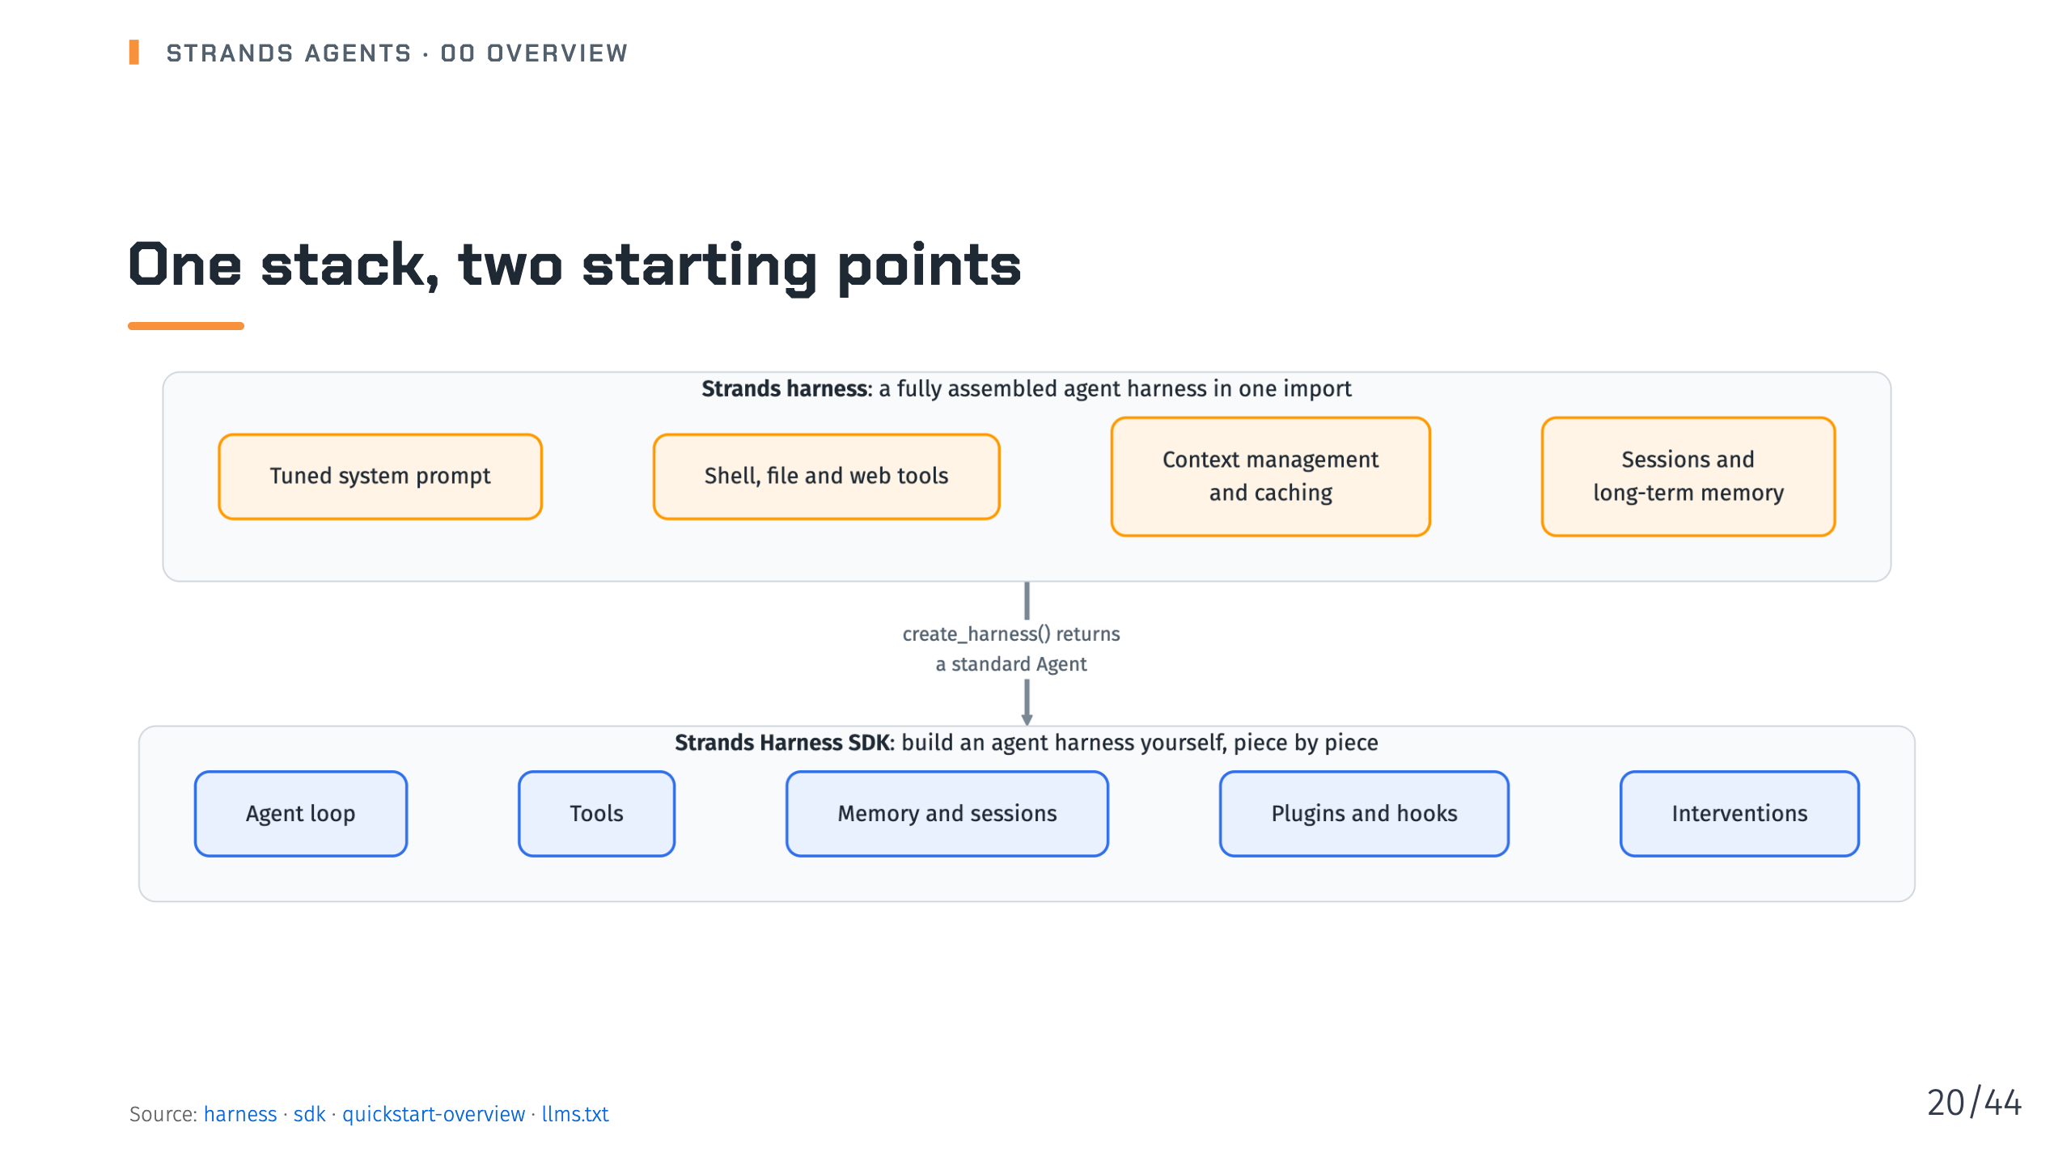
Notes:
Notes: The docs map calls the harness a thin composition layer over the Strands Harness SDK. What create_harness returns is a plain Agent, so the whole Harness SDK stays reachable, and every default is overridable. Source: pages/docs/user-guide/harness/index.md, pages/docs/user-guide/sdk/index.md, pages/docs/user-guide/sdk/quickstart/overview/index.md, llms.txt

Slide 21
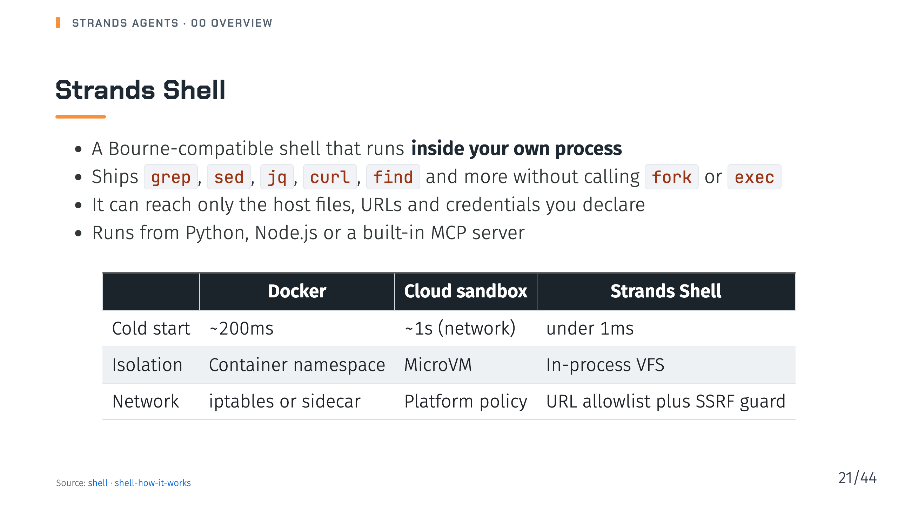
Notes:
Notes: The docs call this a different tradeoff, not a strictly better one: a container isolates at the kernel, Strands Shell isolates at the process. Deck 12 covers the Kernel boundary and the security model. Source: pages/docs/user-guide/shell/index.md, pages/docs/user-guide/shell/how-it-works/index.md

Slide 22
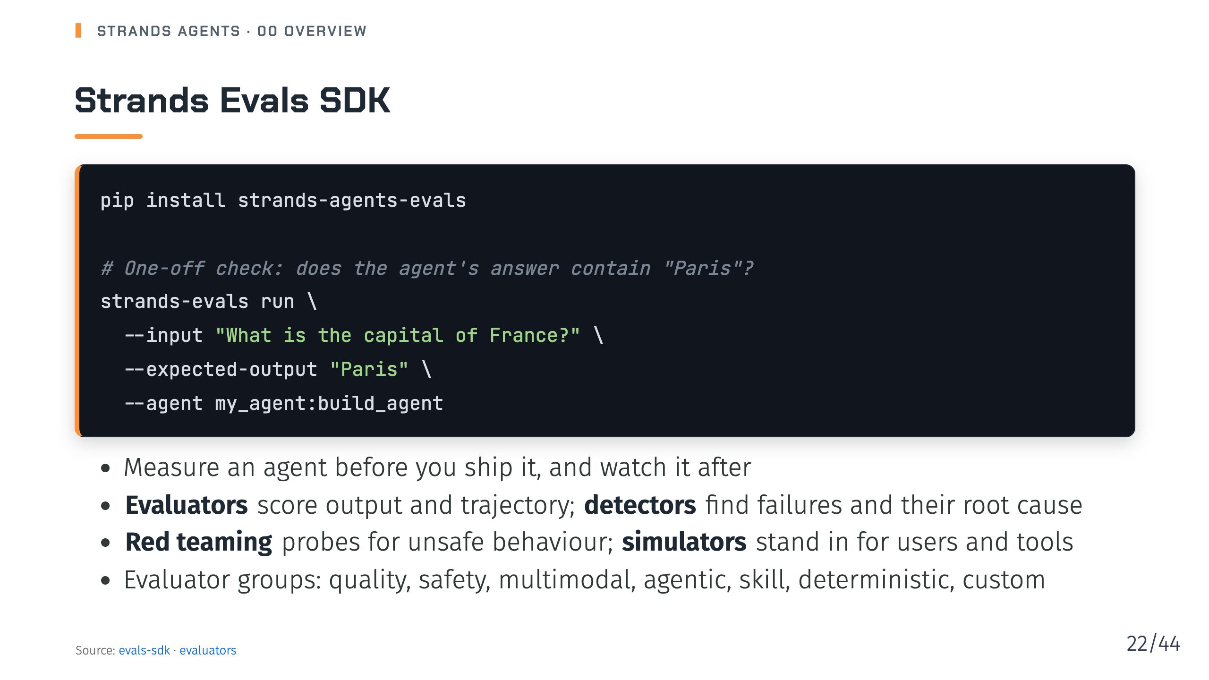
Notes:
Notes: The same evaluation is available as a Python API with eval_task, Case, Experiment and an evaluator. Model-driven agents make dynamic decisions, so evaluation matters more, not less. Deck 14 covers it. Source: pages/docs/user-guide/evals-sdk/index.md, pages/docs/user-guide/evals-sdk/evaluators/index.md

Slide 23

Notes:
_transition: cover
Notes: Section break: one slide per build topic, each one a later deck.

Slide 24
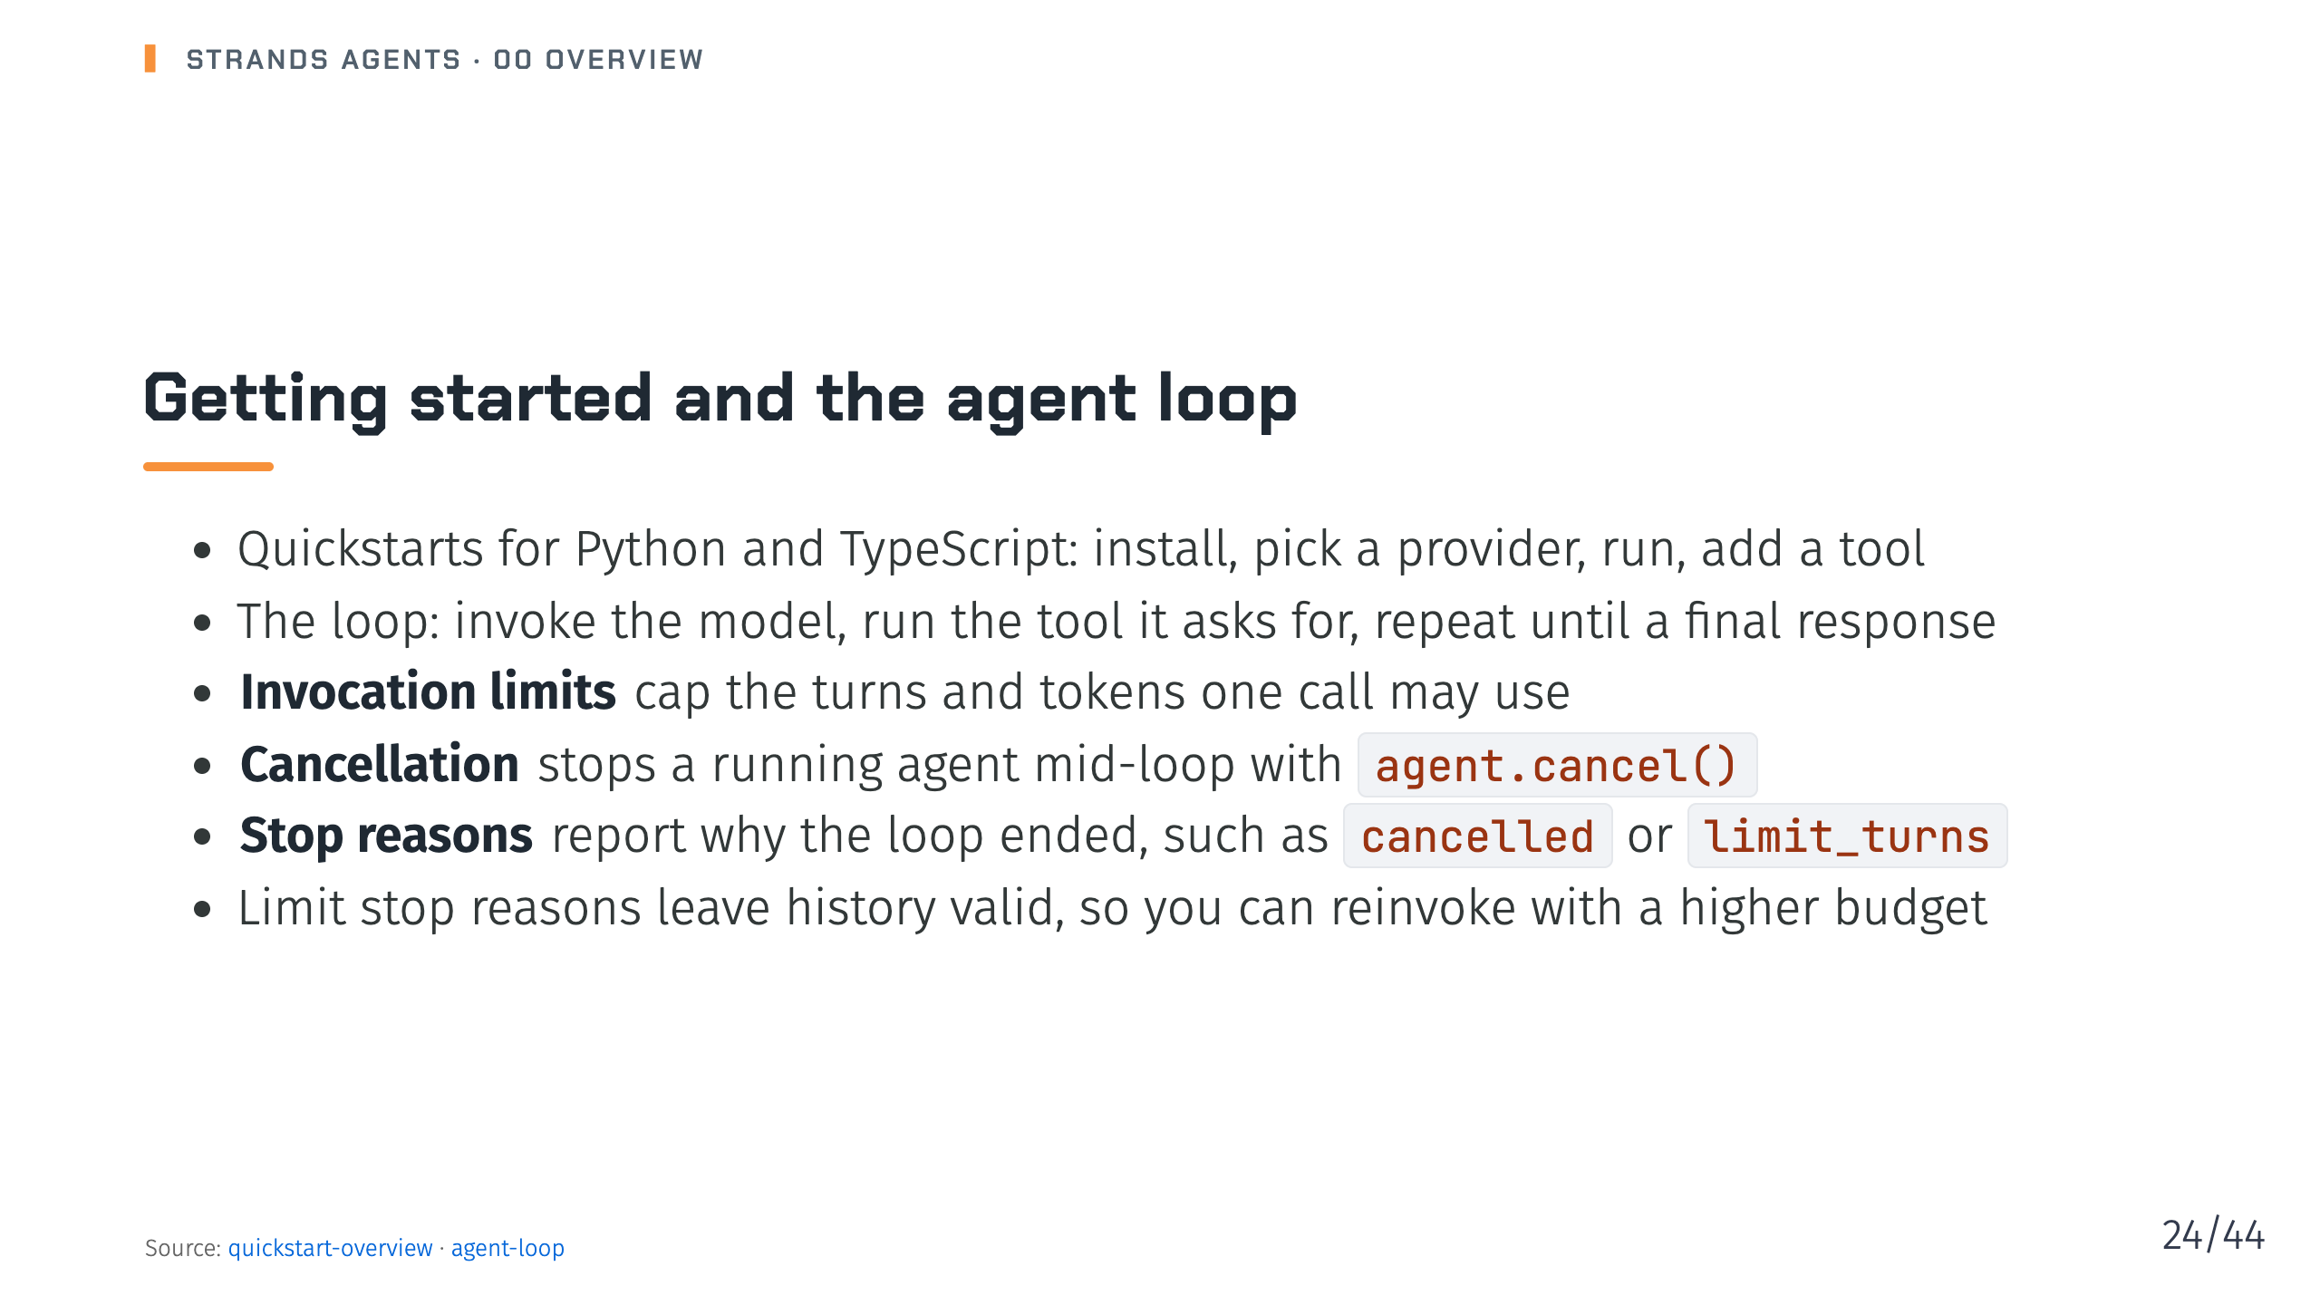
Notes:
Notes: Decks 01 and 02. The agent-loop page also covers concurrent invocations, hooks and retry strategies. The quickstart overview says the guides get you running a simple agent in less than 20 minutes. Source: pages/docs/user-guide/sdk/quickstart/overview/index.md, pages/docs/user-guide/sdk/agents/agent-loop/index.md

Slide 25
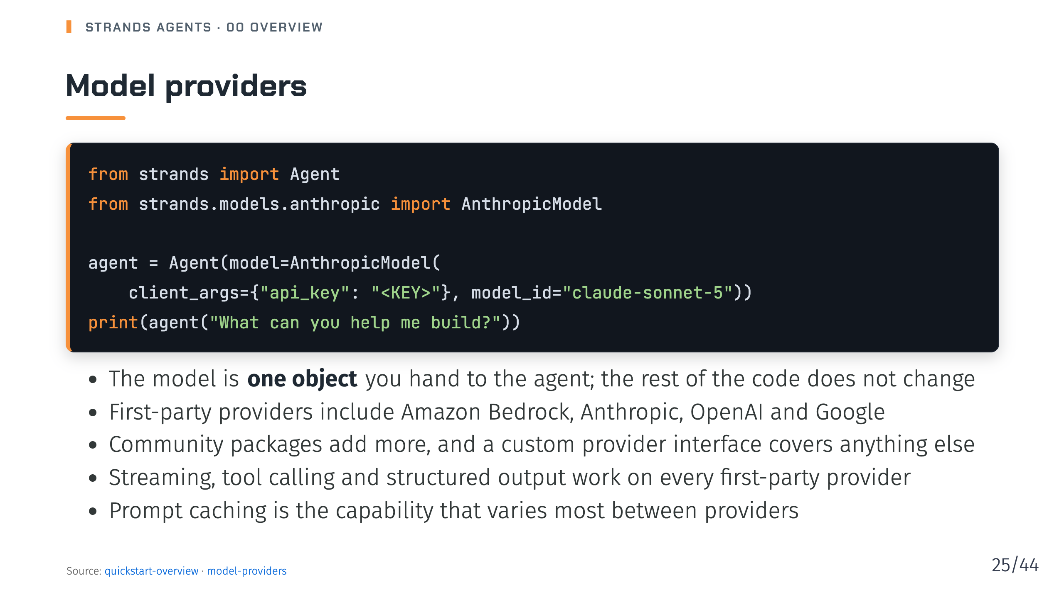
Notes:
Notes: Deck 03. The provider table also lists Ollama, LiteLLM, Mistral, Llama API, llama.cpp, SageMaker, Vercel and Writer. Source: pages/docs/user-guide/sdk/quickstart/overview/index.md, pages/docs/user-guide/sdk/model-providers/index.md

Slide 26
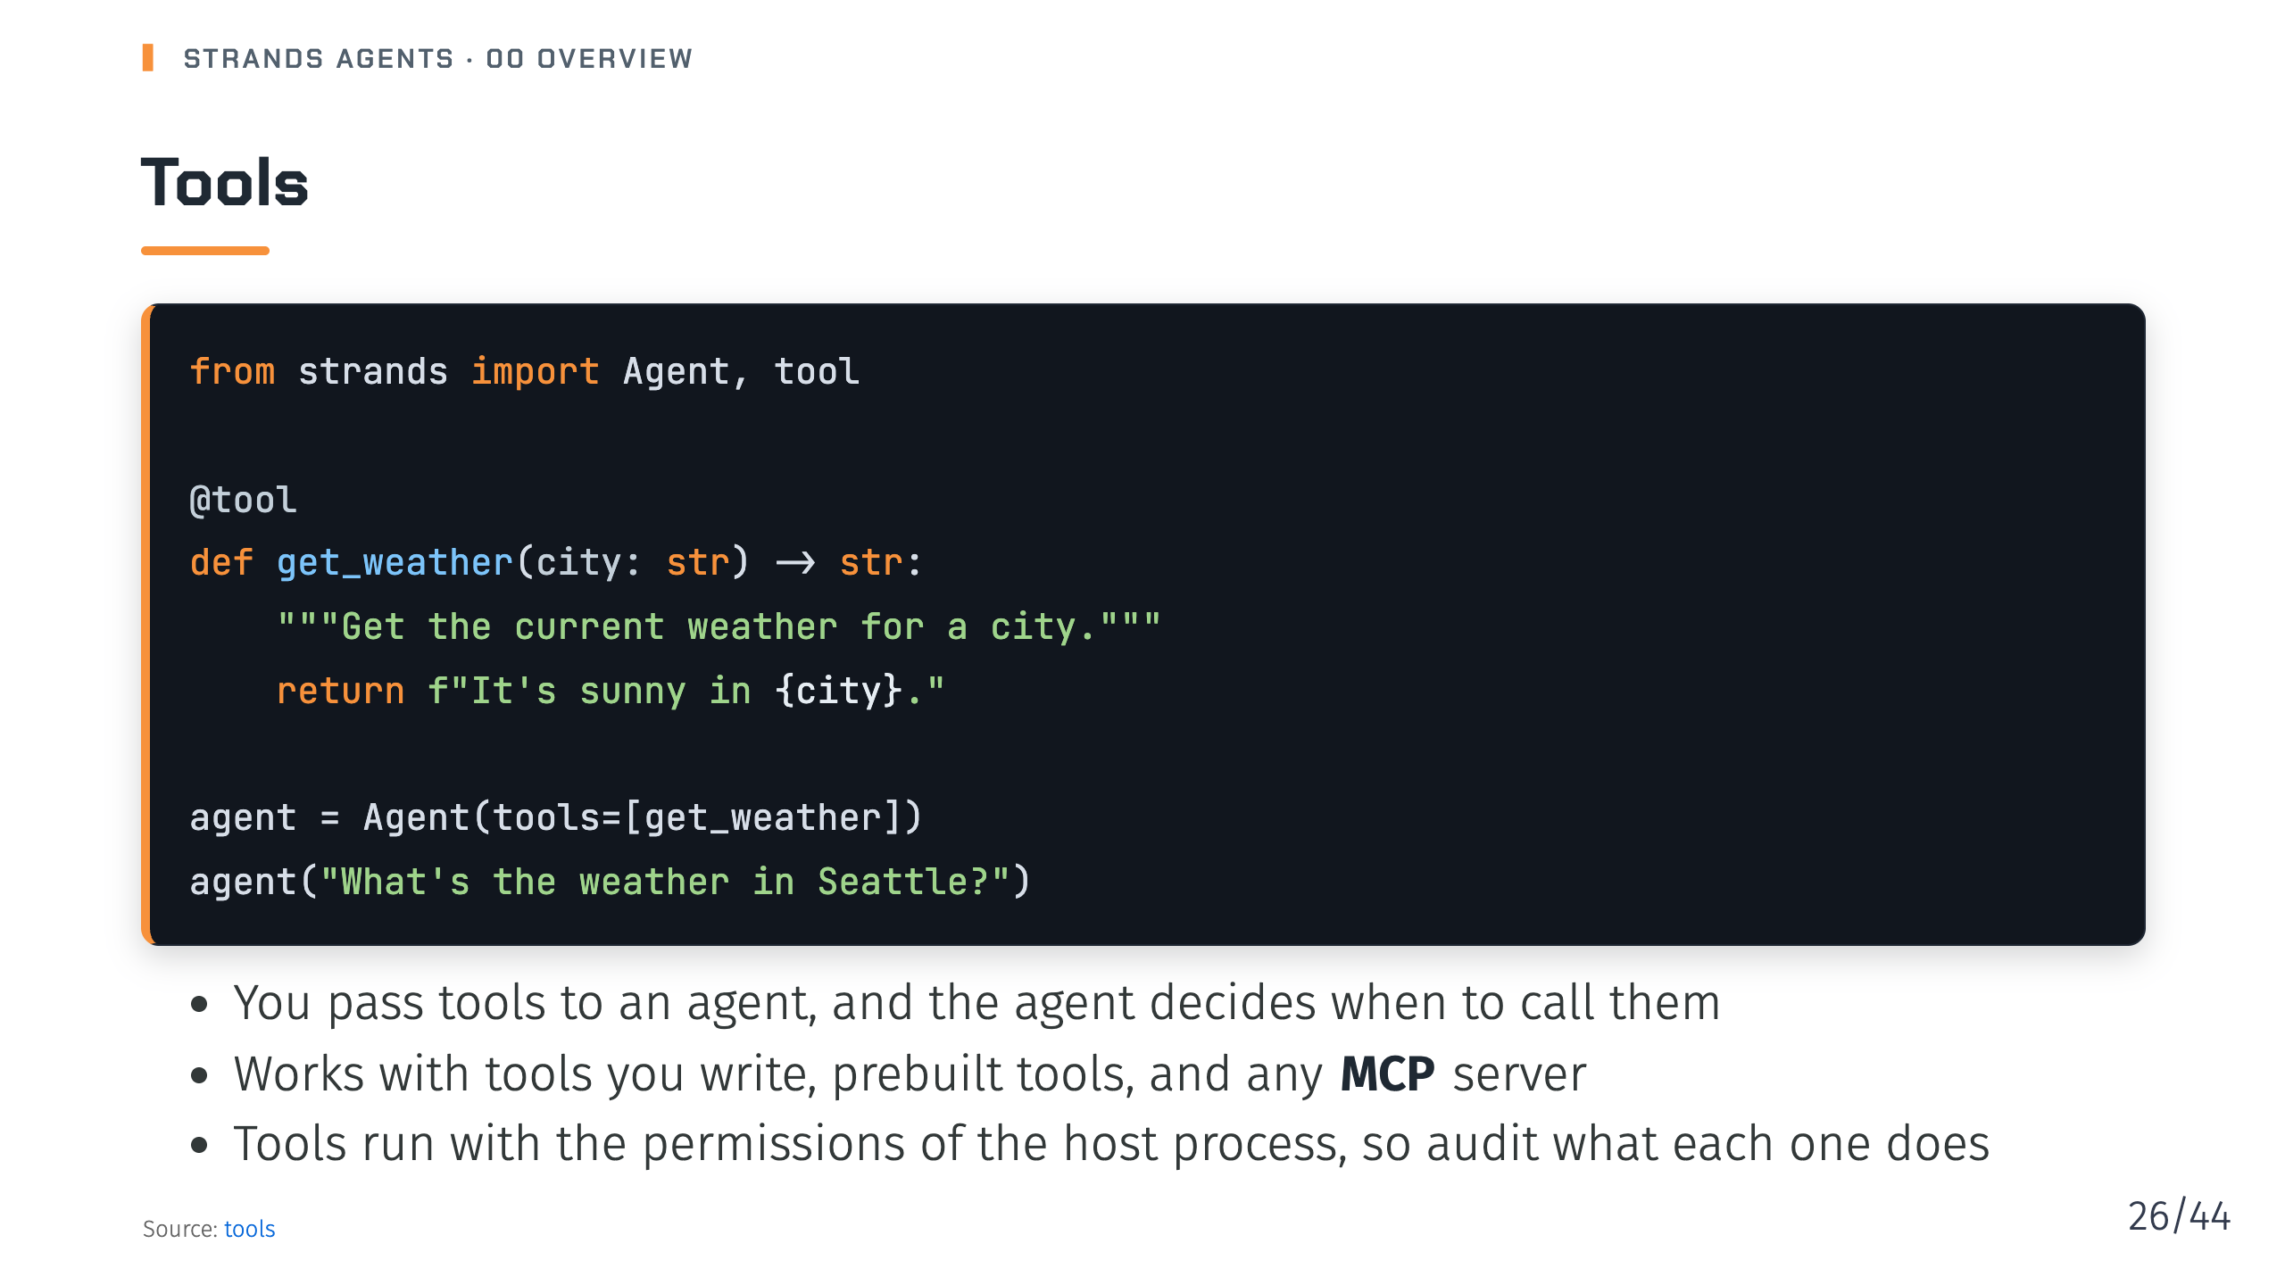
Notes:
Notes: Deck 04. The tools section also covers vended tools for files, HTTP, notebooks and shell, and tool executors that control whether multiple tool calls run concurrently or in sequence. Source: pages/docs/user-guide/sdk/tools/index.md

Slide 27
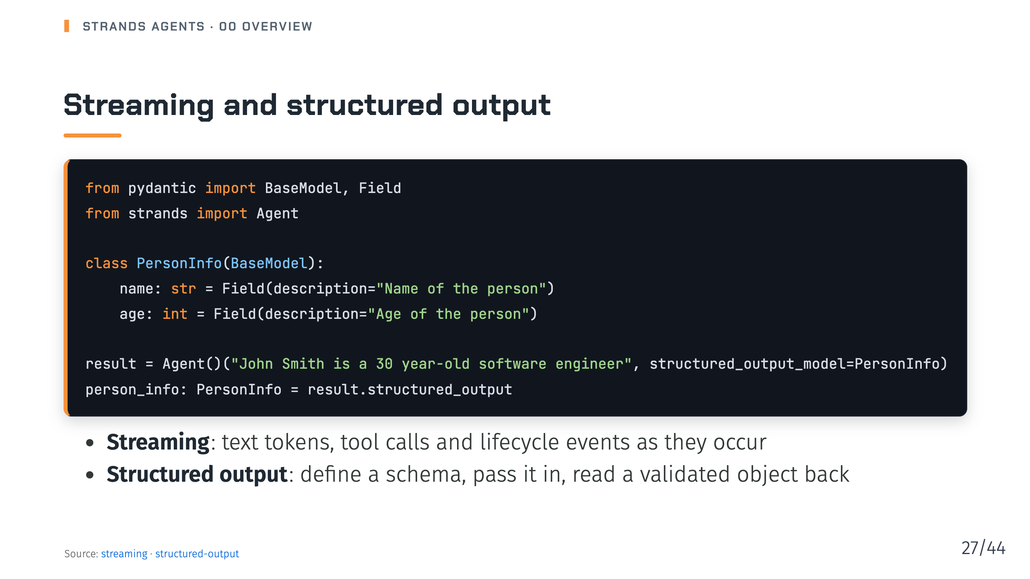
Notes:
Notes: Deck 05. The code is trimmed from the structured output page, which also has an occupation field. Streaming emits the same events whether you consume them with async iterators or with callback handlers in synchronous Python. Source: pages/docs/user-guide/sdk/streaming/index.md, pages/docs/user-guide/sdk/agents/structured-output/index.md

Slide 28
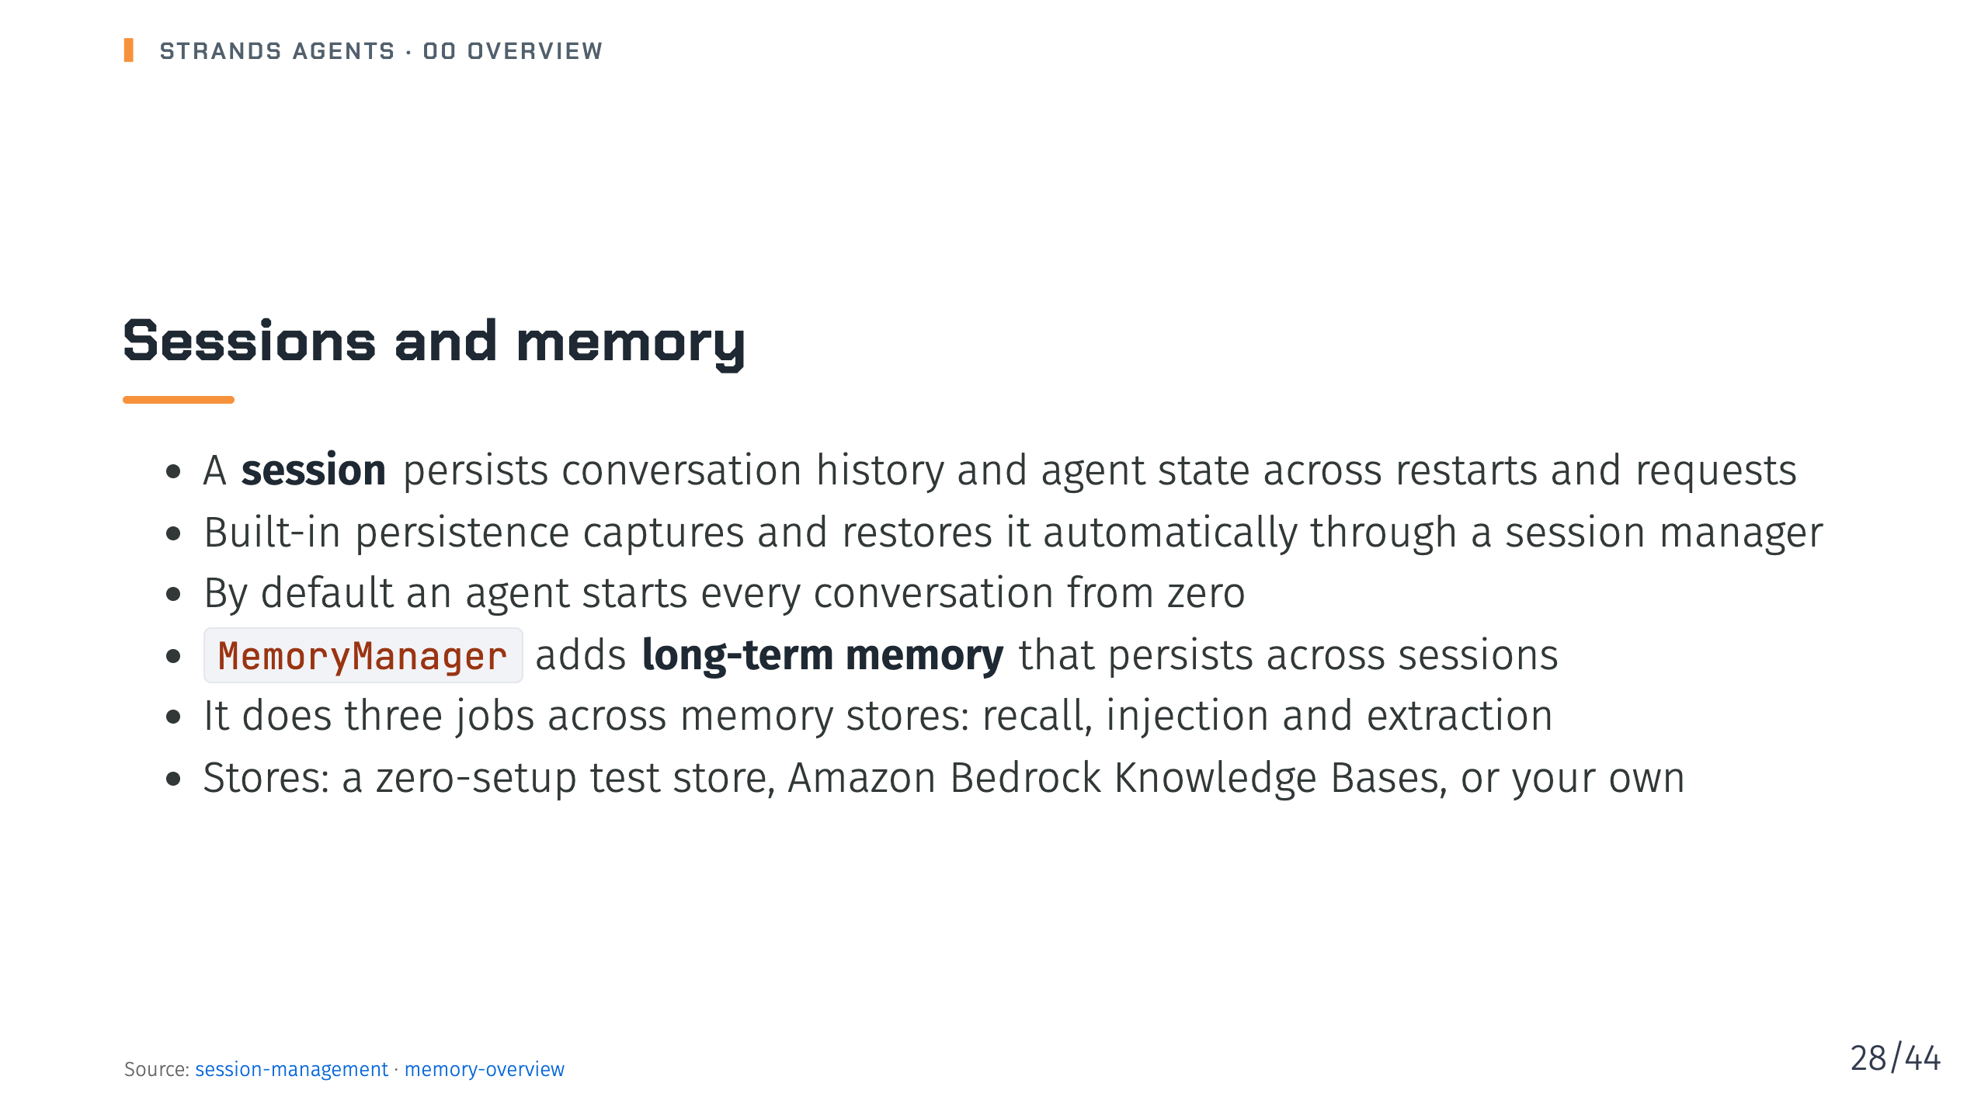
Notes:
Notes: Deck 06. Recall and injection are enabled by default when you attach a store; writing memories is opt-in. Sessions also cover multi-agent systems: orchestrator state, node transitions and shared context. Source: pages/docs/user-guide/sdk/agents/session-management/index.md, pages/docs/user-guide/sdk/memory/overview/index.md

Slide 29
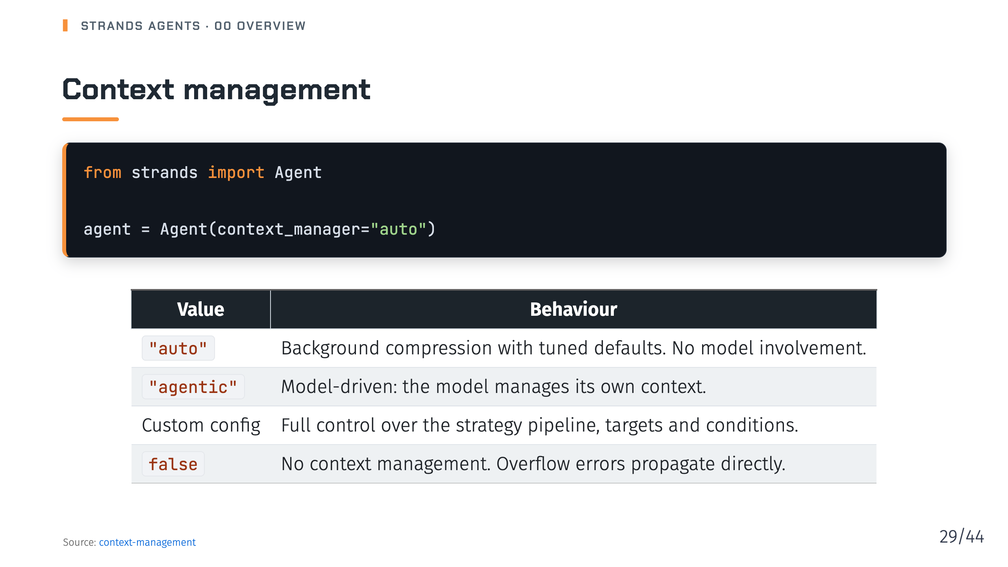
Notes:
Notes: Deck 07. Strategies run as an ordered pipeline with an emergency truncation step appended last. The docs describe the ContextManager strategy API as experimental, and conversation managers and the ContextOffloader keep working alongside it. Source: pages/docs/user-guide/sdk/context-management/index.md

Slide 30
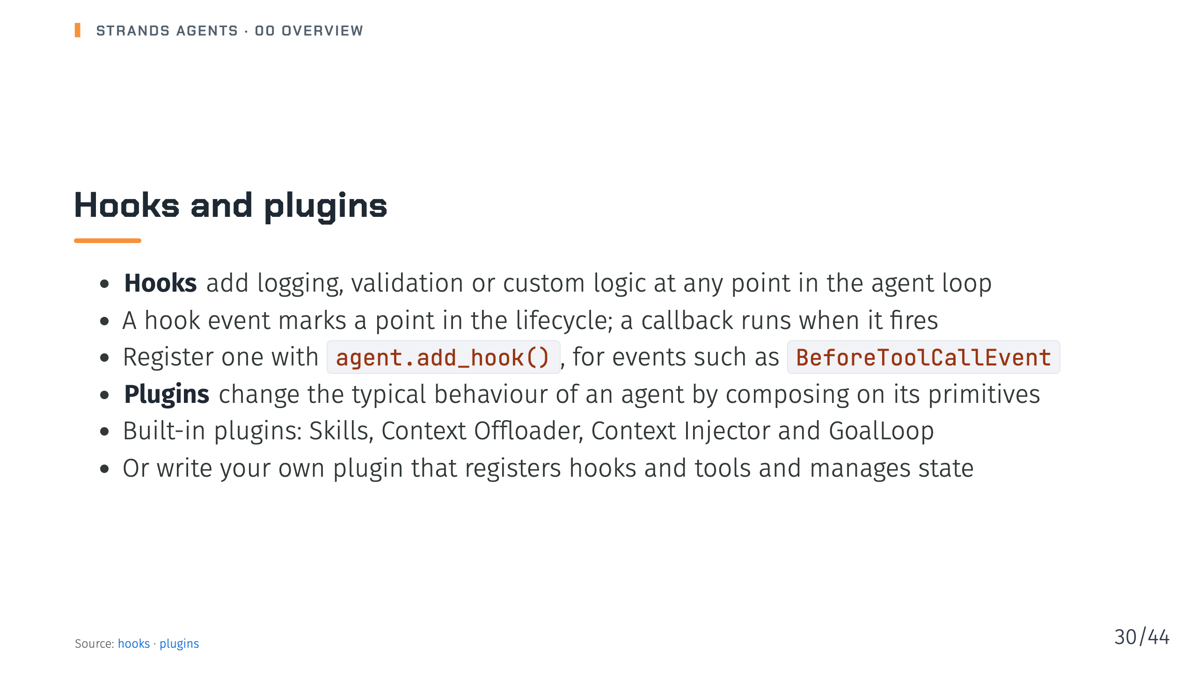
Notes:
Notes: Deck 08. Hooks are composable and type-safe, and every event type accepts multiple subscribers. Skills follow the AgentSkills specification. Source: pages/docs/user-guide/sdk/agents/hooks/index.md, pages/docs/user-guide/sdk/plugins/index.md

Slide 31
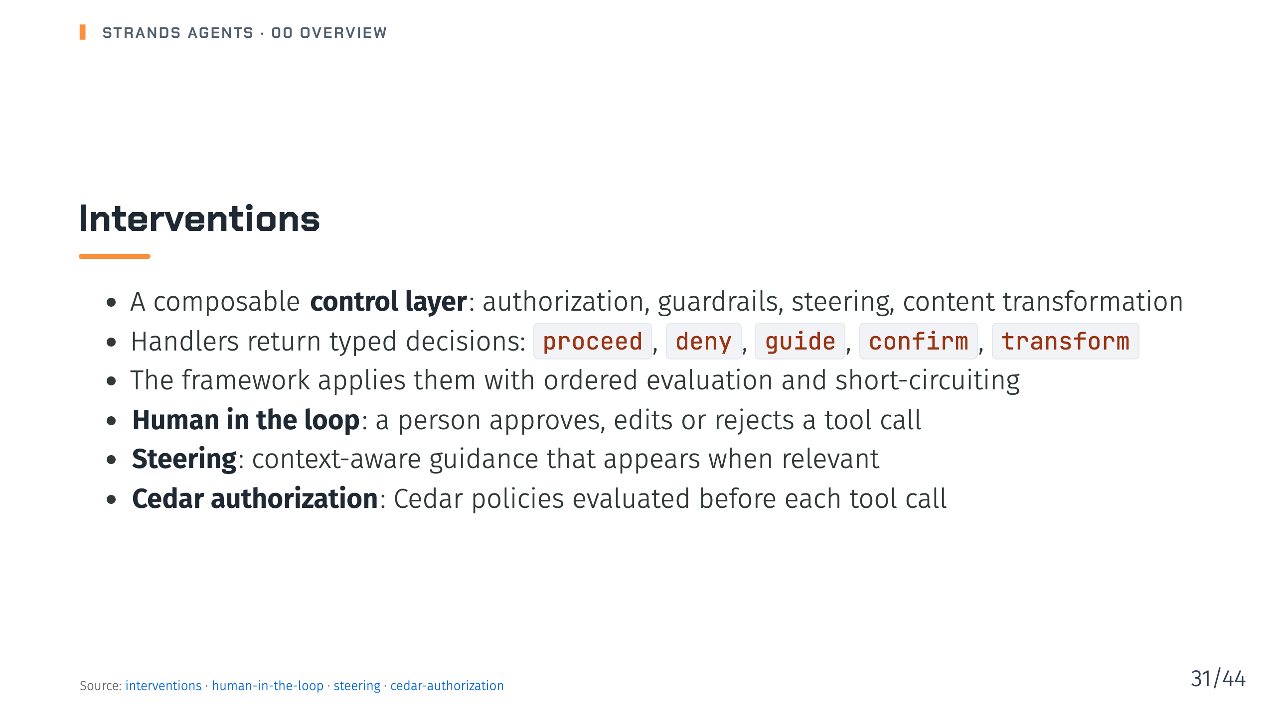
Notes:
Notes: Deck 09. Unlike raw hooks and plugins, which mutate event objects directly, intervention handlers return decisions. With Cedar, if no permit statement matches, the tool call is denied and the agent gets feedback explaining why. Source: pages/docs/user-guide/sdk/agents/interventions/index.md, pages/docs/user-guide/sdk/agents/interventions/human-in-the-loop/index.md, pages/docs/user-guide/sdk/agents/interventions/steering/index.md, pages/docs/user-guide/sdk/agents/interventions/cedar-authorization/index.md

Slide 32
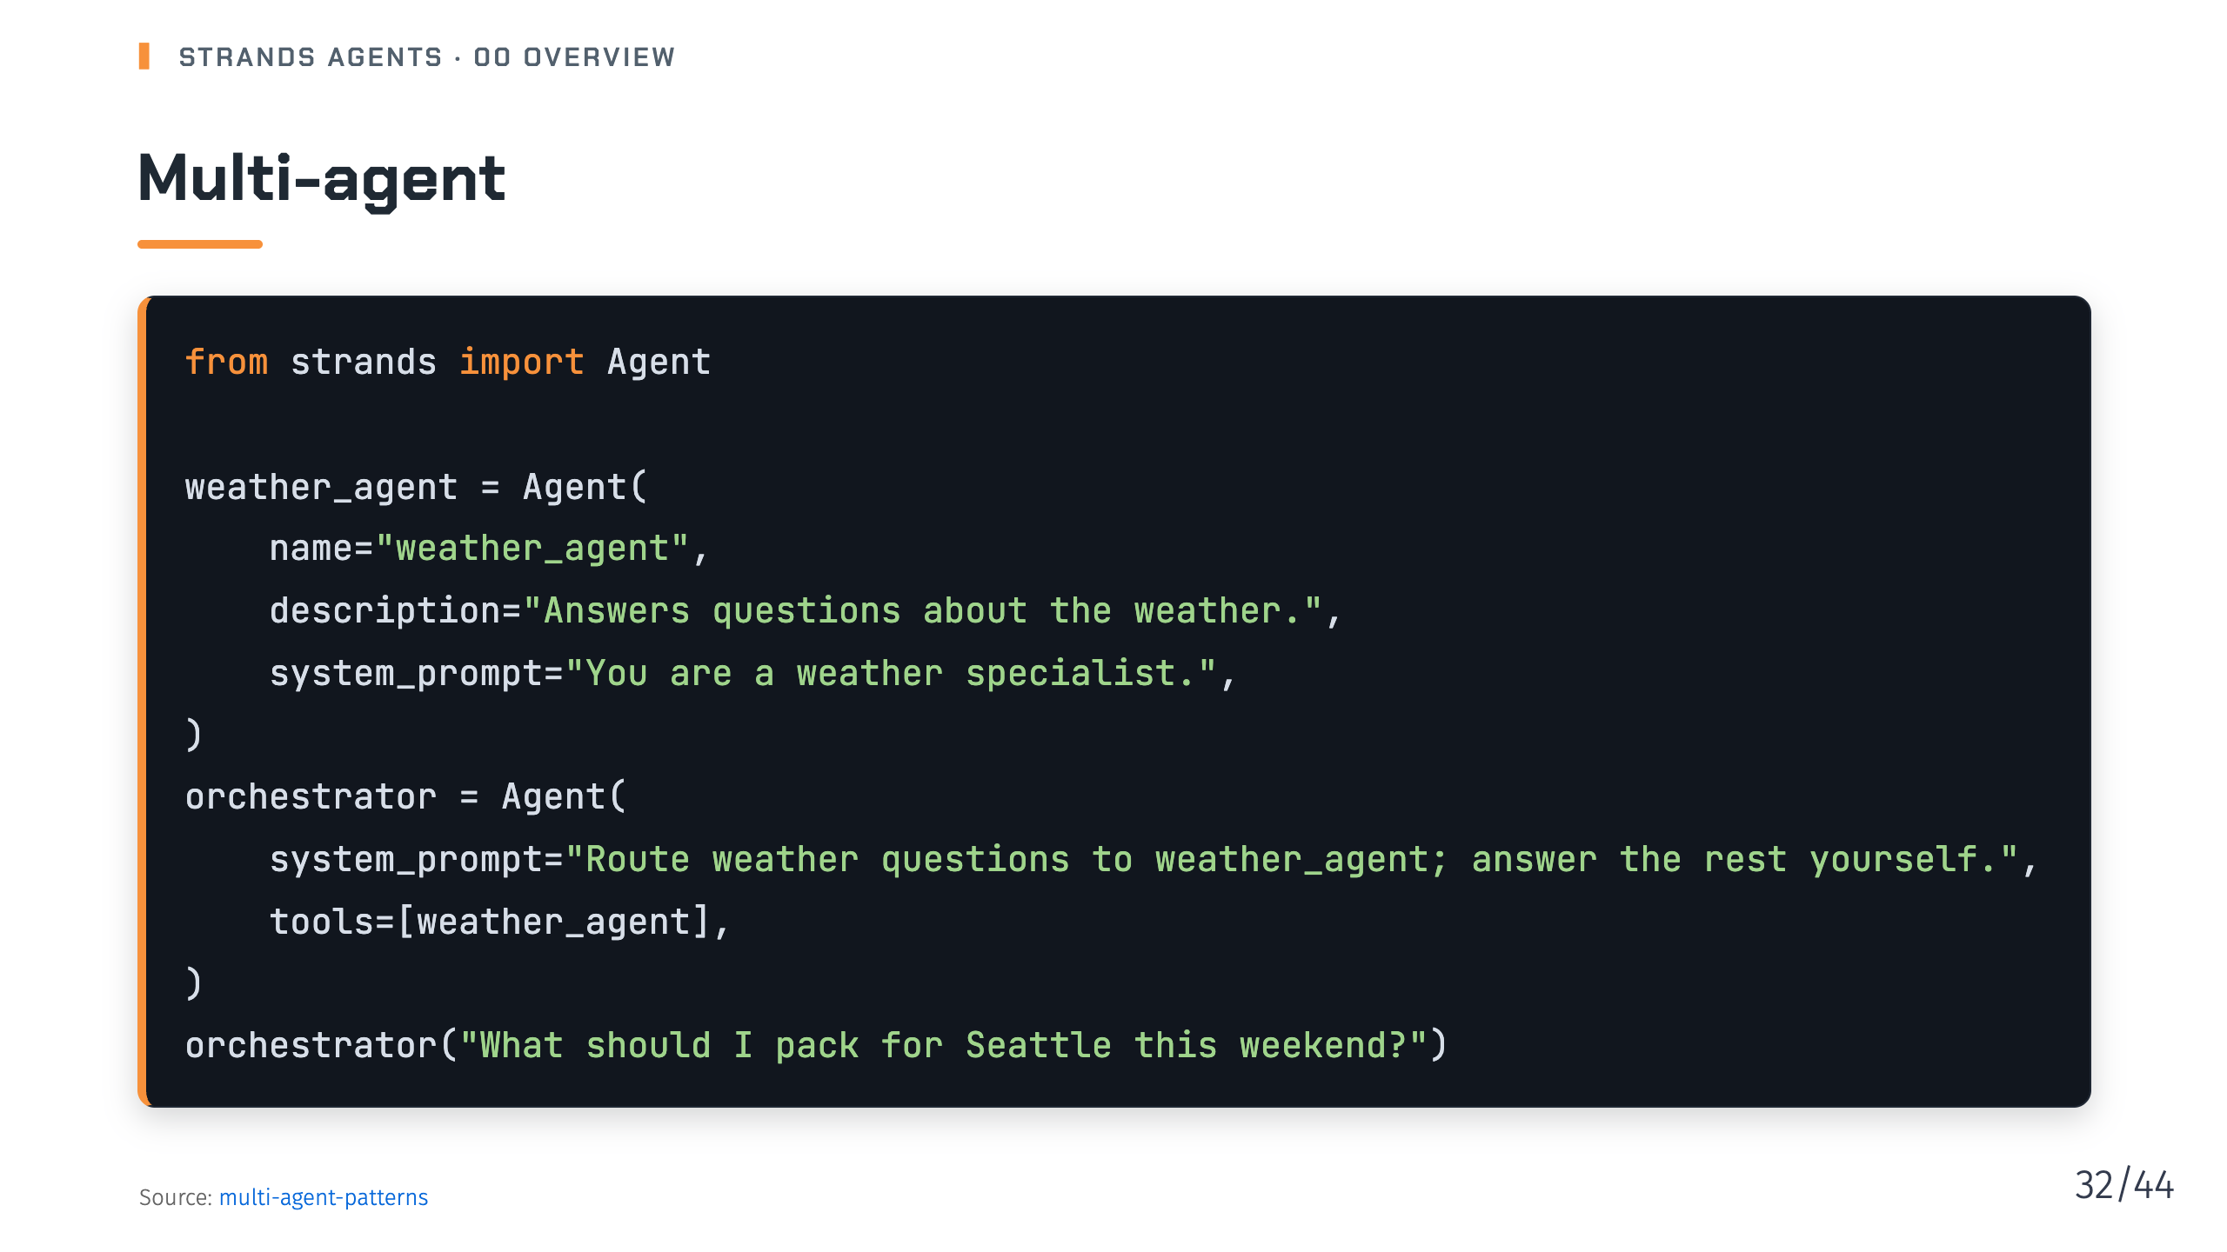
Notes:
Notes: Deck 10. The simplest way to compose agents is to pass one agent to another as a tool. The orchestrator reads each specialist's description and calls it when the query fits, exactly as it would call any other tool. Source: pages/docs/user-guide/sdk/multi-agent/multi-agent-patterns/index.md

Slide 33
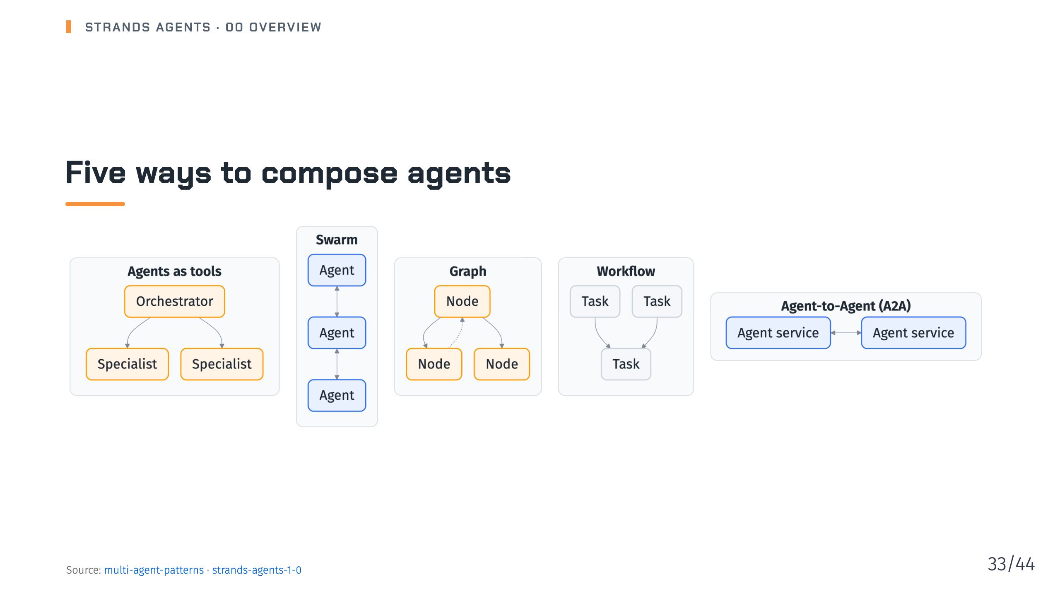
Notes:
Notes: Agents as tools: an orchestrator delegates to specialists. Swarm: a pool of agents that hand off to one another. Graph: a flowchart of agents with branching and loops. Workflow: a fixed task graph run as a single tool, with independent tasks in parallel. A2A: agents running as separate services. The 1.0 post says the patterns nest and combine. Source: pages/docs/user-guide/sdk/multi-agent/multi-agent-patterns/index.md, pages/blog/strands-agents-1-0/index.md

Slide 34
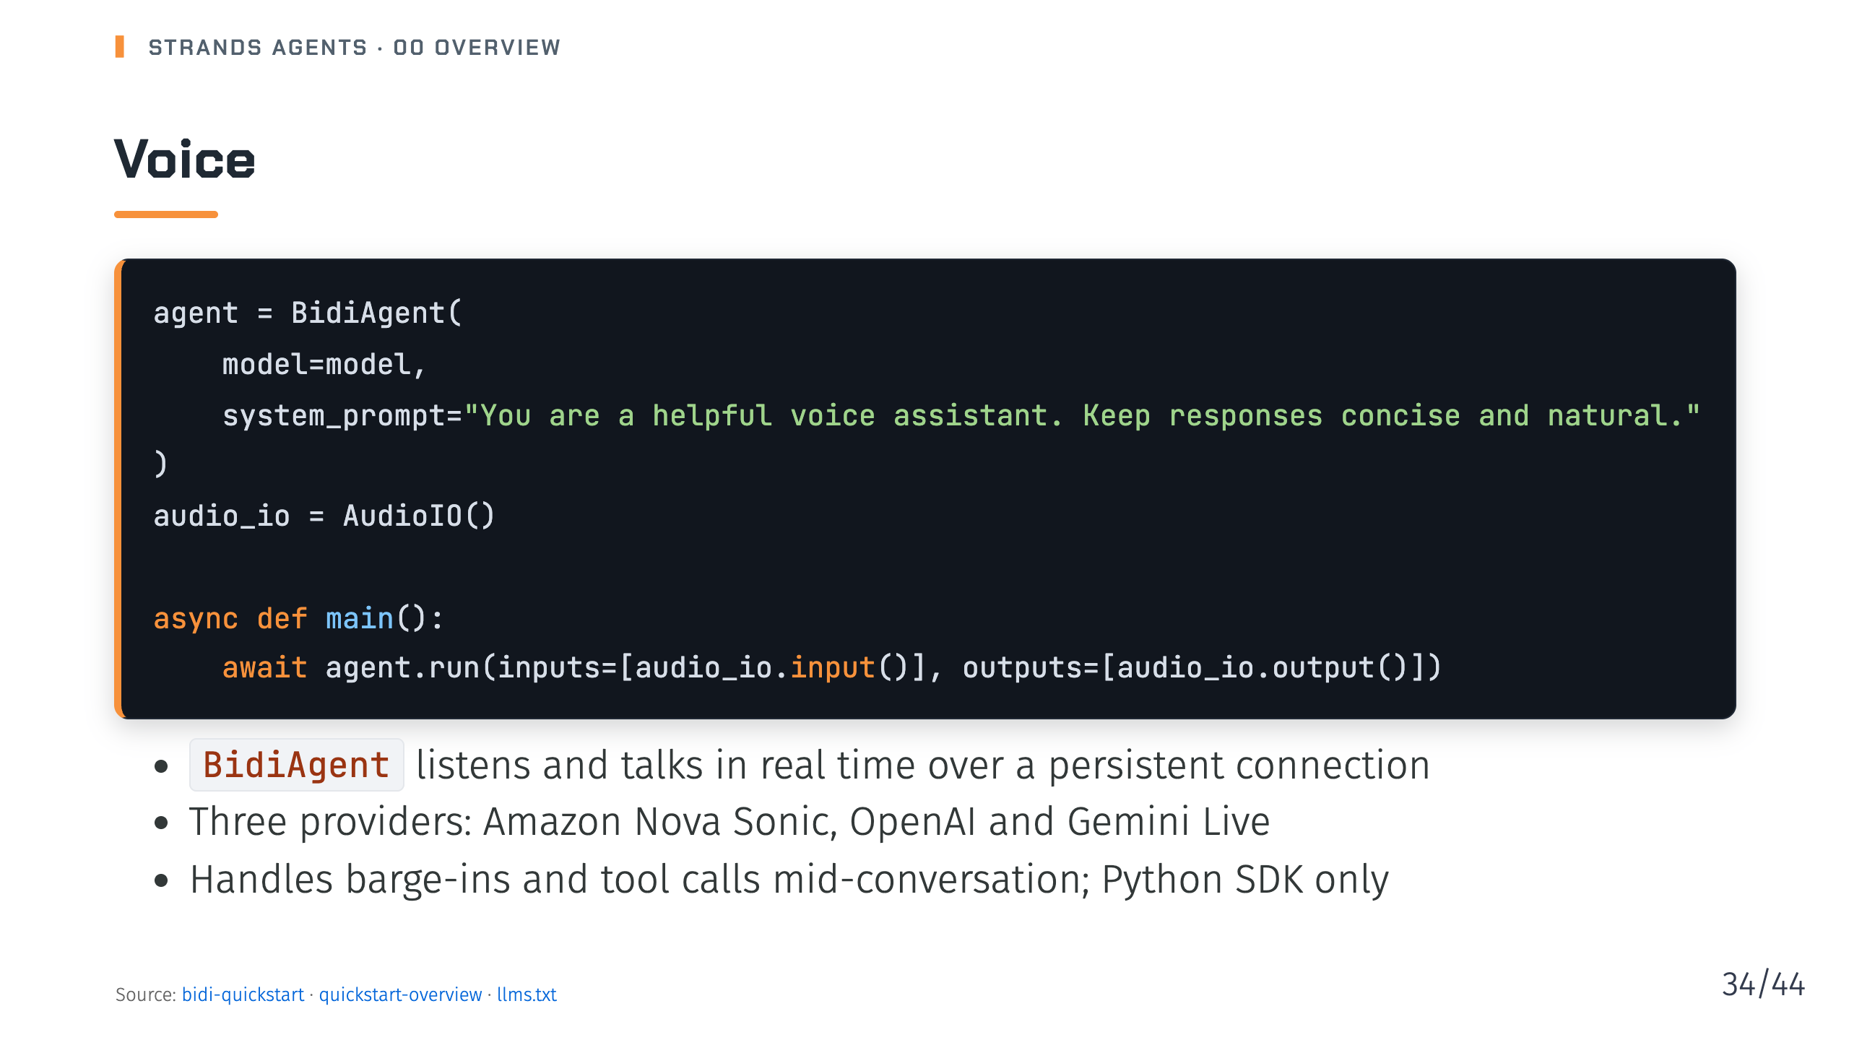
Notes:
Notes: Deck 11. Install with pip install "strands-agents[bidi-all]"; AudioIO for a local microphone and speakers also needs PortAudio and the bidi-pyaudio extra. The quickstart needs Python 3.10 or later, and 3.12 or later for Nova Sonic. The docs map says session management and interrupt support for BidiAgent are still in development. Source: pages/docs/user-guide/sdk/bidi/quickstart/index.md, pages/docs/user-guide/sdk/quickstart/overview/index.md, llms.txt

Slide 35
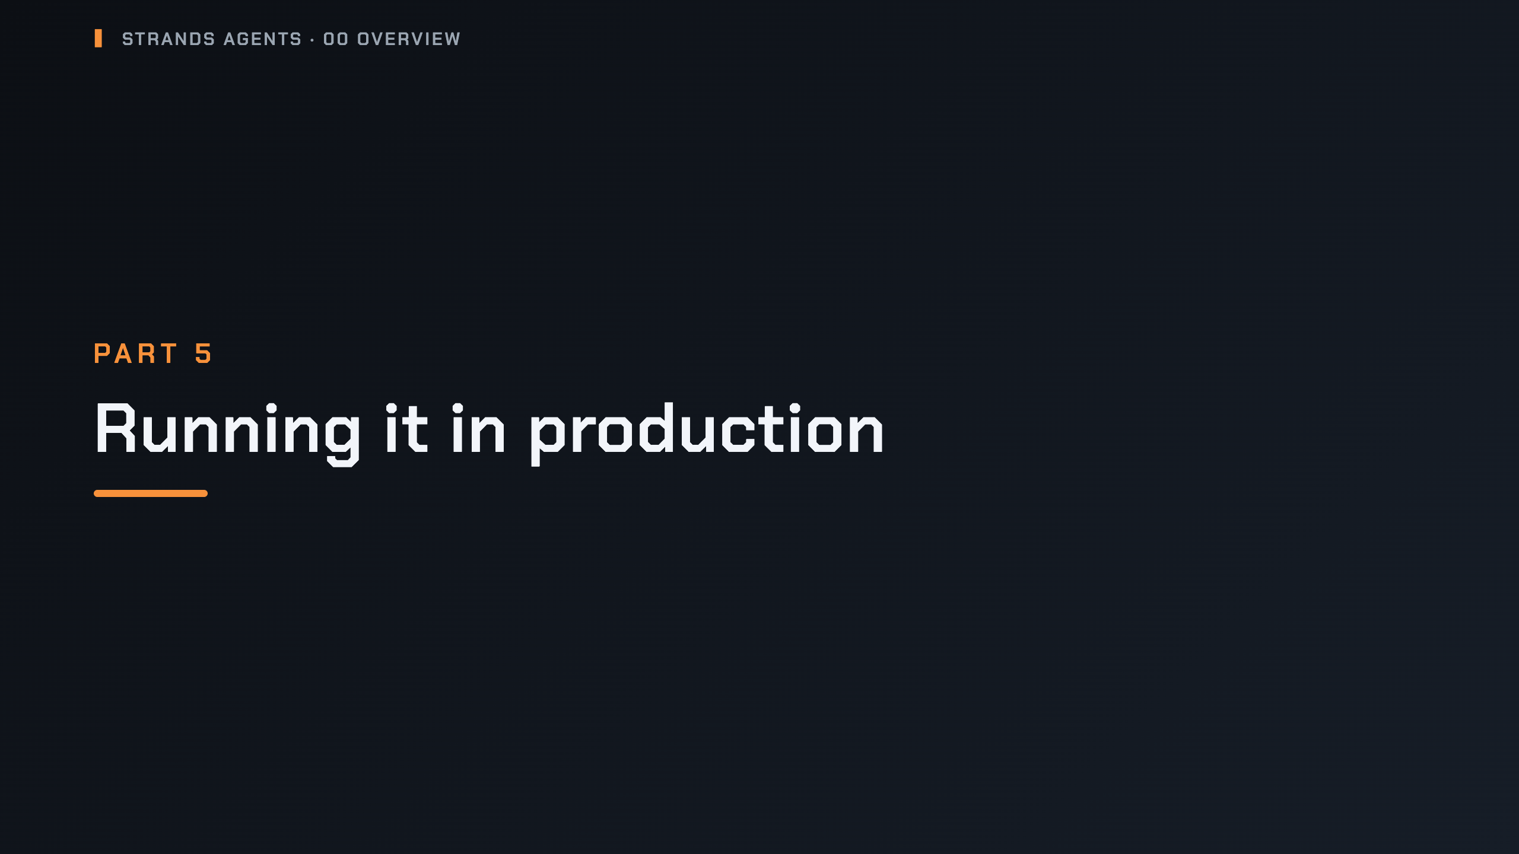
Notes:
_transition: cover
Notes: Section break: observe, secure, deploy, and what is supported where.

Slide 36
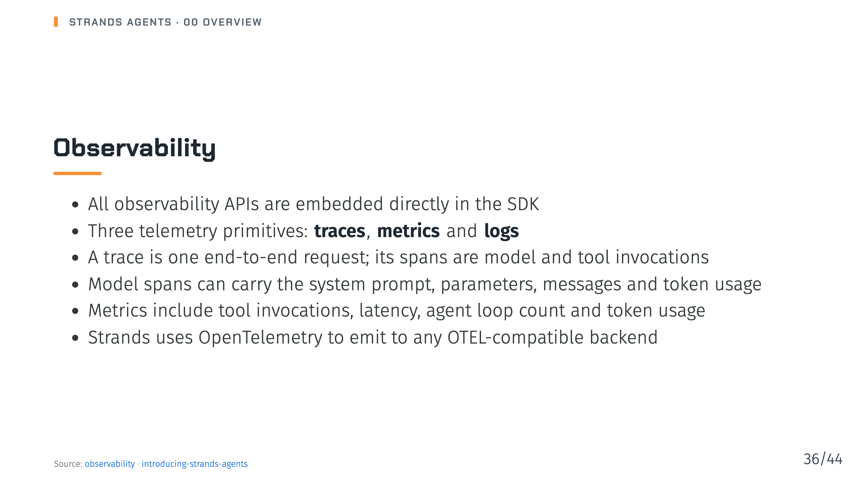
Notes:
Notes: Deck 13. Traces show how the agent arrived at its answer, which feeds back into prompt, tool and context management improvements. Source: pages/docs/user-guide/sdk/observability-evaluation/observability/index.md, pages/blog/introducing-strands-agents/index.md

Slide 37
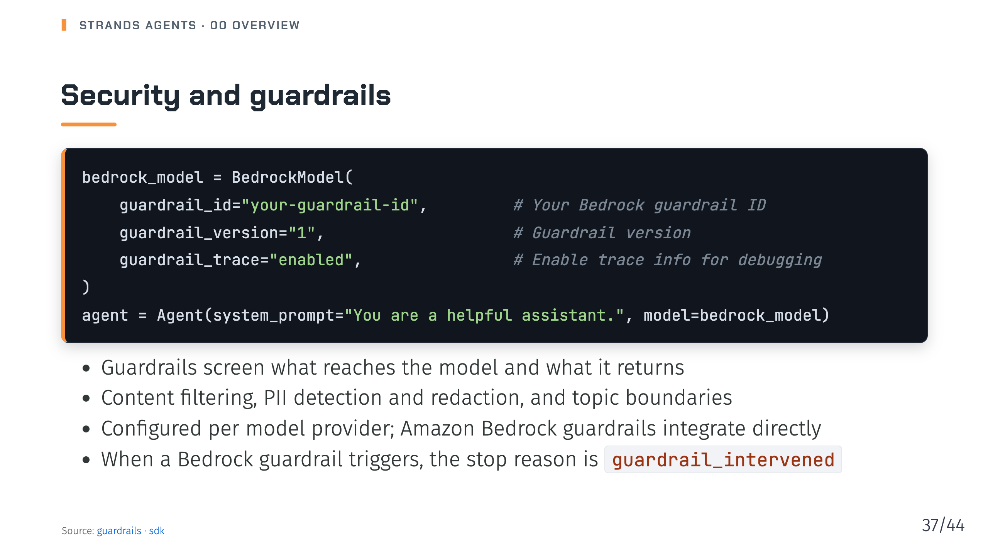
Notes:
Notes: Deck 15. The SDK overview lists guardrails, PII redaction and trusted message history under securing for production. The guardrails page also shows how to run them in shadow mode before you enforce. Source: pages/docs/user-guide/sdk/safety-security/guardrails/index.md, pages/docs/user-guide/sdk/index.md

Slide 38
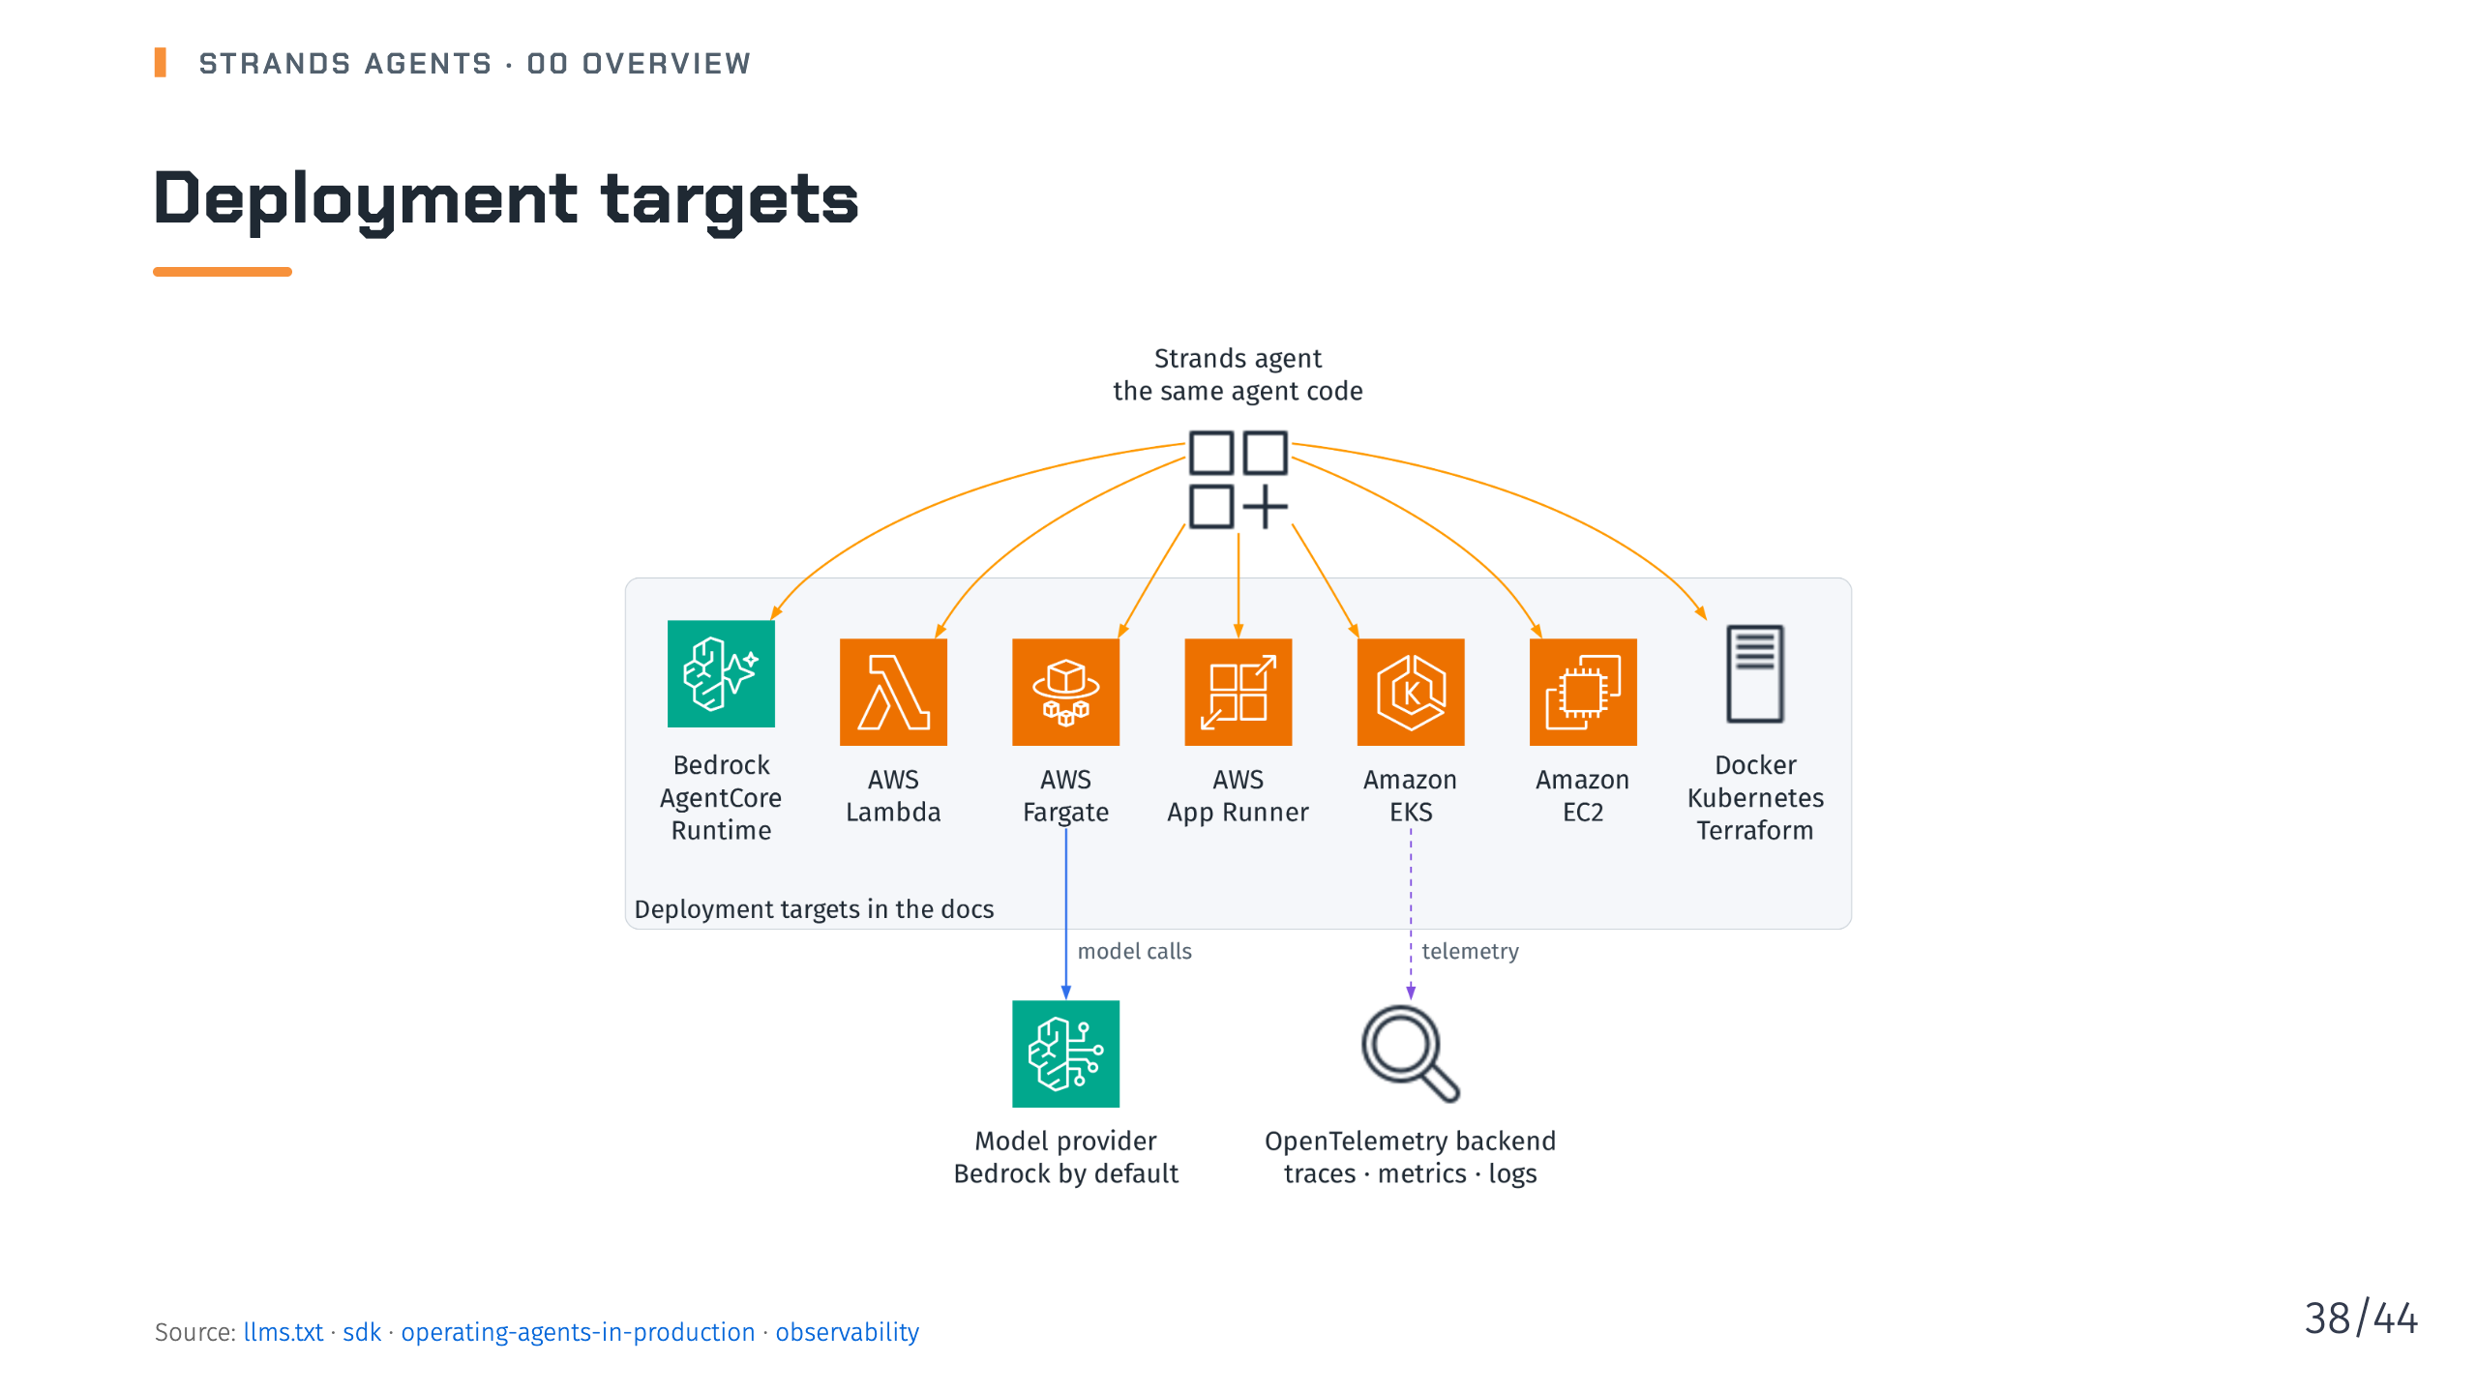
Notes:
Notes: Deck 16. The docs have one guide per target. The operating-in-production page adds the checklist: configure the model explicitly, pass an explicit tool list, and keep automatic tool loading disabled, which is the default. Source: llms.txt, pages/docs/user-guide/sdk/index.md, pages/docs/user-guide/sdk/deploy/operating-agents-in-production/index.md, pages/docs/user-guide/sdk/observability-evaluation/observability/index.md

Slide 39
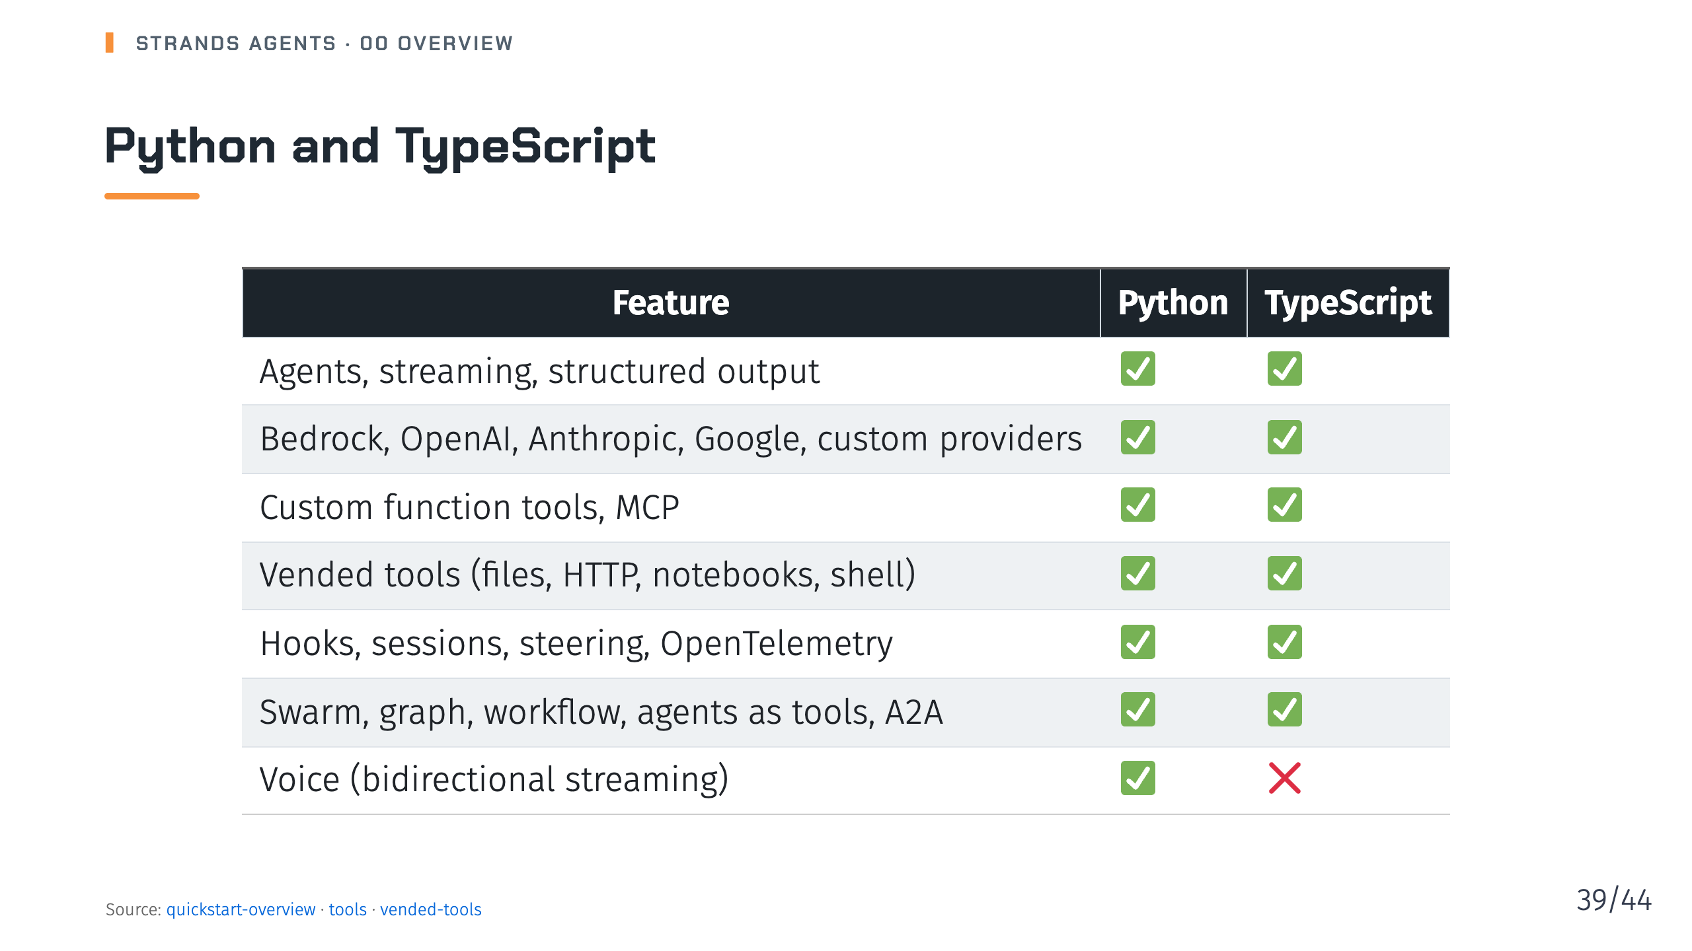
Notes:
Notes: This condenses the feature availability table on the quickstart overview page. The series shows Python first and TypeScript where the two differ. The vended tools row comes from the vended tools page, which lists the file editor, HTTP request, notebook and bash tools for both languages. Source: pages/docs/user-guide/sdk/quickstart/overview/index.md, pages/docs/user-guide/sdk/tools/index.md, pages/docs/user-guide/sdk/tools/vended-tools/index.md

Slide 40
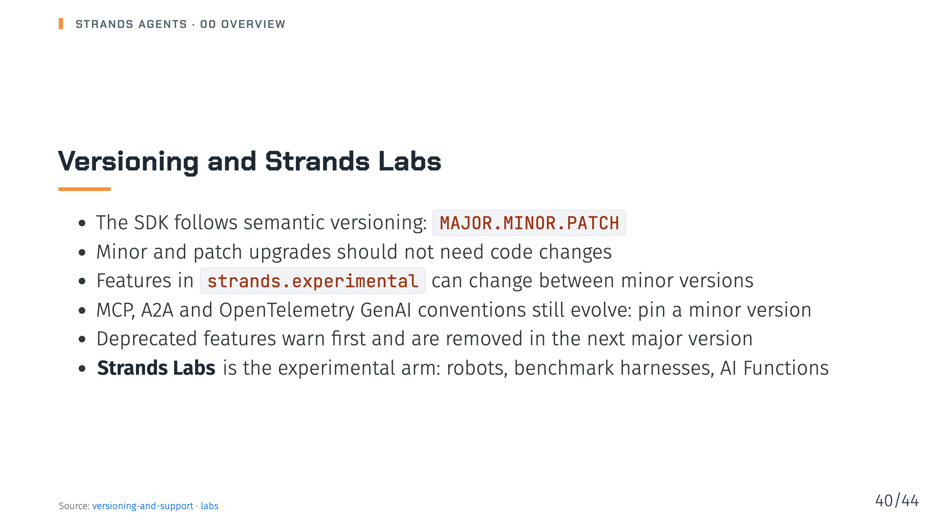
Notes:
Notes: Labs projects move faster than the core SDK. Some graduate into it or become standalone products, and others stay experimental. Each lives in its own repository under the strands-labs organization. Source: pages/docs/user-guide/sdk/versioning-and-support/index.md, pages/docs/labs/index.md

Slide 41
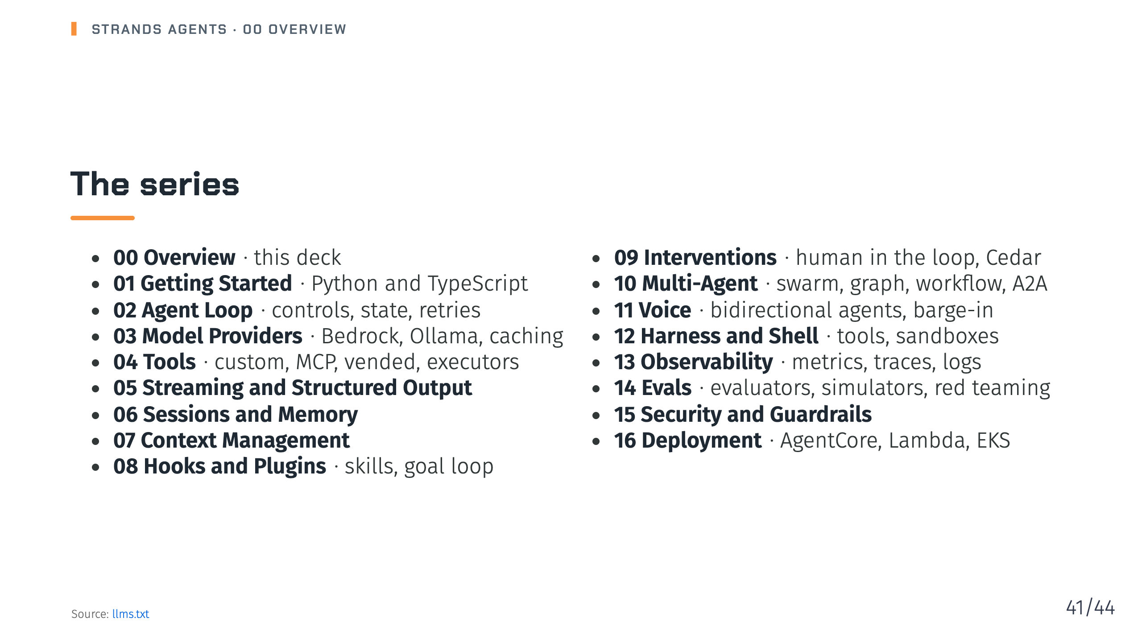
Notes:
Notes: One deck per fortnight, in the order of the docs map: build topics first, then the run topics. The series page lists every deck with its post. Source: llms.txt

Slide 42
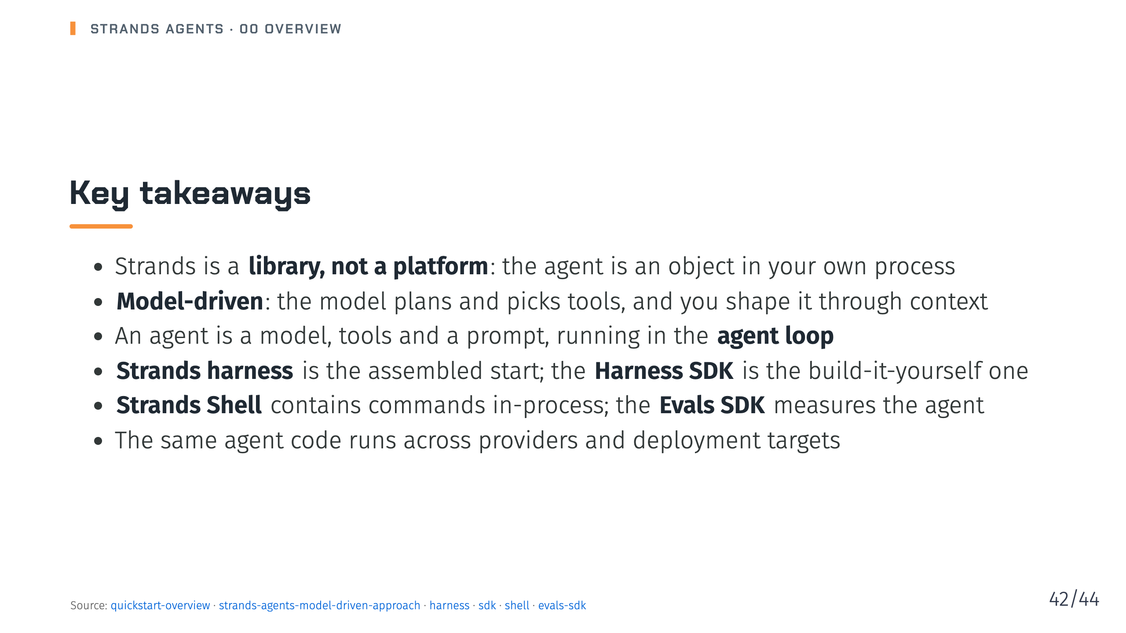
Notes:
Notes: Leave the audience with the map: four products, one loop, and a model that drives. Every later deck fills in one box on that map. Source: pages/docs/user-guide/sdk/quickstart/overview/index.md, pages/blog/strands-agents-model-driven-approach/index.md, pages/docs/user-guide/harness/index.md, pages/docs/user-guide/sdk/index.md, pages/docs/user-guide/shell/index.md, pages/docs/user-guide/evals-sdk/index.md

Slide 43
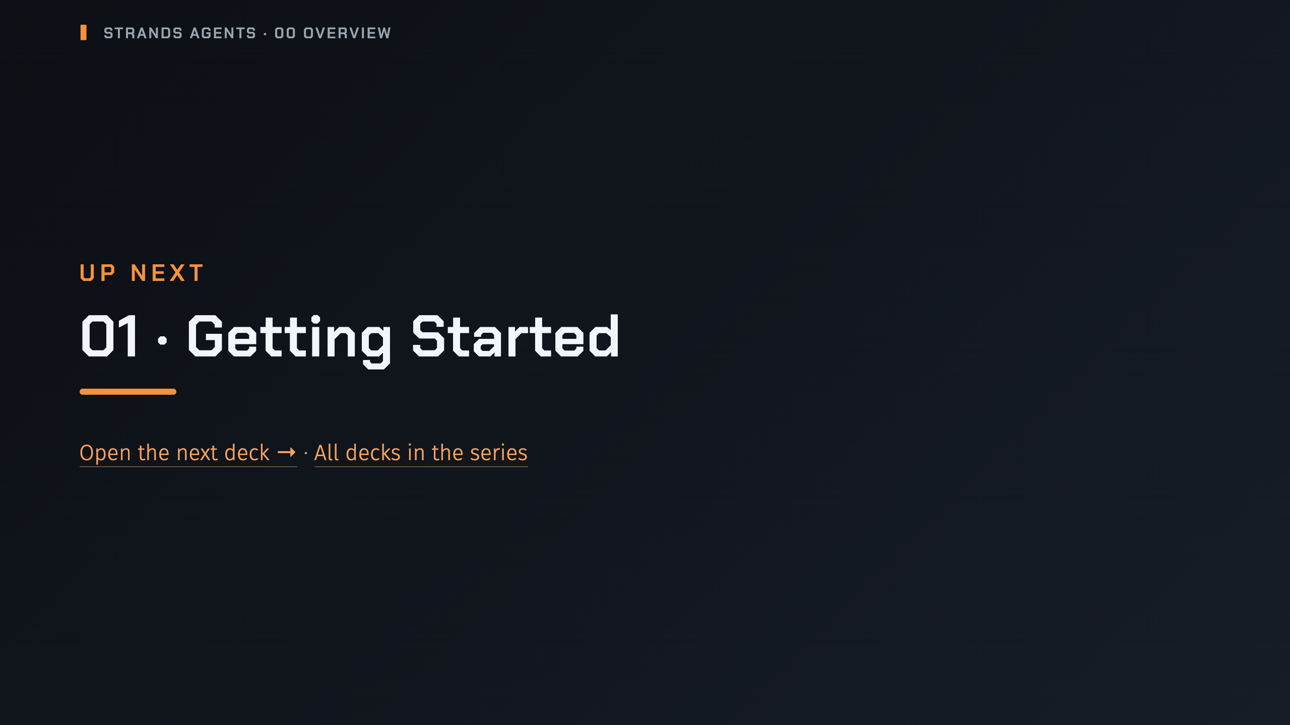
Notes:
nav:up-next
_transition: cover
Notes: That's the end of the Overview. Next up is Getting Started; the series page lists every deck in order.

Slide 44
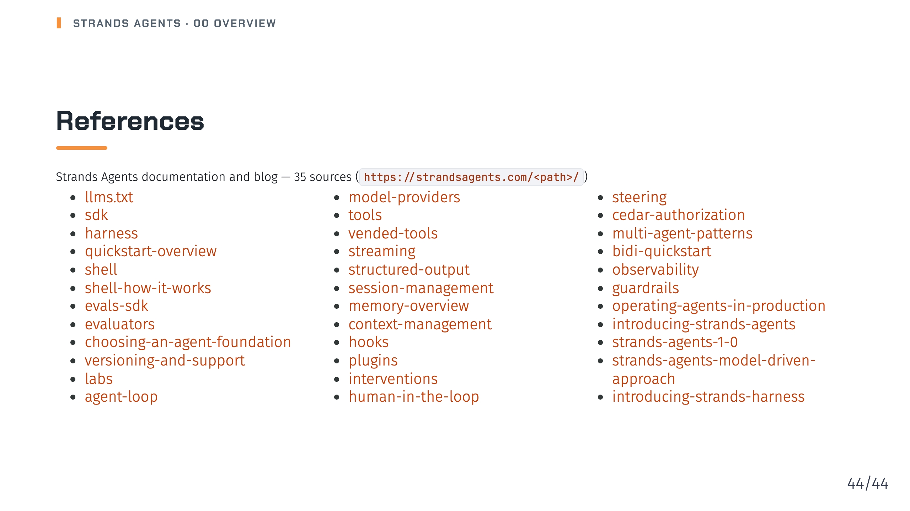
Notes:
Notes: All content in this deck comes from these Strands Agents documentation and blog pages. Source: strands-agents-docs-live/pages and llms.txt

