Slide 1
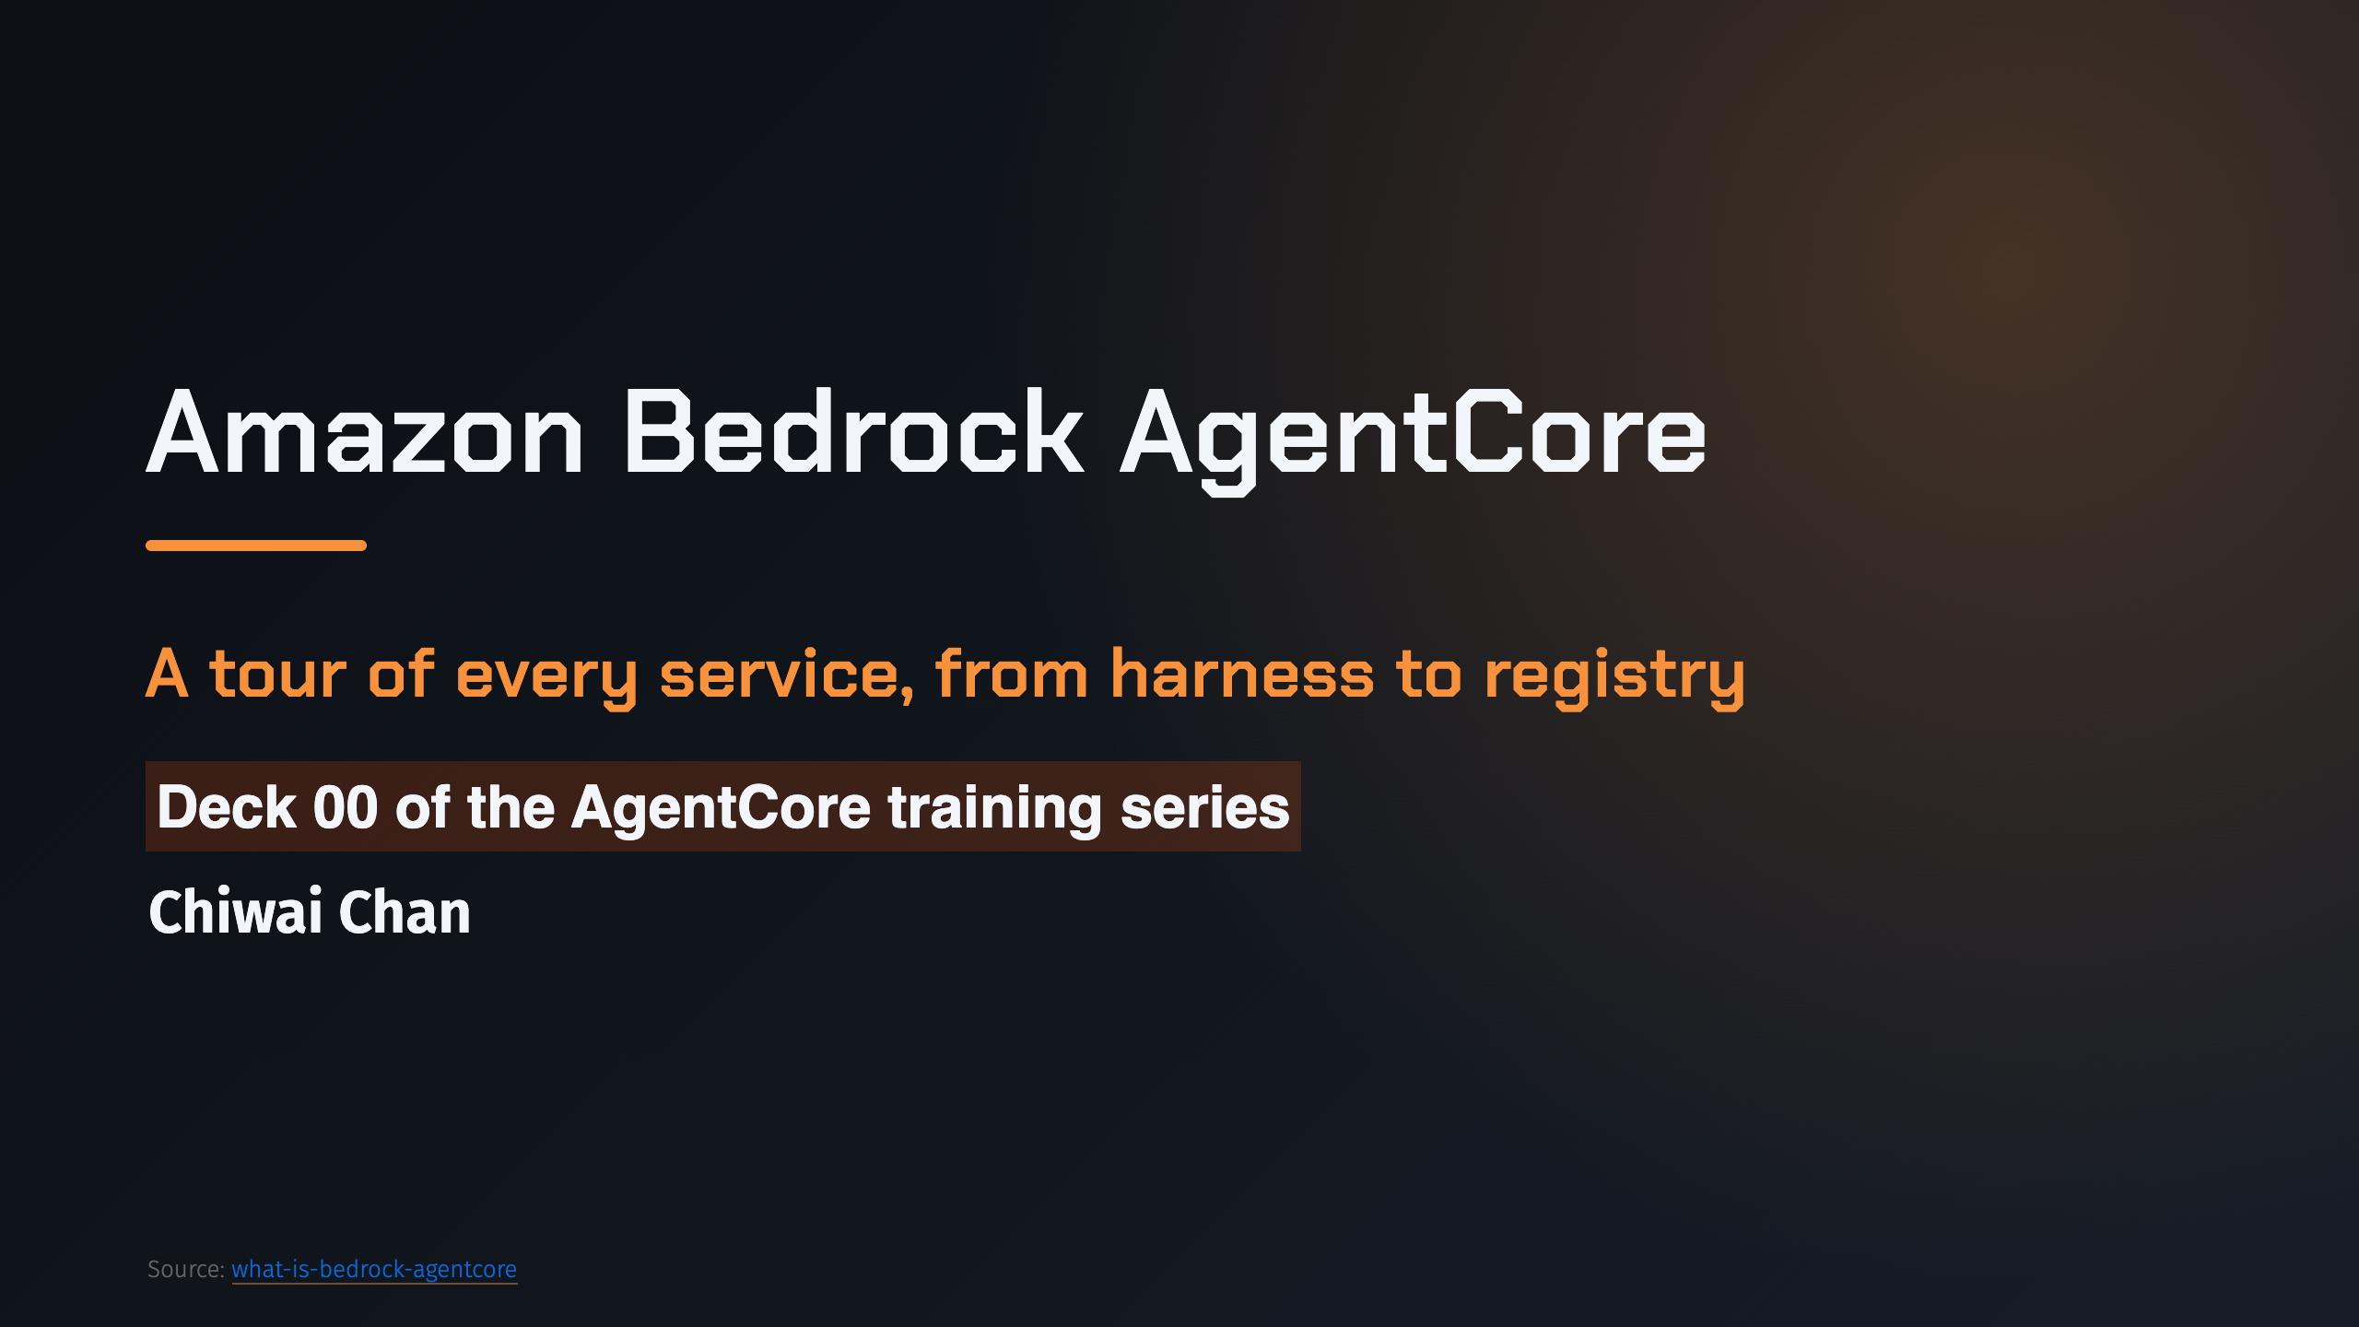
Notes:
_transition: cover
Notes: This deck is the map for the whole series: a short stop at every AgentCore service, then pointers to the deep-dive decks. Source: 01-what-is-bedrock-agentcore.md

Slide 2
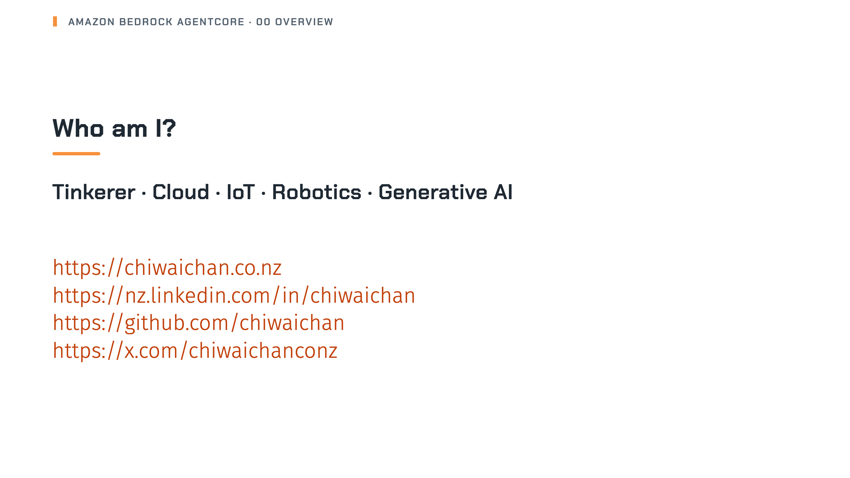
Notes:
Notes: Quick hello before we start. Source: src/pages/cv.md, docusaurus.config.ts (site links)

Slide 3

Notes:
_transition: cover
Notes: Section break: what AgentCore is and how the services fit together.

Slide 4
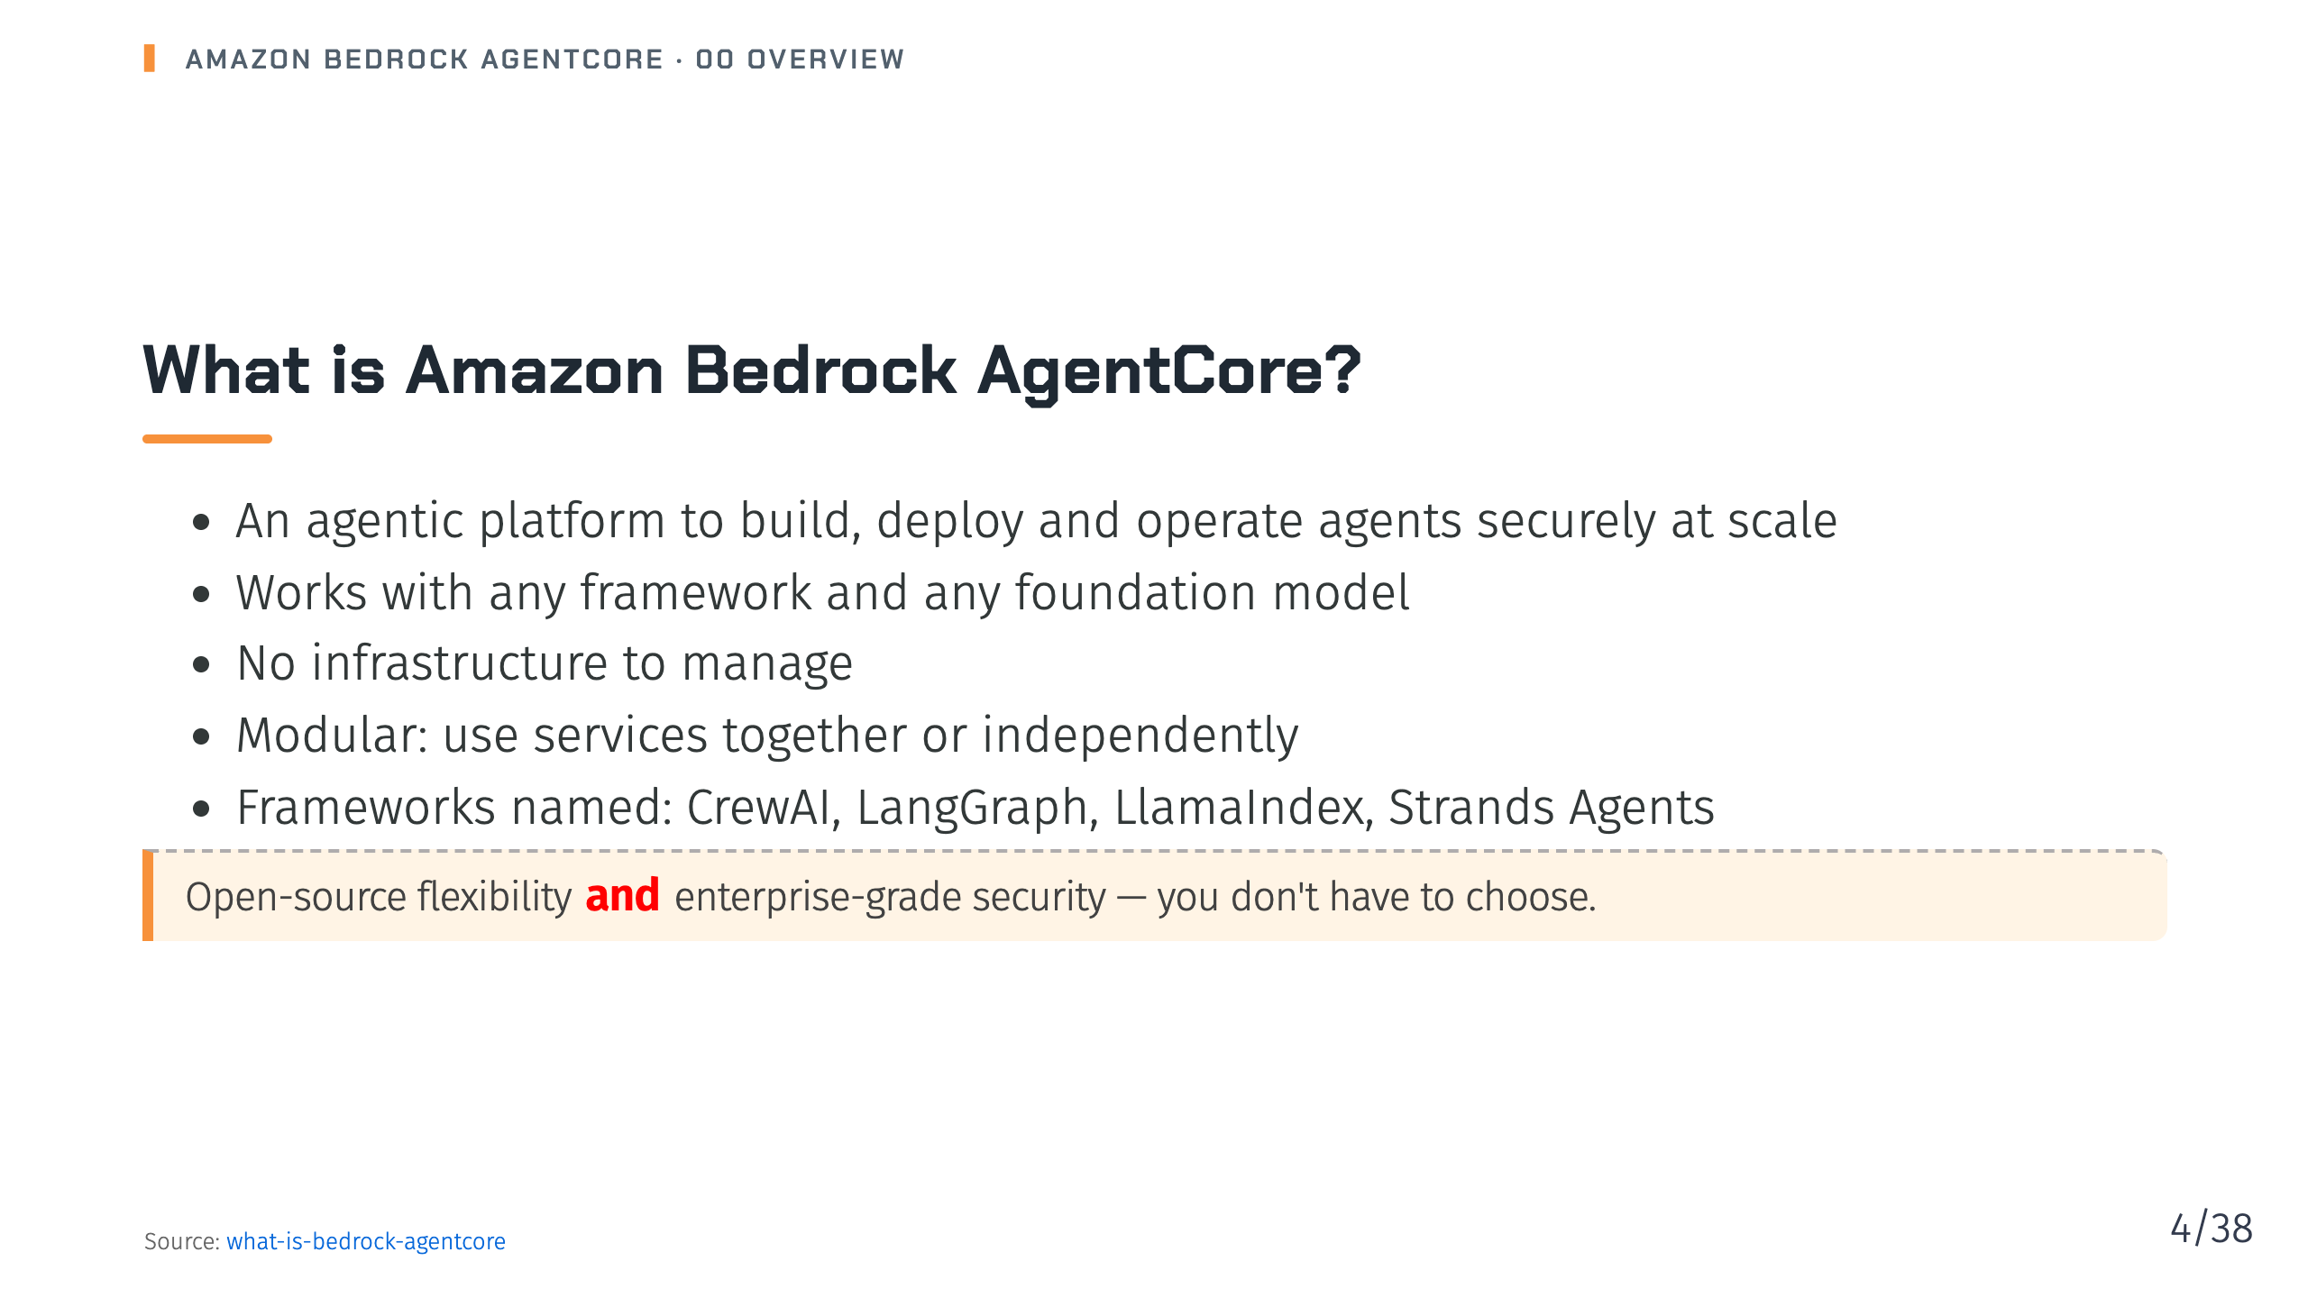
Notes:
Notes: AgentCore is a set of modular services, not a single framework. You can adopt just one service, like Memory or Gateway, alongside an agent you host elsewhere. Source: 01-what-is-bedrock-agentcore.md

Slide 5
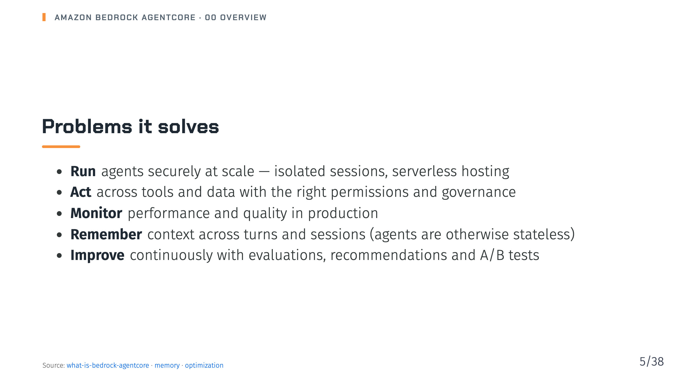
Notes:
Notes: These map directly to the service groups we'll walk through: run, connect, remember, govern, observe and improve. Source: 01-what-is-bedrock-agentcore.md, 07-memory/_index.md, 17-optimization/_index.md

Slide 6
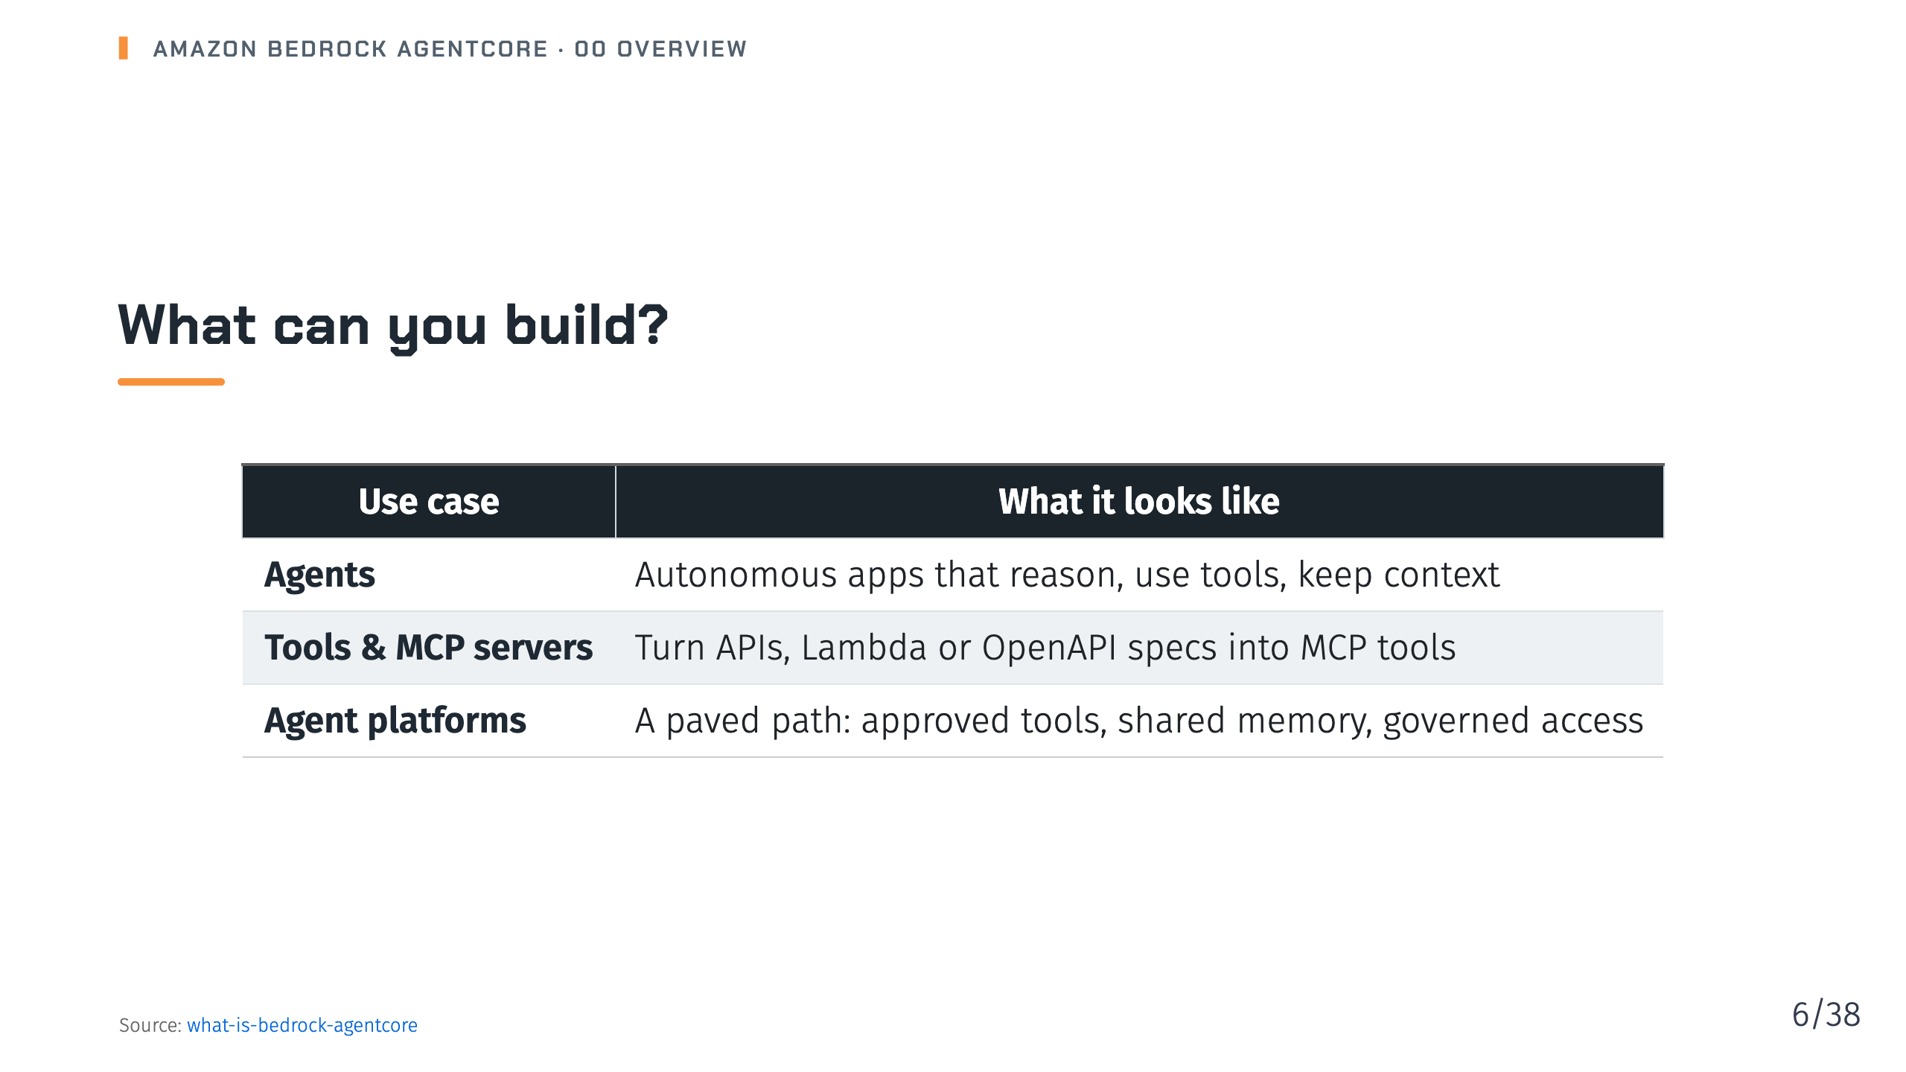
Notes:
Notes: The docs call out three patterns. Many teams start with an agent, then grow into a shared platform with centralised auth, observability and compliance. Source: 01-what-is-bedrock-agentcore.md

Slide 7
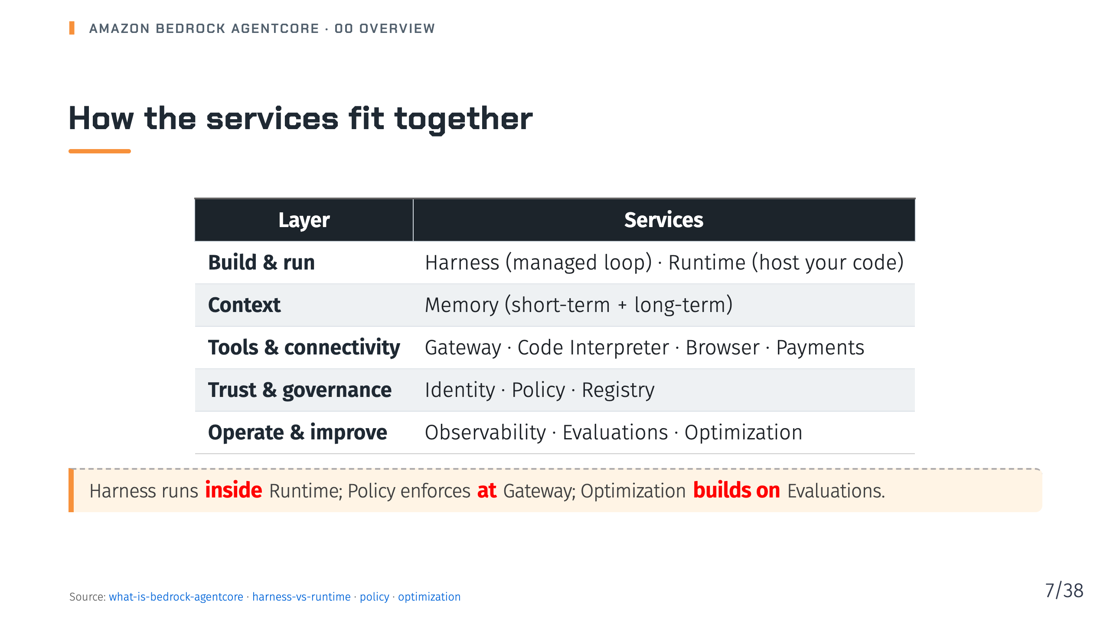
Notes:
Notes: This grouping is my own framing of the core services table. The three relationships in the callout are stated explicitly in the docs. Source: 01-what-is-bedrock-agentcore.md, 04-harness/13-harness-vs-runtime.md, 15-policy/_index.md, 17-optimization/_index.md

Slide 8
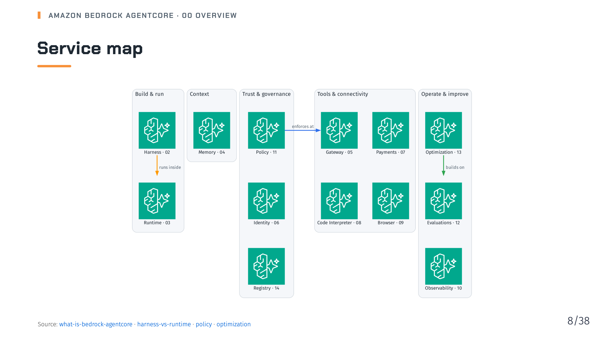
Notes:
Notes: The same grouping as the previous table (my framing of the core services table), drawn as a map. The number beside each service is the deck in this series that covers it in depth. The three arrows are the relationships the docs state explicitly: harness runs inside Runtime, Policy enforces at Gateway, Optimization builds on Evaluations. Source: 01-what-is-bedrock-agentcore.md, 04-harness/13-harness-vs-runtime.md, 15-policy/_index.md, 17-optimization/_index.md

Slide 9
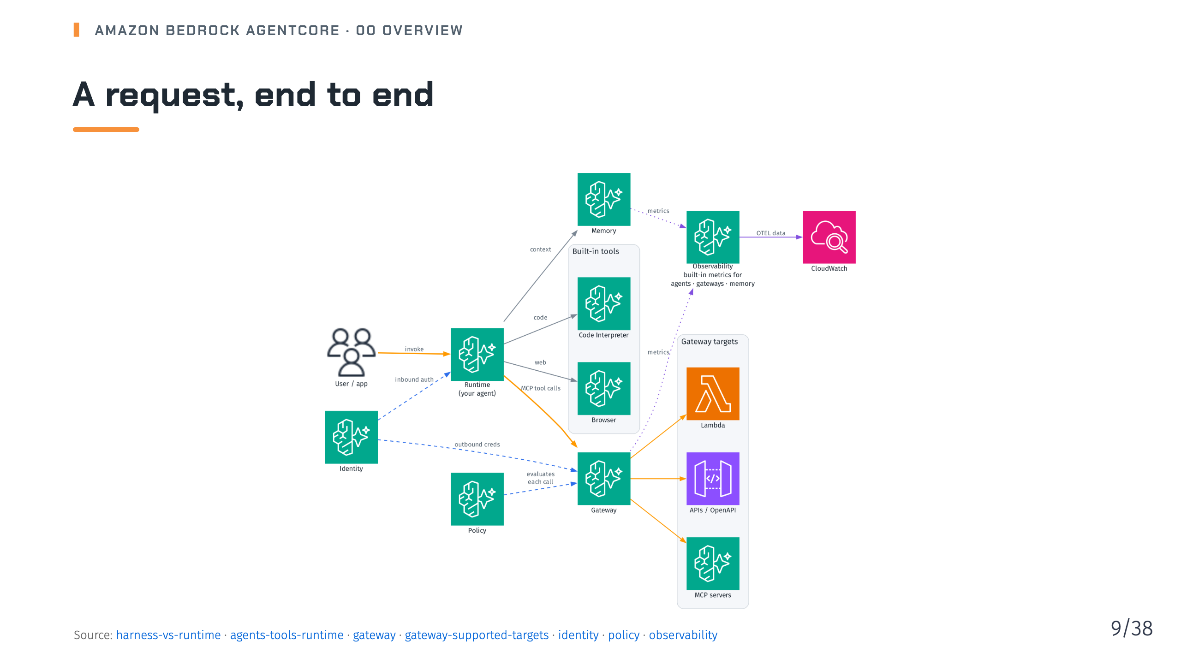
Notes:
Notes: A user or app invokes the agent on Runtime, with inbound auth from AgentCore Identity. Agent code calls Memory for context, Code Interpreter and Browser directly, and Gateway for MCP tools. Policy evaluates every tool call at the gateway before execution, and Identity supplies outbound credentials to targets. AgentCore emits built-in metrics for agents, gateways and memory in OTEL-compatible format, stored in CloudWatch. Source: 04-harness/13-harness-vs-runtime.md, 06-agents-tools-runtime/_index.md, 08-gateway/_index.md, 08-gateway/04-gateway-supported-targets/_index.md, 09-identity/_index.md, 15-policy/_index.md, 13-observability/_index.md

Slide 10

Notes:
_transition: cover
Notes: Section break: the Harness and Runtime services.

Slide 11
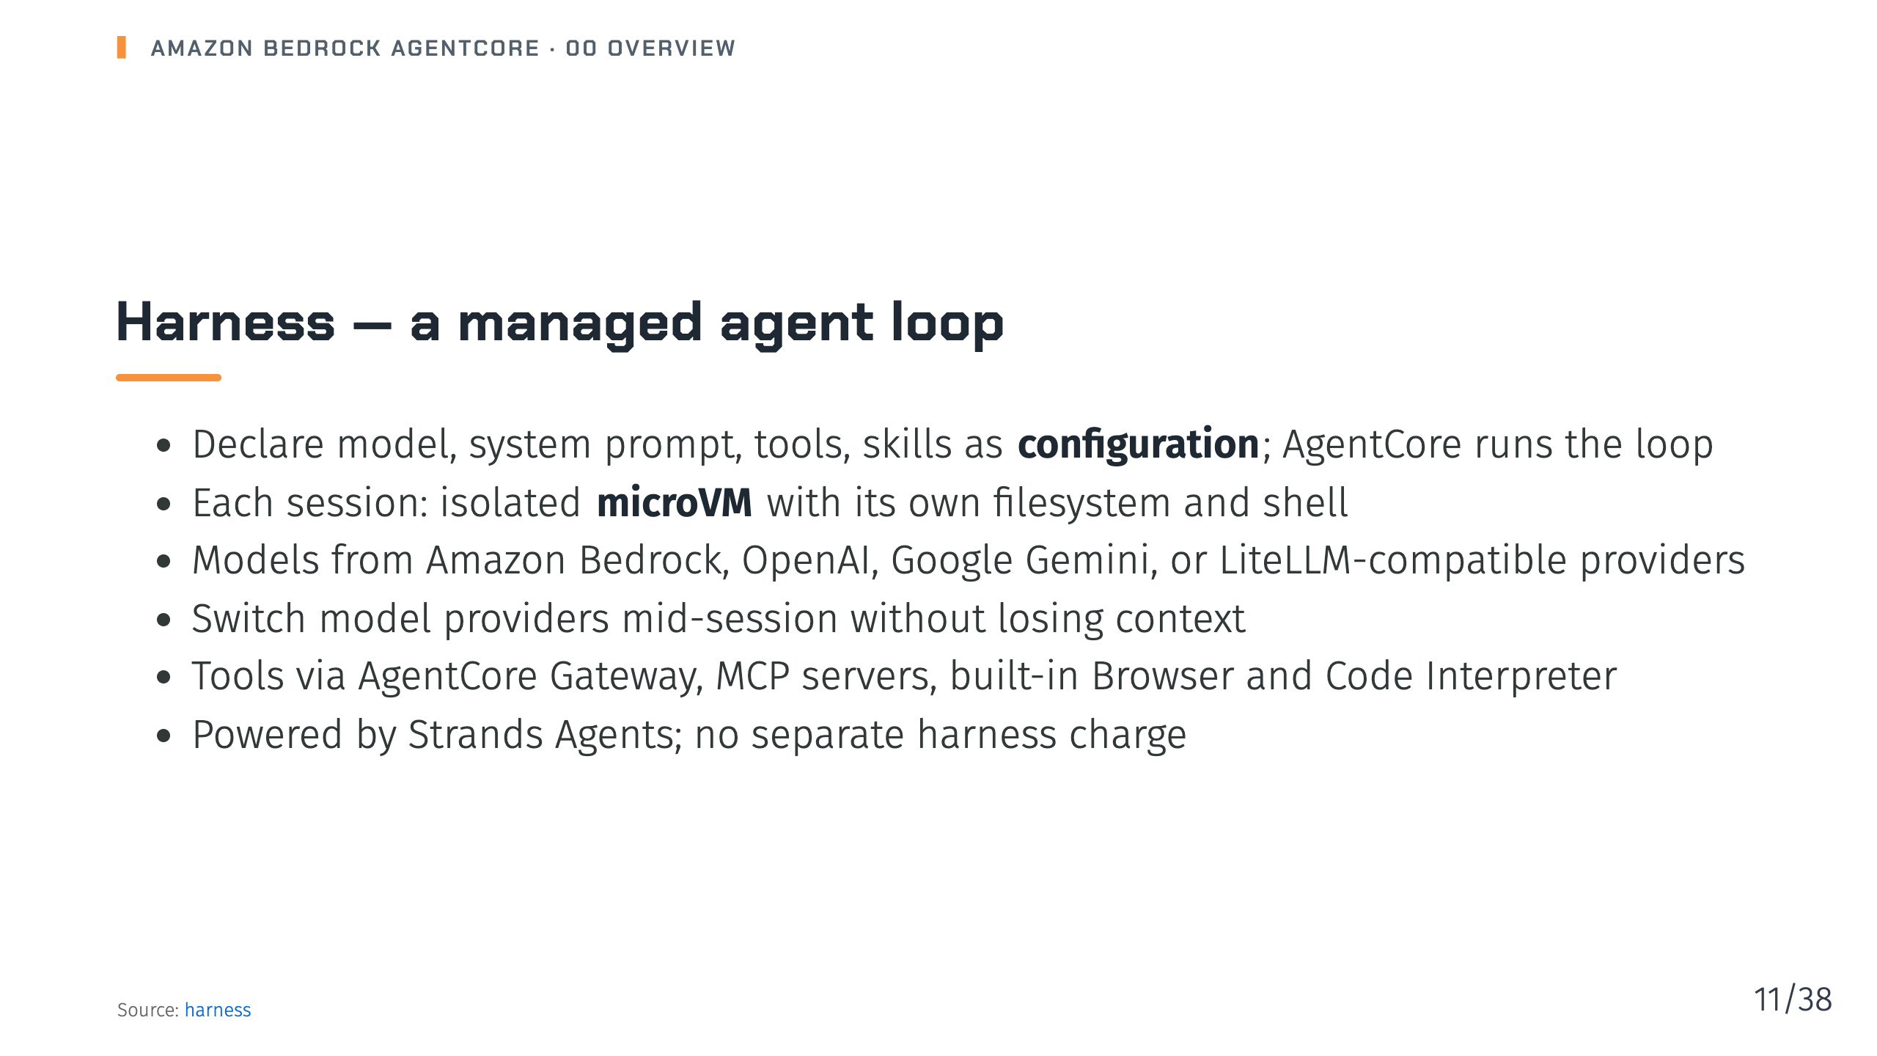
Notes:
Notes: Harness turns production agent plumbing into configuration. Trying a new model or tool is a config change, not a rewrite. You pay only for the underlying AgentCore capabilities it uses. Source: 04-harness/_index.md

Slide 12
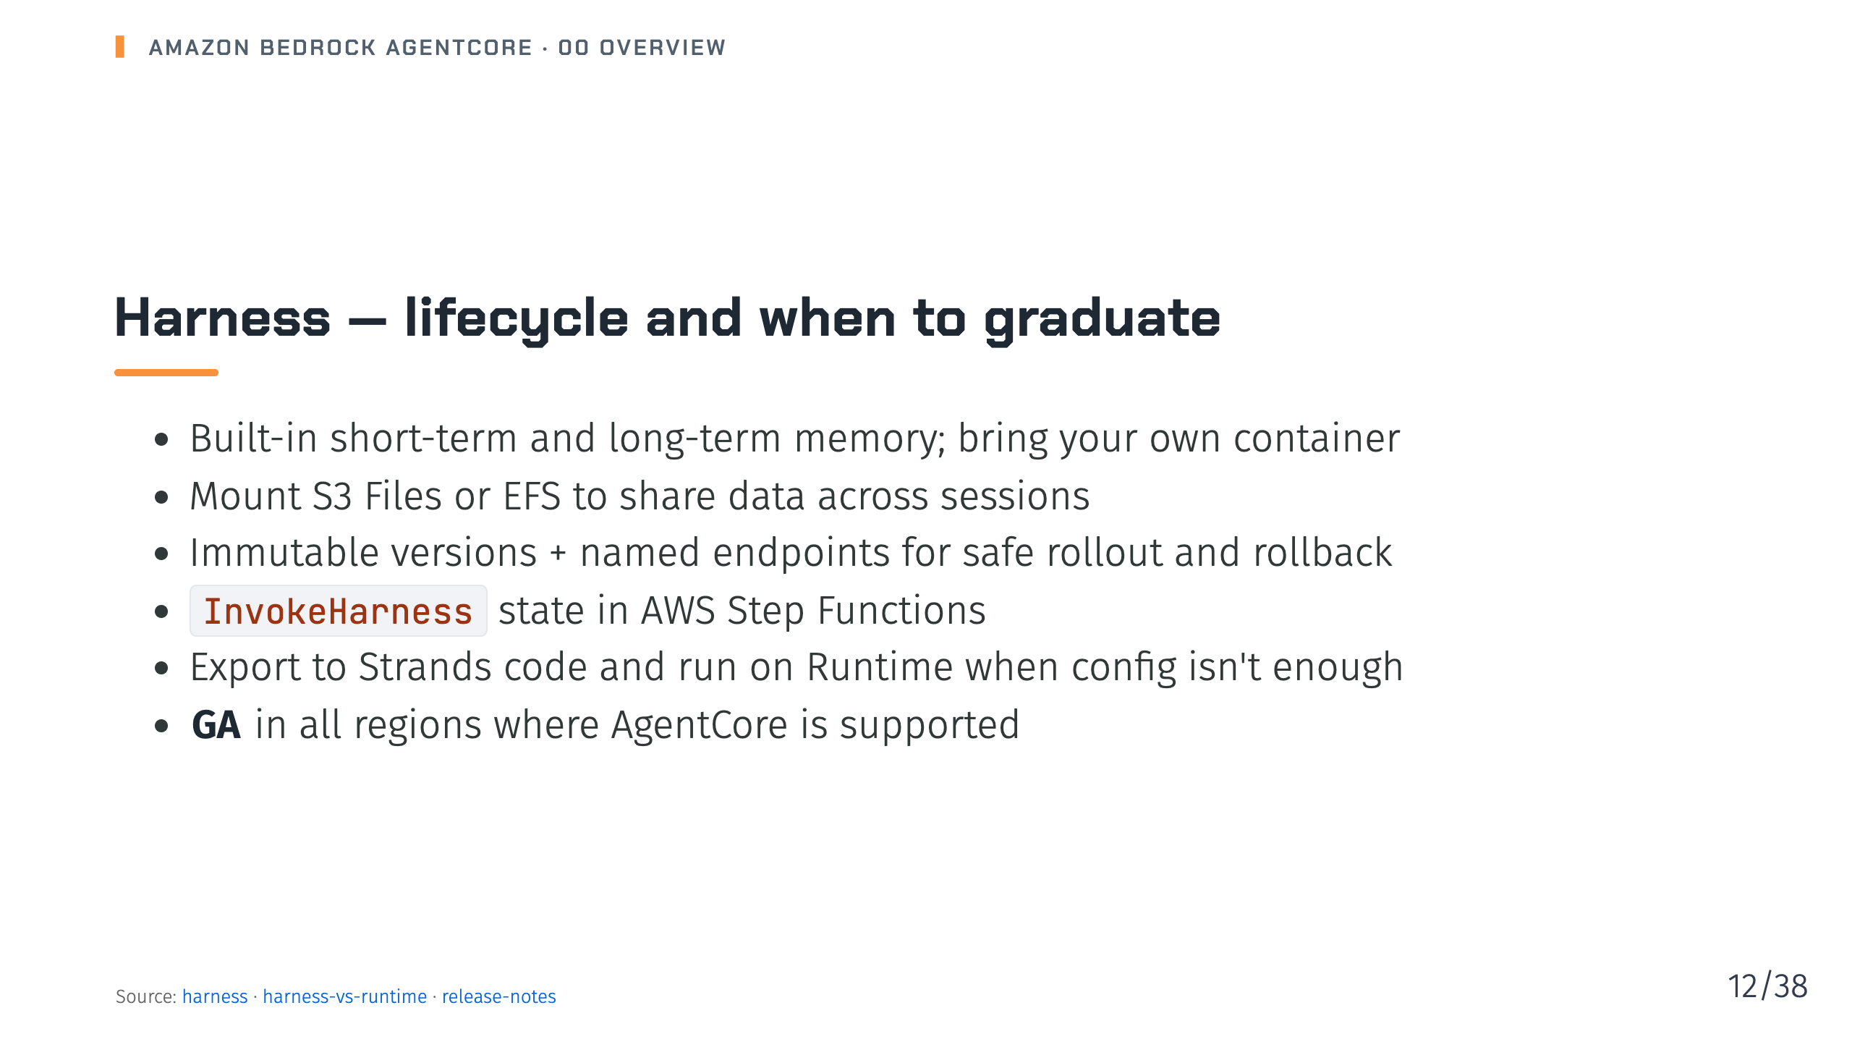
Notes:
Notes: The harness is designed to take you to production, and gives you an escape hatch: export to code and move to Runtime when you need a custom framework or non-agent-loop patterns. Source: 04-harness/_index.md, 04-harness/13-harness-vs-runtime.md, 25-release-notes.md

Slide 13
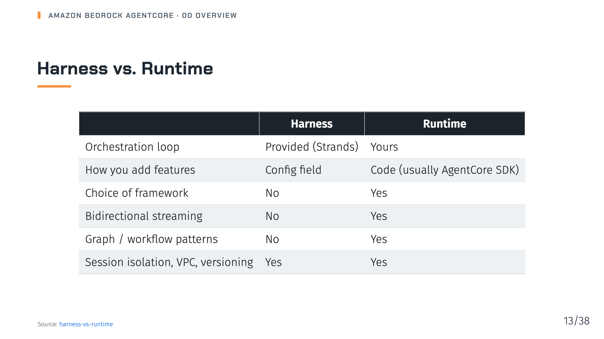
Notes:
Notes: The rule of thumb from the docs: harness is configuration with no code, Runtime is code you write. Harness itself runs inside Runtime, so CloudTrail records harness operations under the Runtime resource type. Source: 04-harness/13-harness-vs-runtime.md

Slide 14
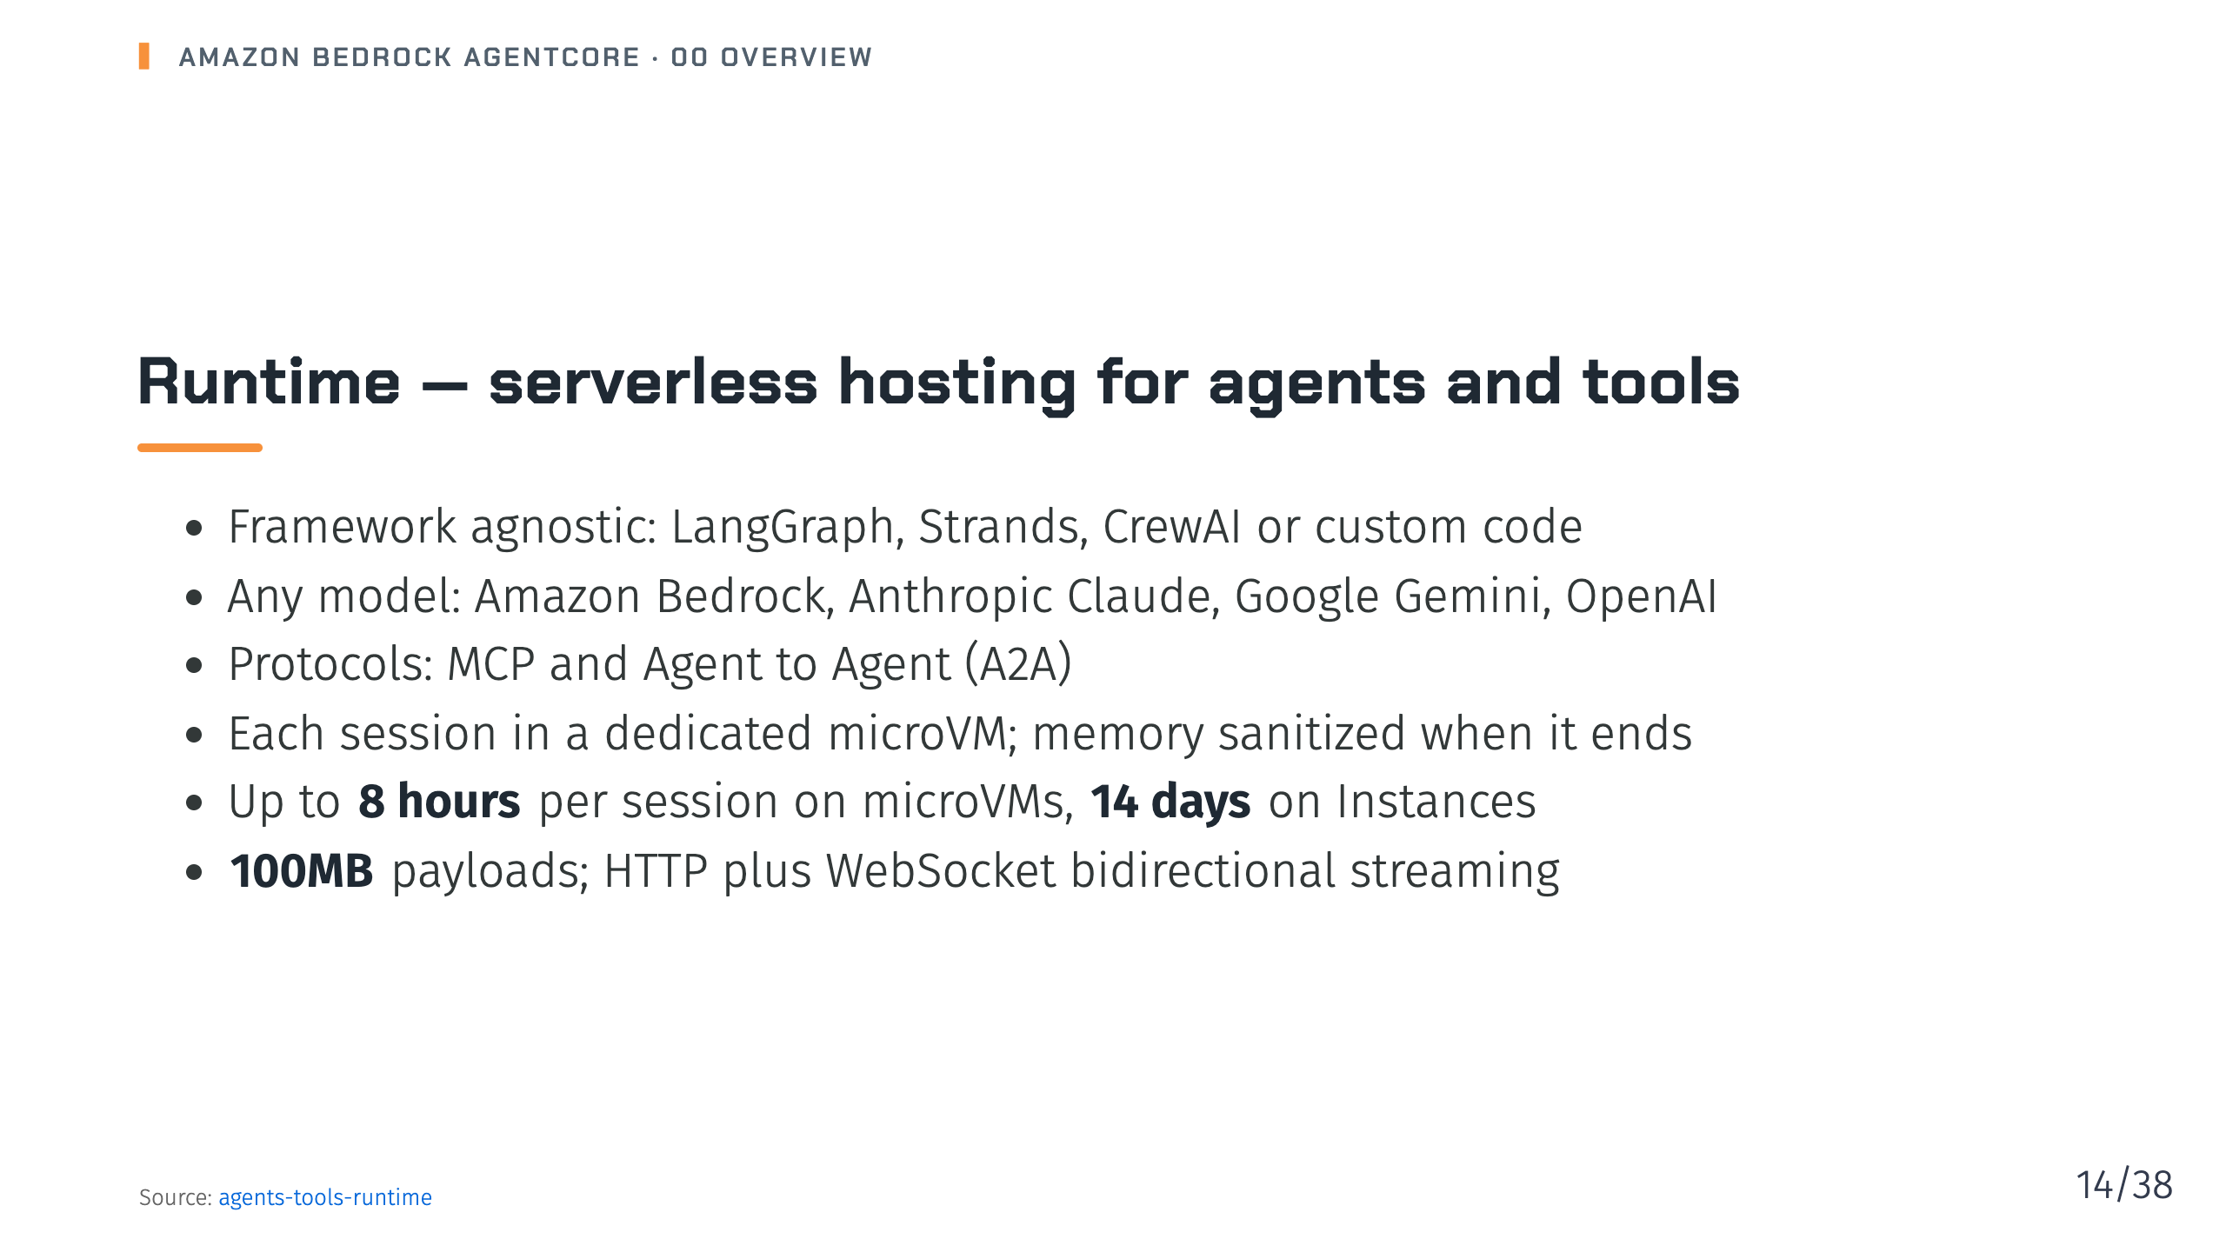
Notes:
Notes: Runtime is where you host your own agent code. Two compute types: microVMs, which are fully managed and pay-per-use, and Instances, which run on AWS-managed EC2 in your account for multi-day or GPU workloads. Source: 06-agents-tools-runtime/_index.md

Slide 15
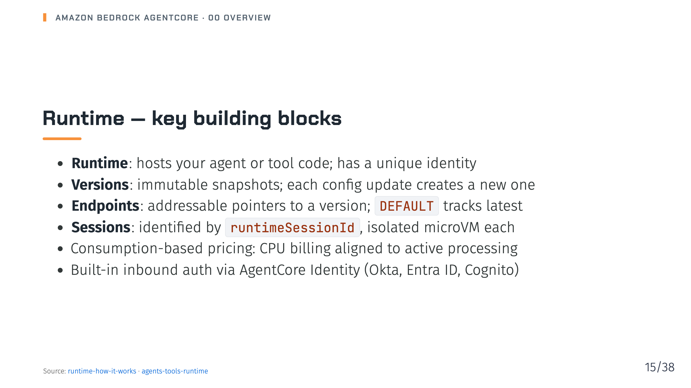
Notes:
Notes: Versions plus endpoints give you dev, test and prod endpoints and rollback without downtime. Billing typically avoids charges during I/O wait while the agent waits on the LLM. Source: 06-agents-tools-runtime/01-runtime-compute-how-it-works/01-runtime-how-it-works.md, 06-agents-tools-runtime/_index.md

Slide 16
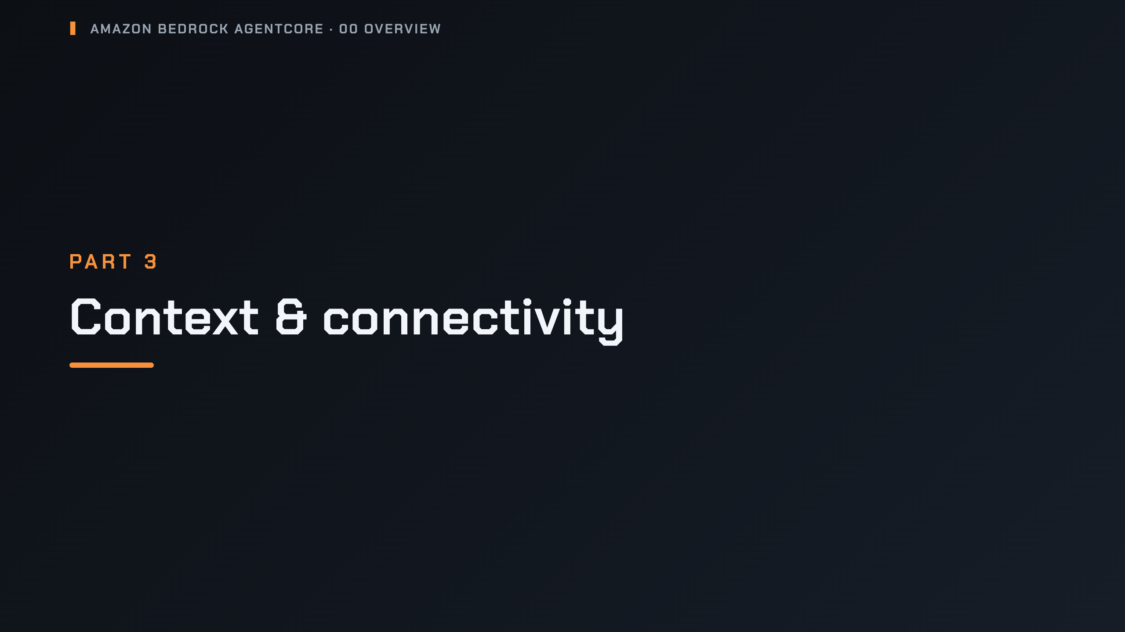
Notes:
_transition: cover
Notes: Section break: Memory, Gateway, Identity, Payments, Code Interpreter and Browser.

Slide 17
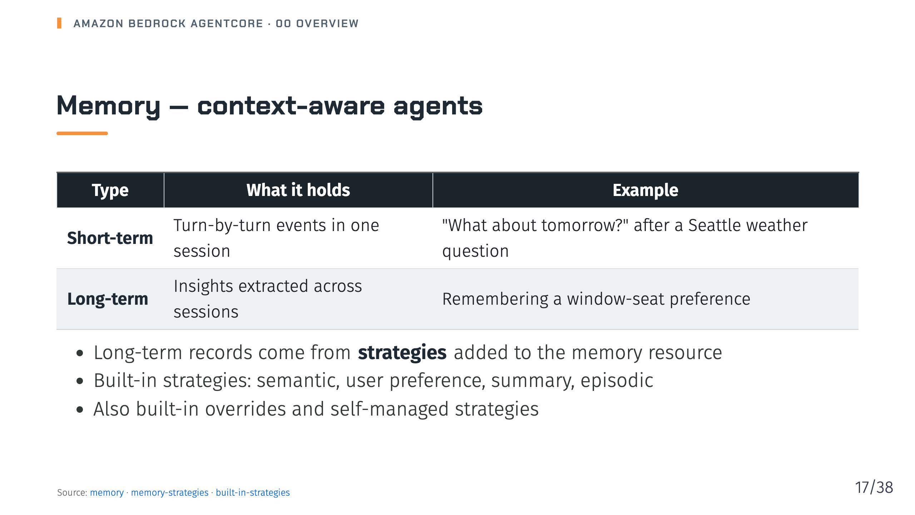
Notes:
Notes: Without strategies, no long-term records are extracted. Built-in strategies run extraction and consolidation for you; overrides let you customise prompts; self-managed gives you full control. Source: 07-memory/_index.md, 07-memory/01-how-it-works/03-memory-strategies/_index.md, 07-memory/01-how-it-works/03-memory-strategies/01-built-in-strategies/_index.md

Slide 18
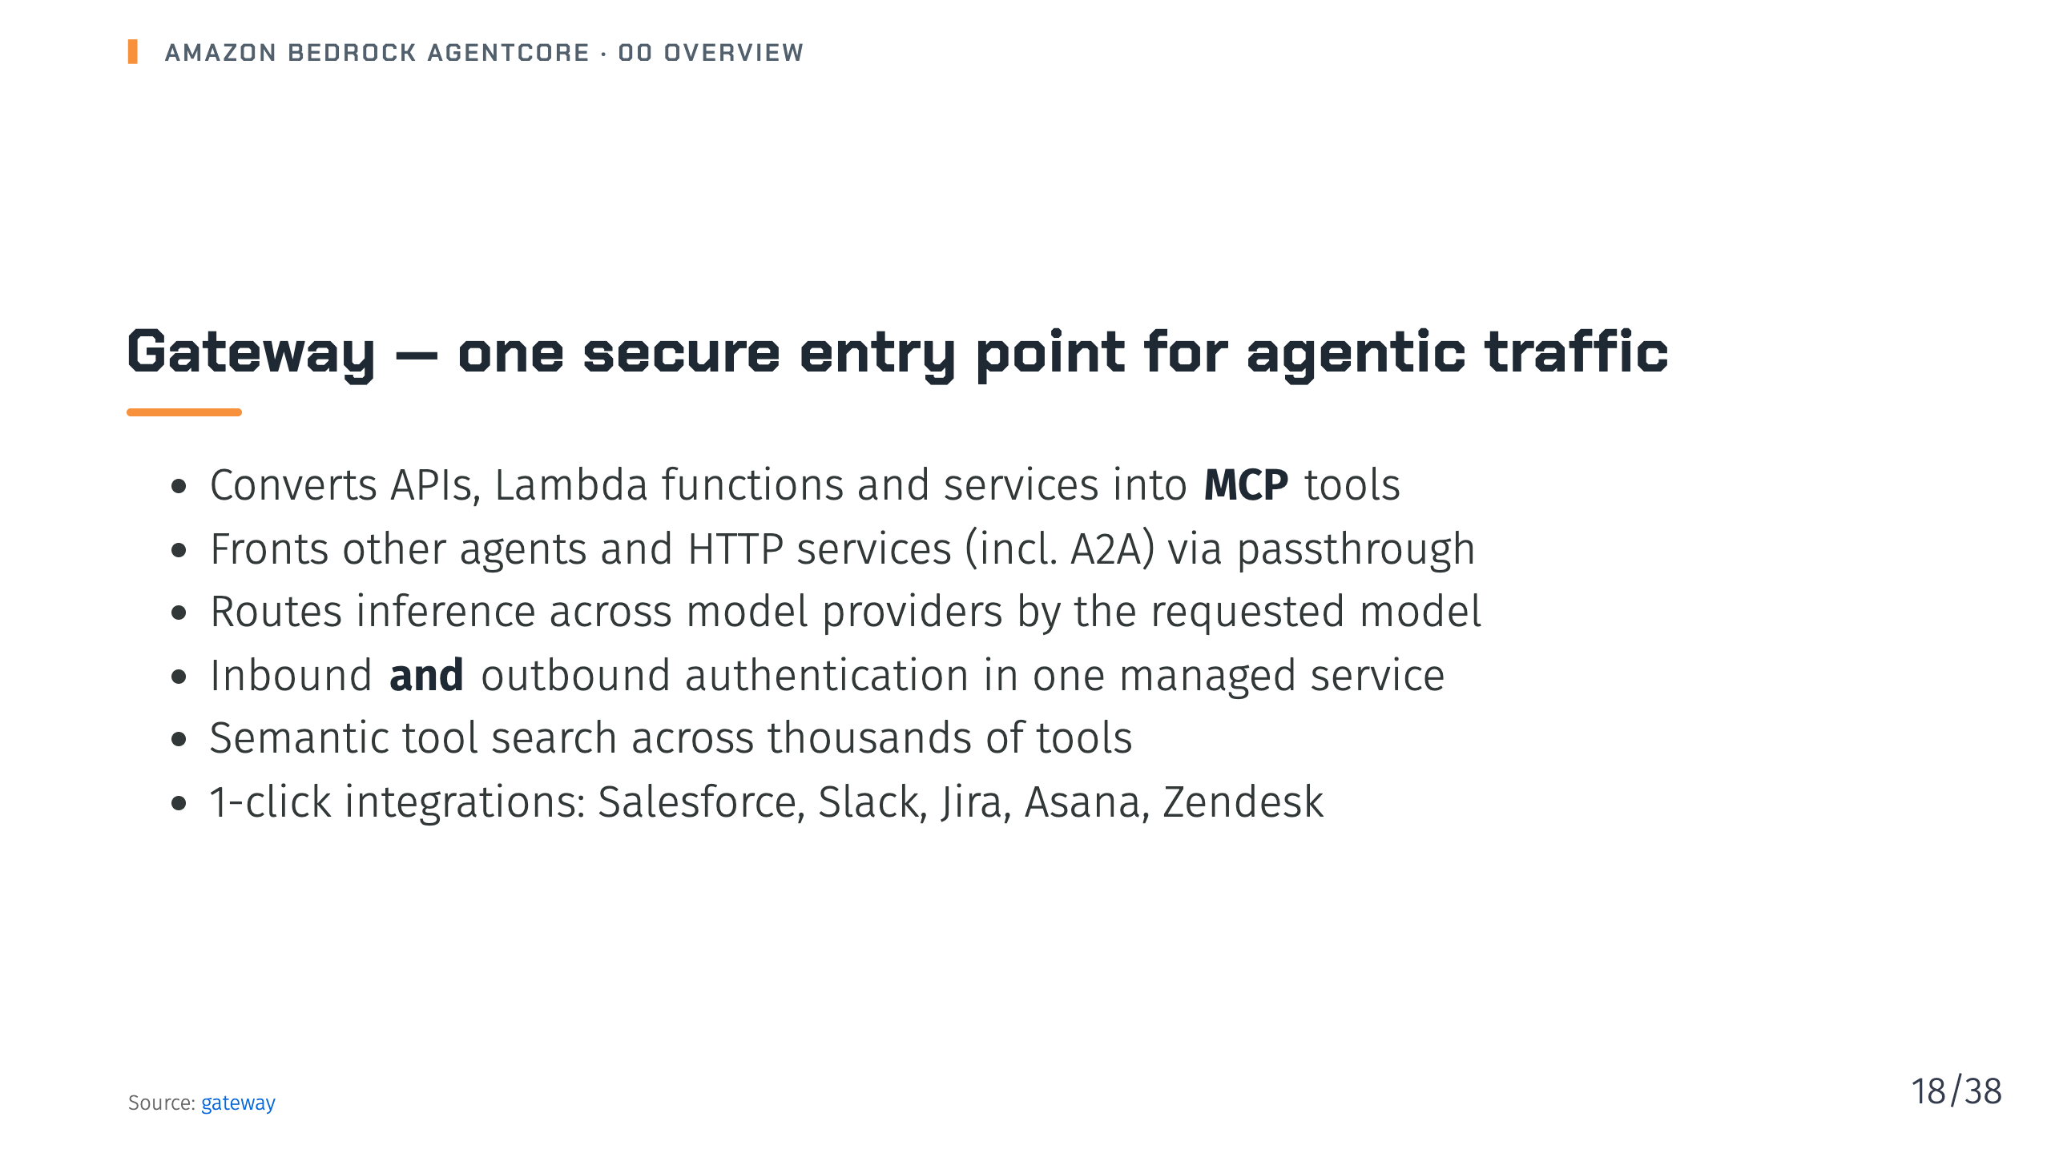
Notes:
Notes: Gateway has grown beyond an MCP tool gateway. It is now a single entry point for tools, other agents and models, with auth on both sides. Source: 08-gateway/_index.md

Slide 19
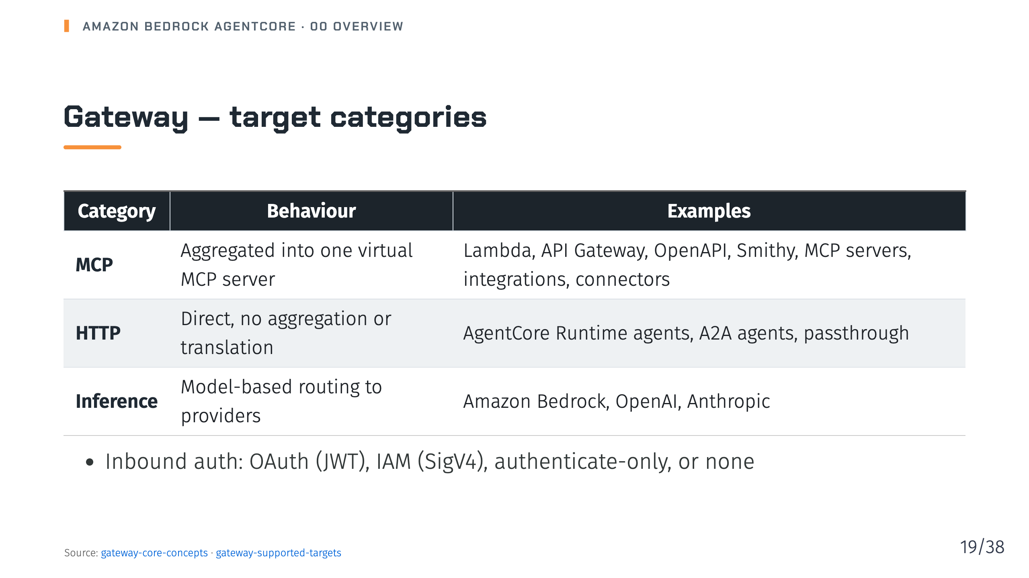
Notes:
Notes: MCP targets show up in one consolidated tools/list. HTTP targets are addressed individually through path-based routing. Inbound "no authorization" is intended for development and testing. Source: 08-gateway/02-gateway-core-concepts.md, 08-gateway/04-gateway-supported-targets/_index.md

Slide 20
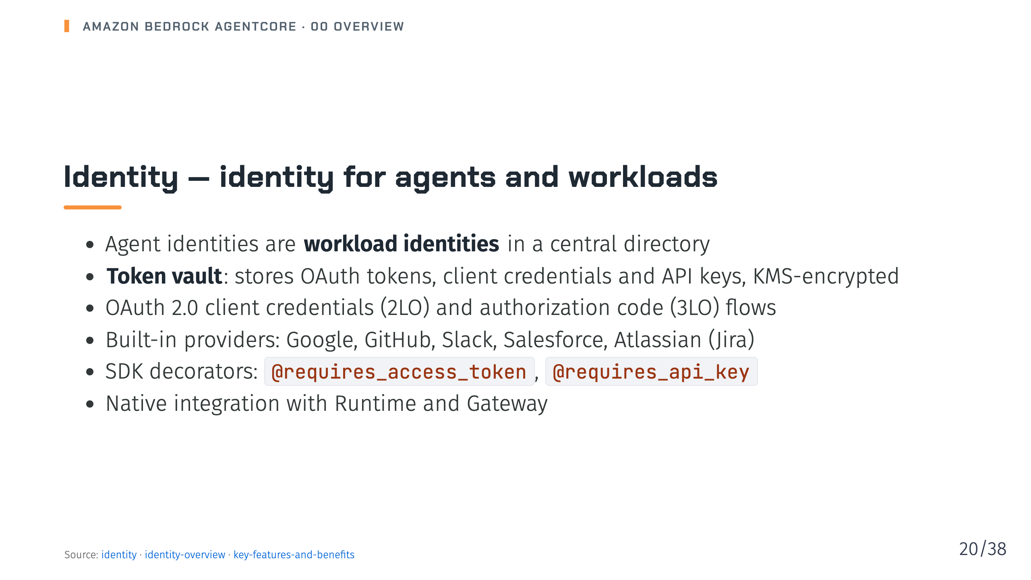
Notes:
Notes: Identity covers both directions: who may call the agent, and how the agent gets credentials for AWS and third-party services on behalf of users. Secrets stay out of agent code. Source: 09-identity/_index.md, 09-identity/01-identity-overview/_index.md, 09-identity/01-identity-overview/01-key-features-and-benefits.md

Slide 21
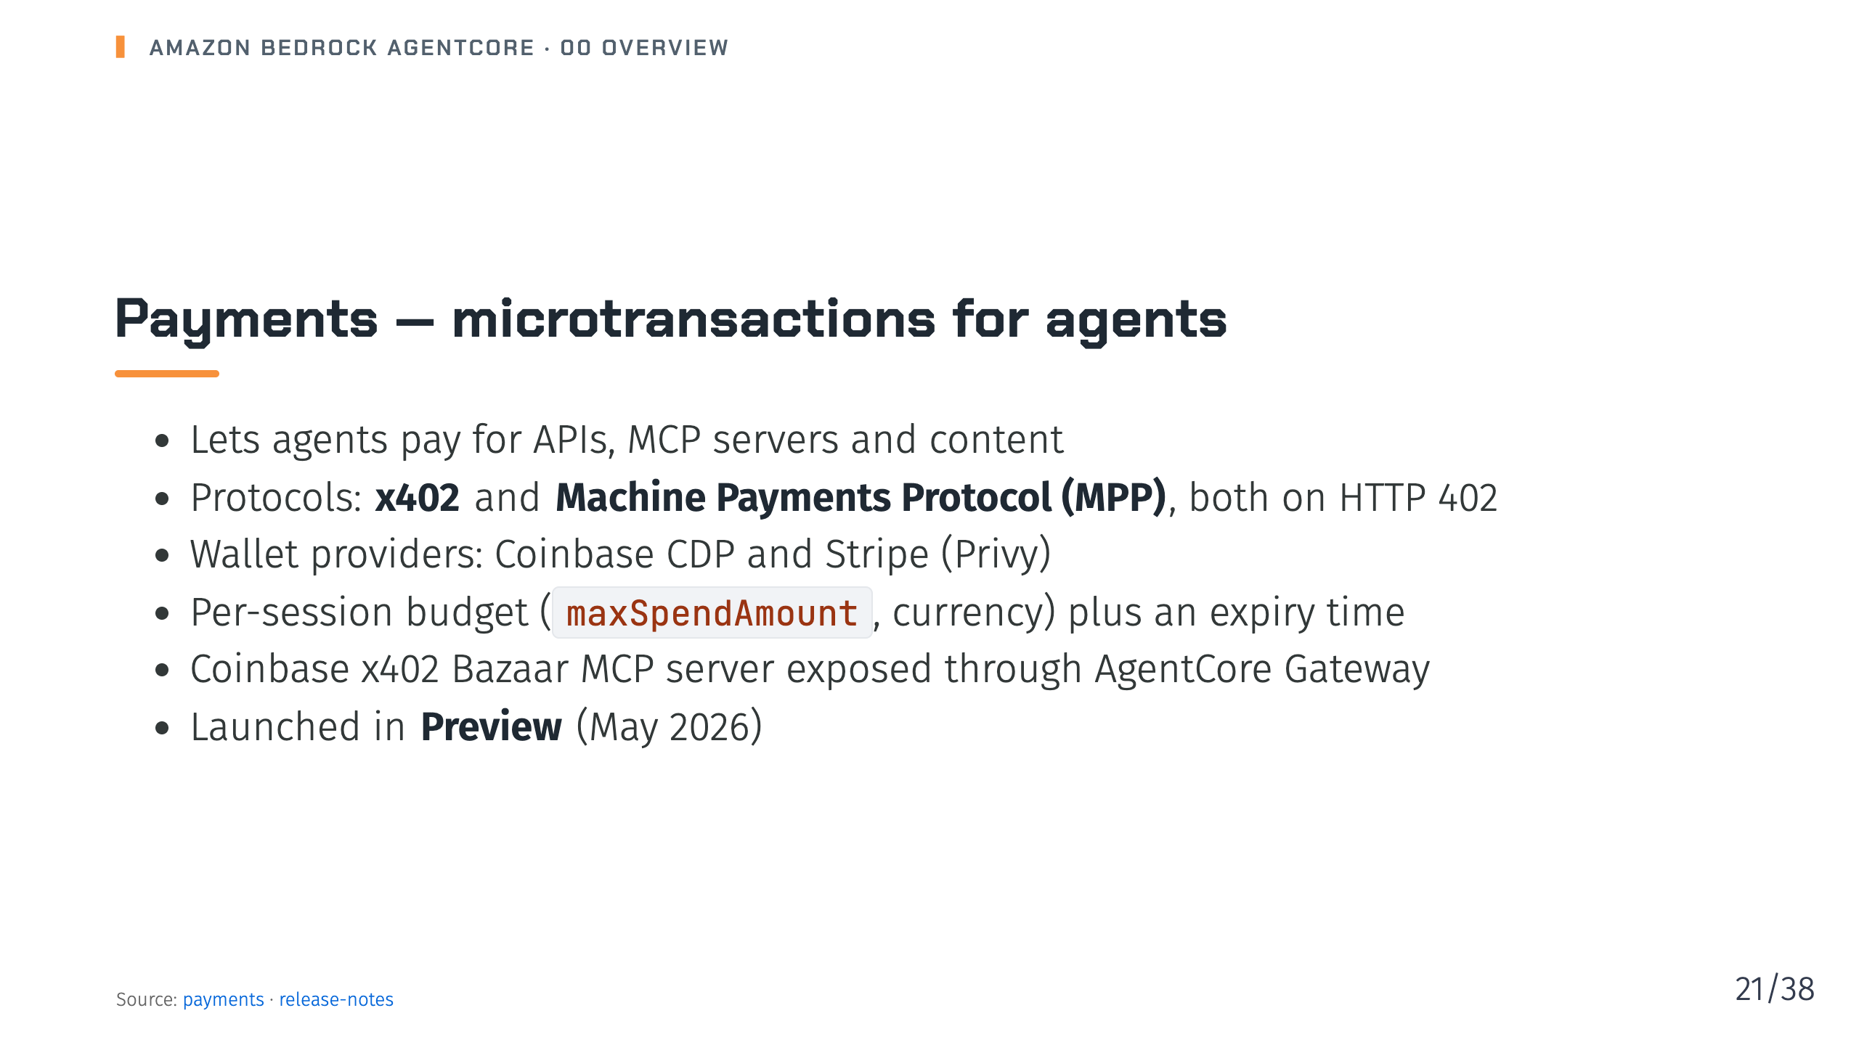
Notes:
Notes: Micro-payments of cents are uneconomic with card fees; payments uses stablecoin wallets and open protocols. Wallet credentials are stored via AgentCore Identity. Source: 10-payments/_index.md, 25-release-notes.md

Slide 22
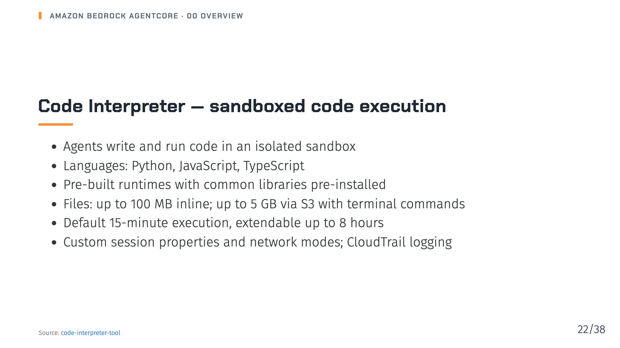
Notes:
Notes: Code Interpreter lets agents solve problems that reasoning alone can't, like precise calculations or data analysis over CSV, Excel or JSON, without risking your own environment. Source: 11-code-interpreter-tool/_index.md

Slide 23
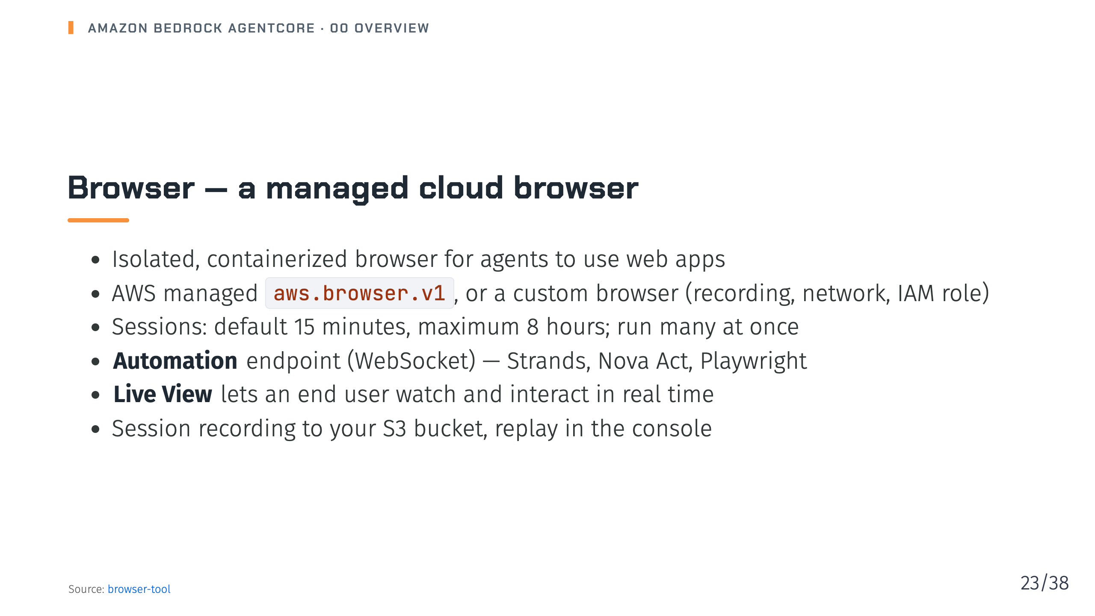
Notes:
Notes: Browser gives agents navigation, form filling, screenshots and extraction, with human-in-the-loop via Live View. Session recording is available for custom browsers. Source: 12-browser-tool/_index.md

Slide 24
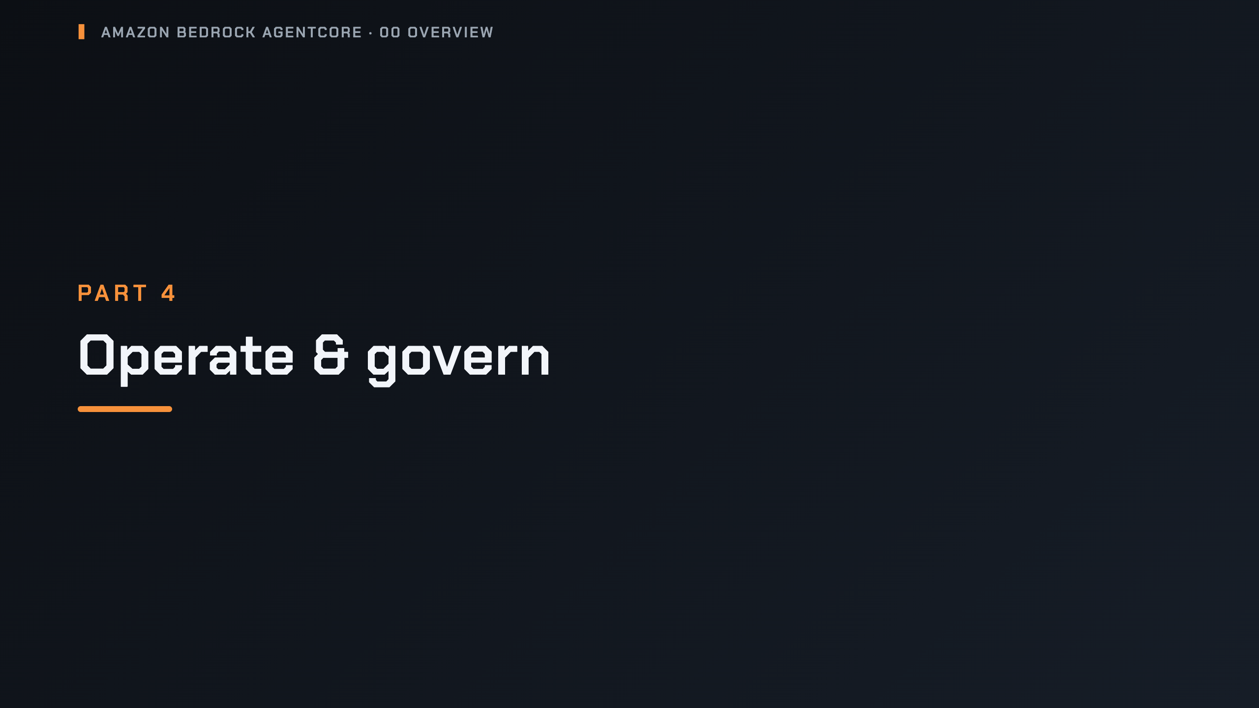
Notes:
_transition: cover
Notes: Section break: Observability, Policy, Evaluations, Optimization, Registry and Security.

Slide 25
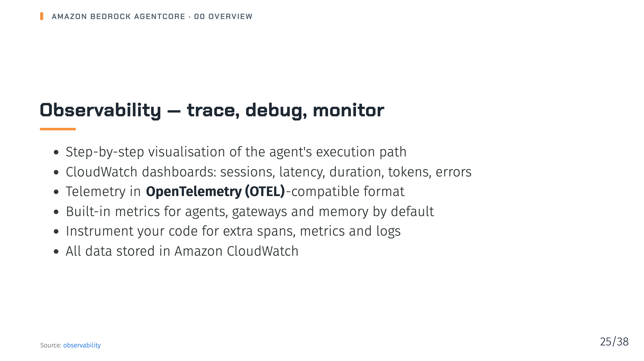
Notes:
Notes: Because the output is OTEL-compatible, you can plug it into your existing observability stack. The CloudWatch observability dashboard applies to agent runtime data. Source: 13-observability/_index.md

Slide 26
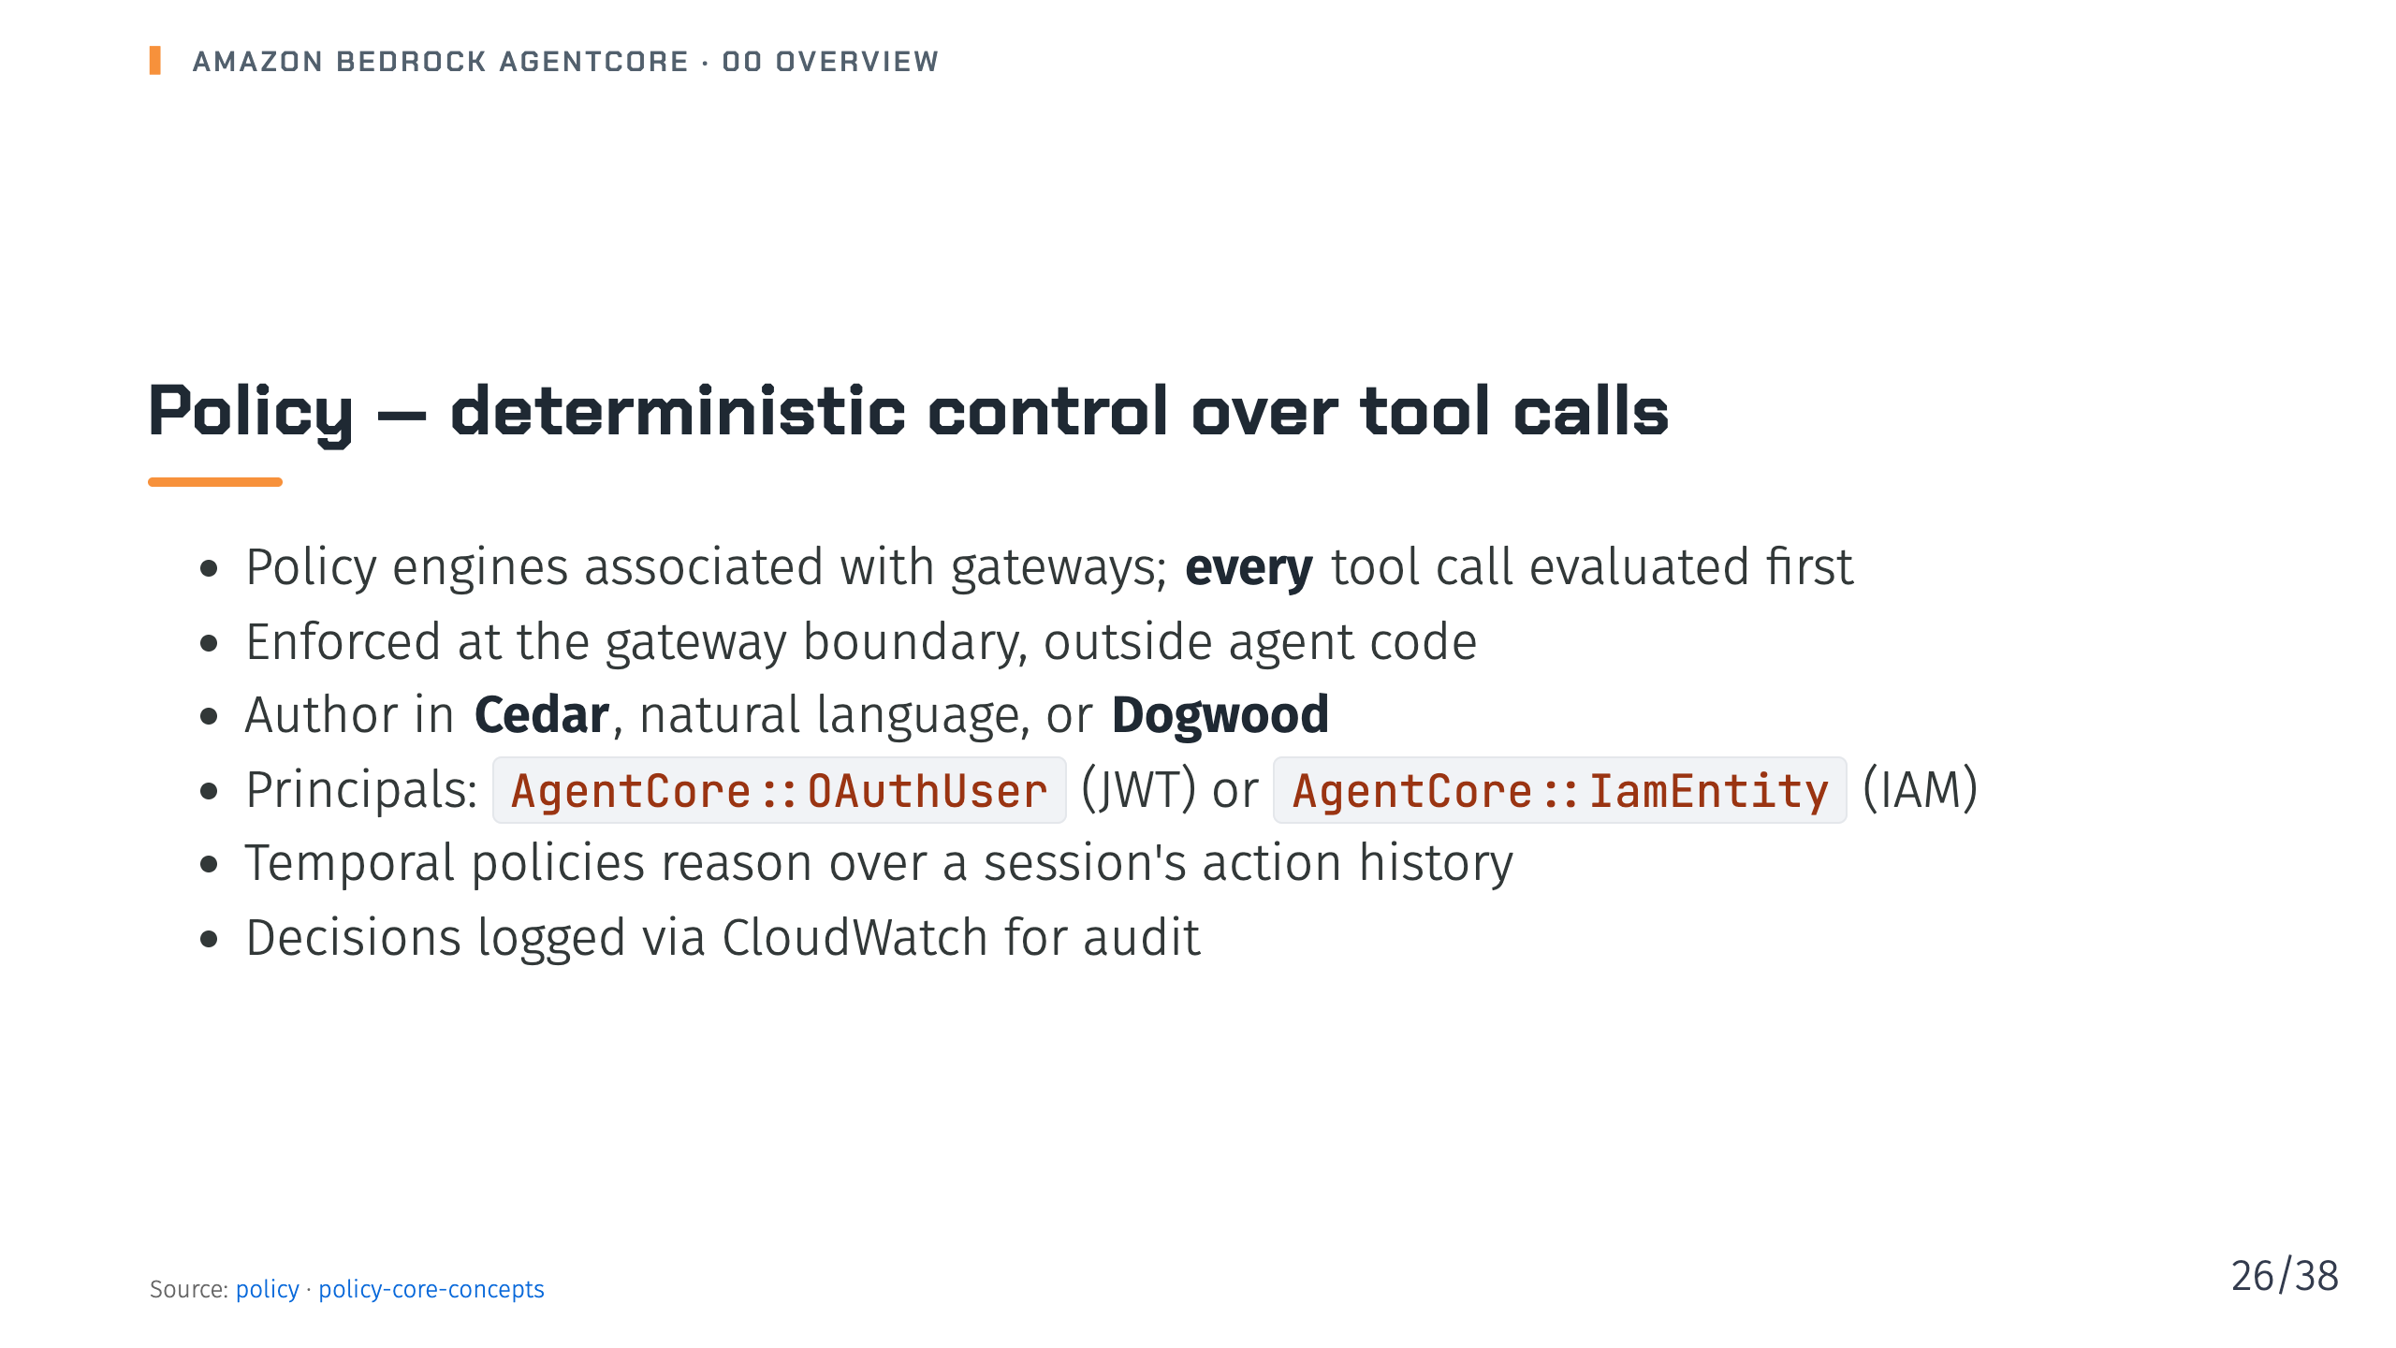
Notes:
Notes: Natural-language authoring generates Cedar, validates it against the tool schema, and uses automated reasoning to flag overly permissive or unsatisfiable policies. Source: 15-policy/_index.md, 15-policy/02-policy-core-concepts.md

Slide 27
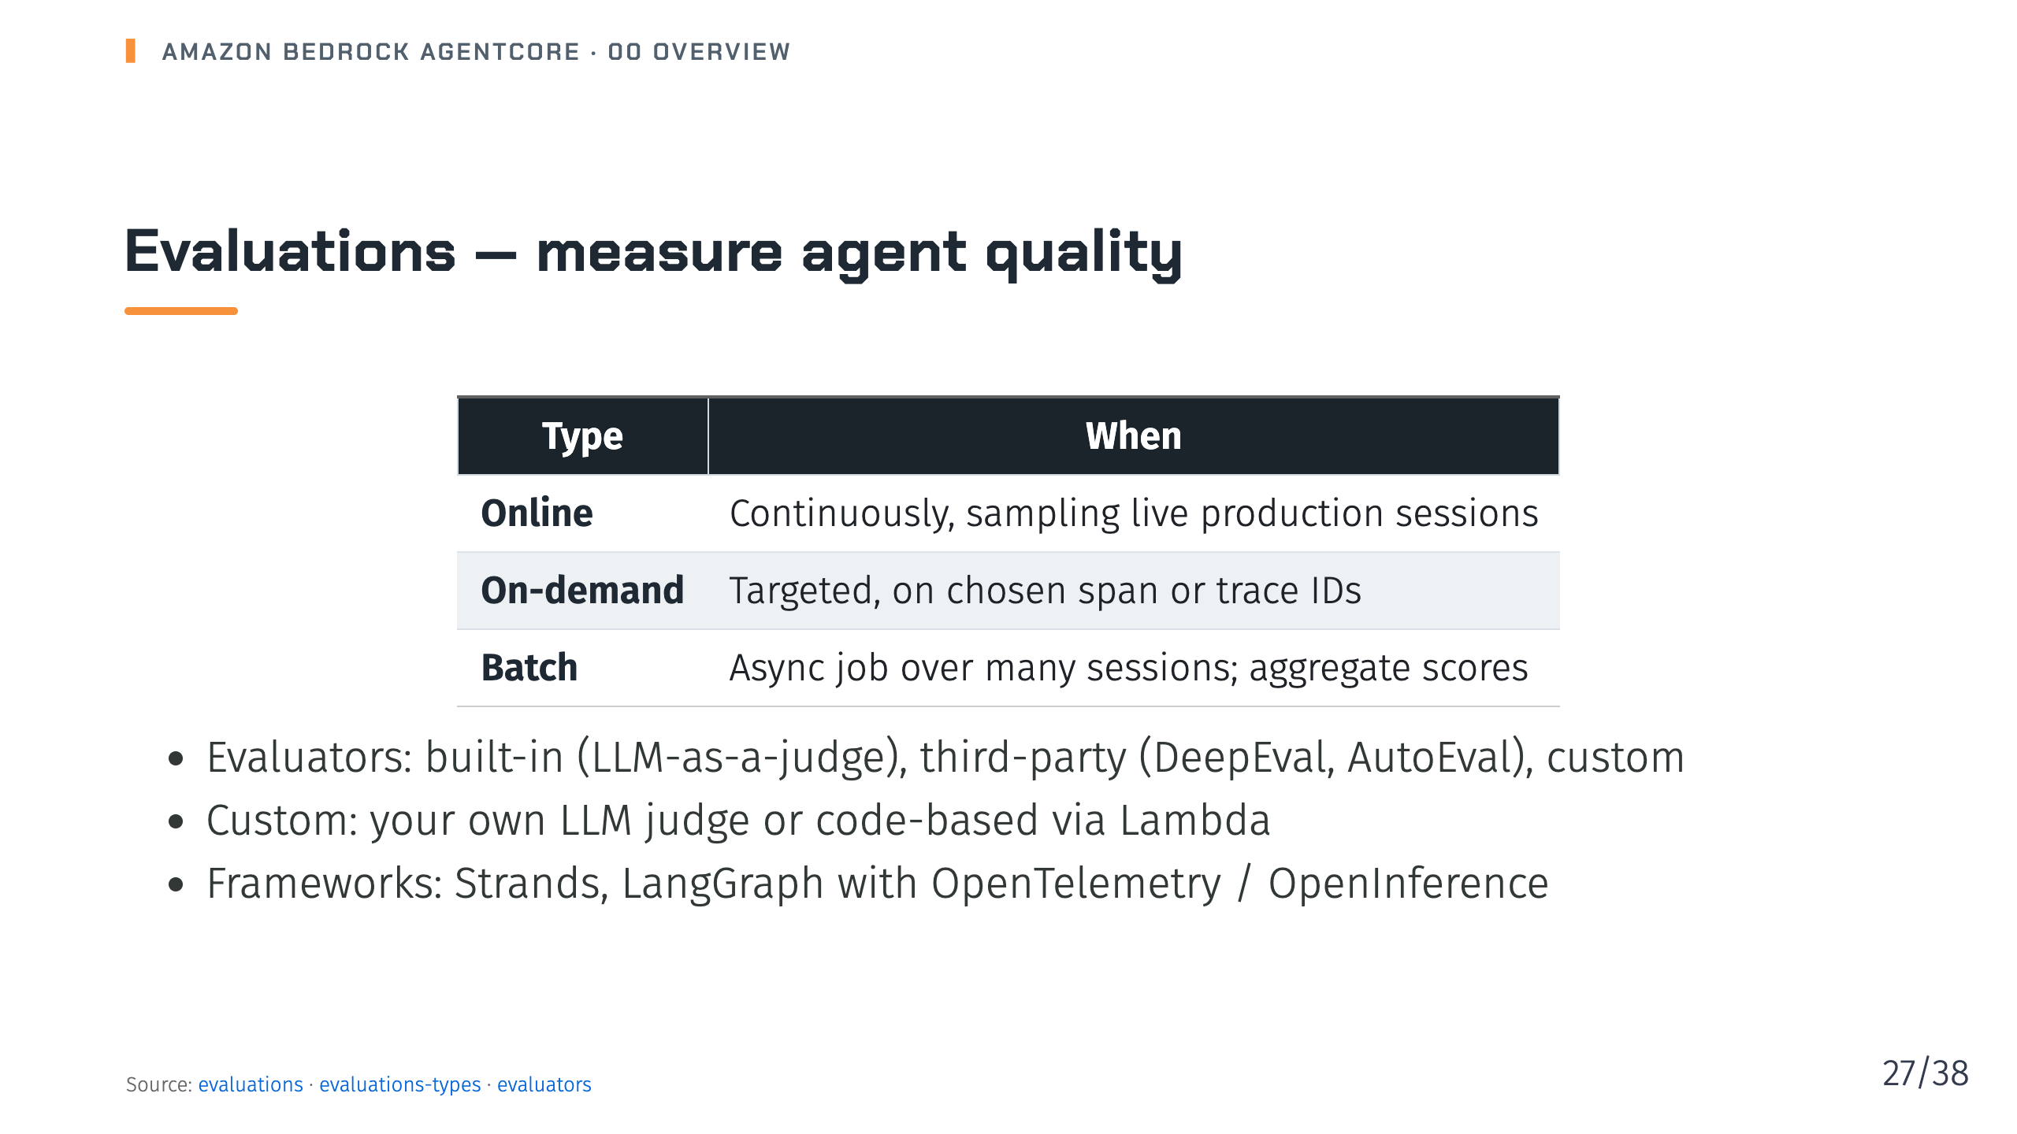
Notes:
Notes: Built-in evaluators have public ARNs such as Builtin.Helpfulness and can't be modified. Batch evaluation supports ground truth for regression testing. Source: 16-evaluations/_index.md, 16-evaluations/01-how-it-works-evaluations/03-evaluations-types.md, 16-evaluations/01-how-it-works-evaluations/02-evaluators.md

Slide 28
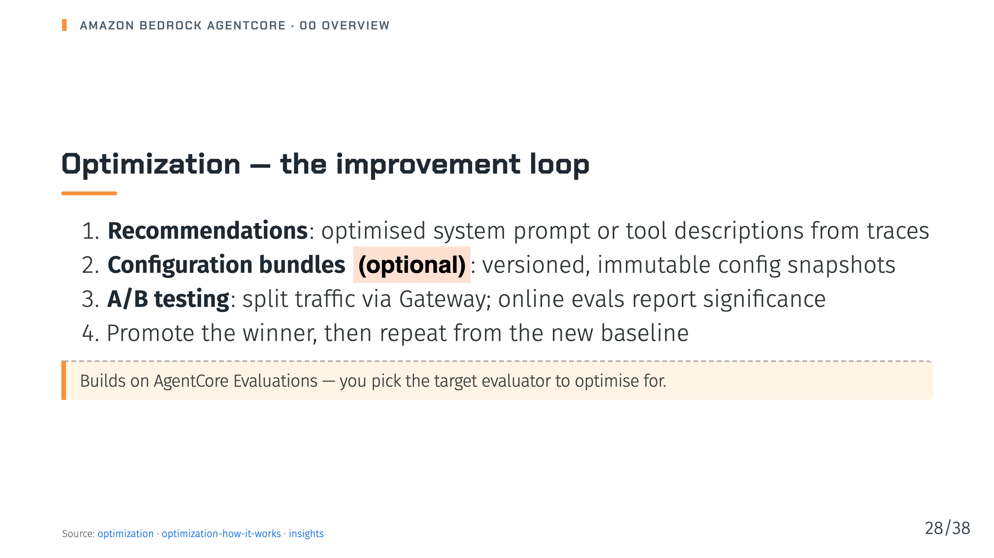
Notes:
Notes: A/B tests can compare bundle versions on the same runtime, or different gateway targets pointing at different runtime endpoints when code changes. Failure Insights, for pattern analysis, is in public preview. Source: 17-optimization/_index.md, 17-optimization/01-optimization-how-it-works.md, 17-optimization/06-insights/_index.md

Slide 29
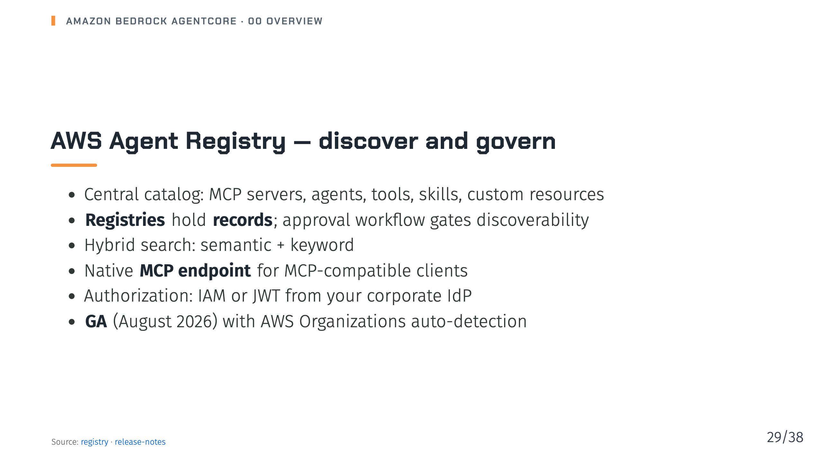
Notes:
Notes: Workflow: an admin creates a registry, publishers submit records, curators approve or reject, and consumers search or connect through MCP. This stops teams rebuilding tools that already exist. Source: 18-registry/_index.md, 25-release-notes.md

Slide 30
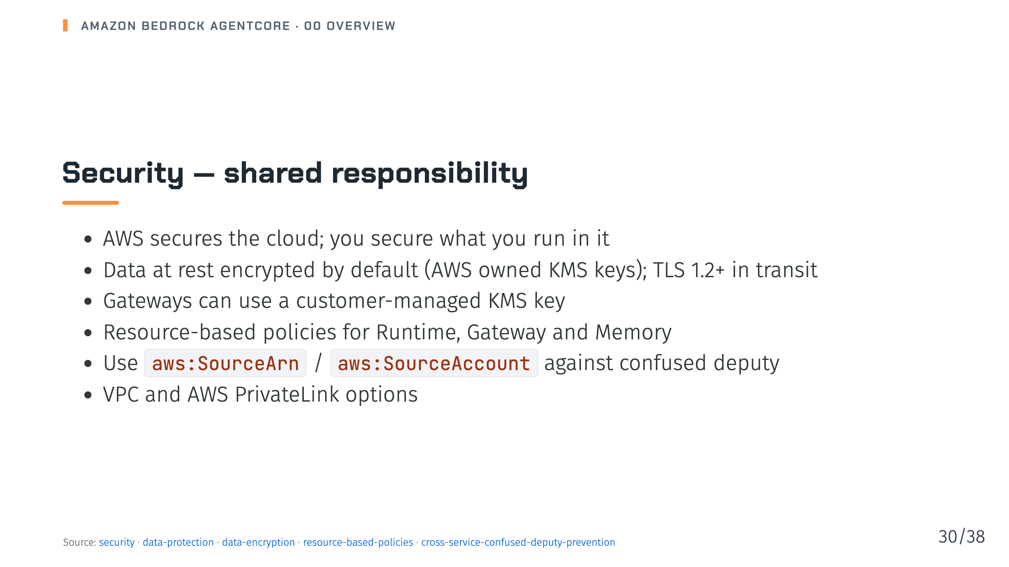
Notes:
Notes: Note that some gateway data isn't encrypted by default, such as gateway, target and tool names, so never put sensitive data in names or tags. Source: 22-security/_index.md, 22-security/01-data-protection/_index.md, 22-security/01-data-protection/01-data-encryption.md, 22-security/04-resource-based-policies.md, 22-security/07-cross-service-confused-deputy-prevention.md

Slide 31

Notes:
_transition: cover
Notes: Section break: availability, the CLI, interfaces and where to go next.

Slide 32
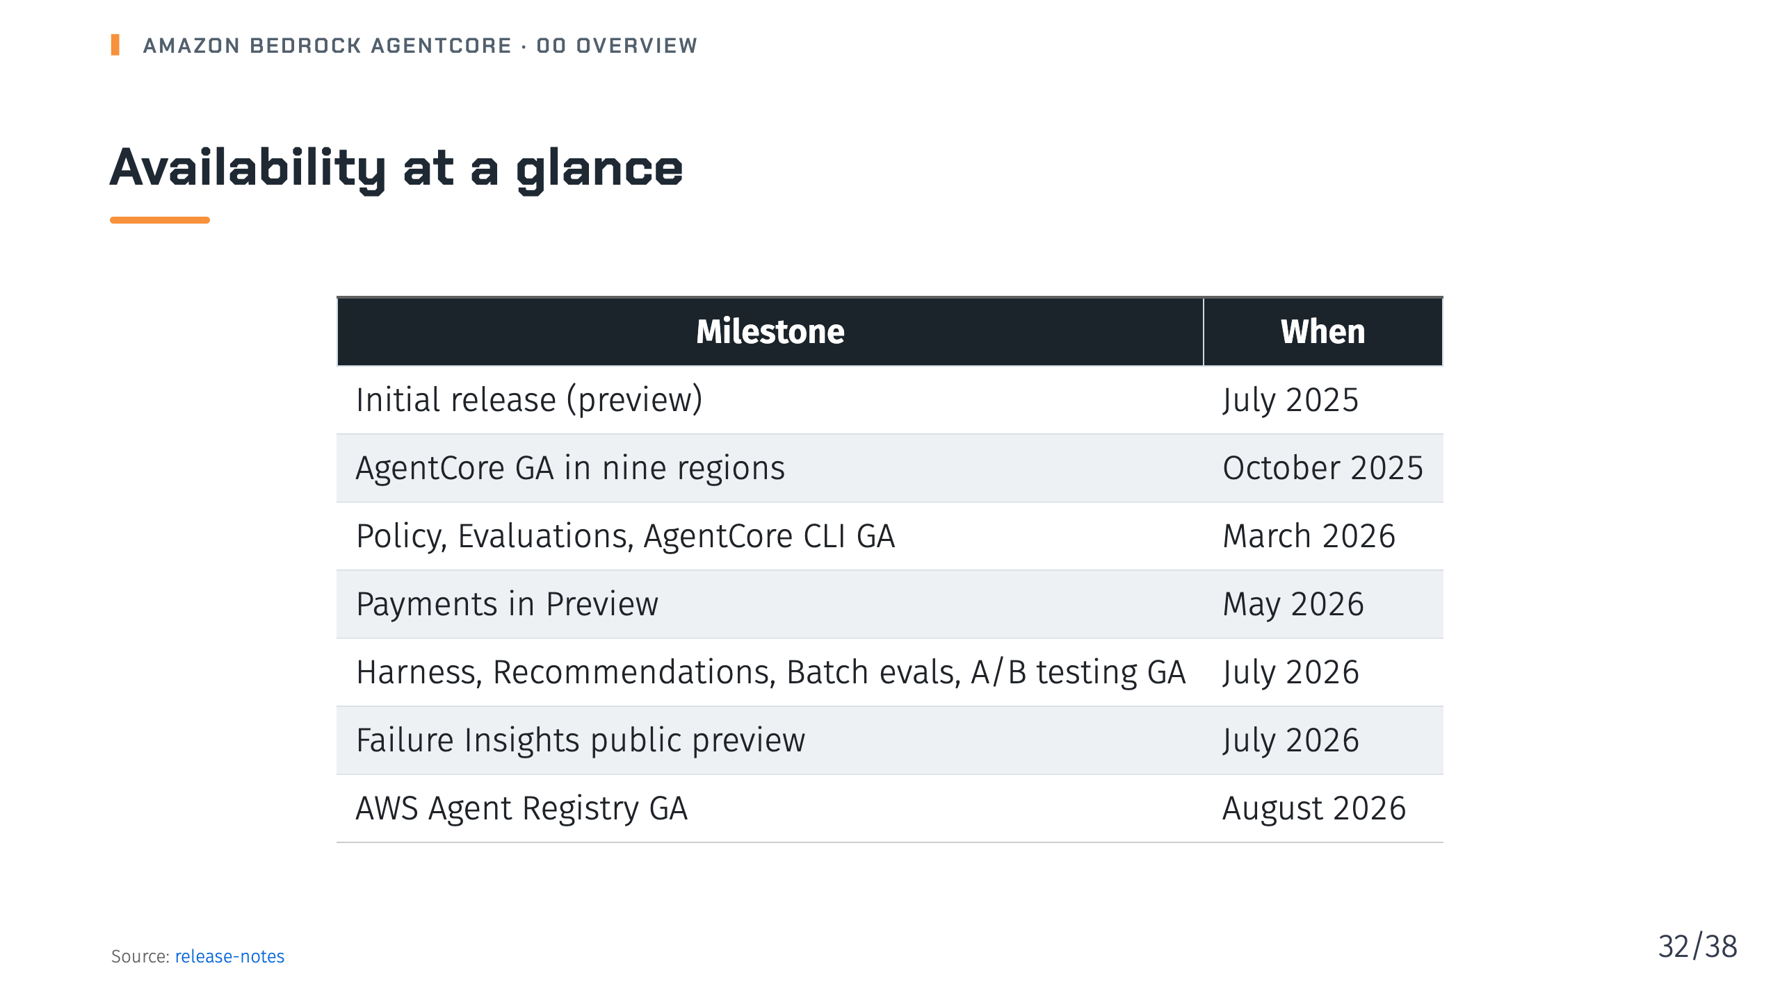
Notes:
Notes: Always check the release notes before a customer conversation; the platform moves fast. Source: 25-release-notes.md

Slide 33
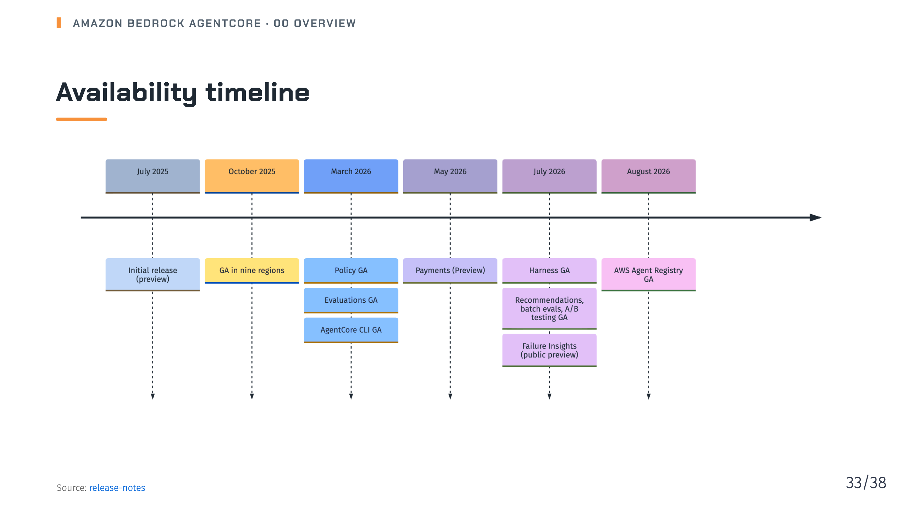
Notes:
Notes: The same milestones as the previous table on a timeline: roughly a year from preview to GA, then a steady cadence of new services through 2026. Source: 25-release-notes.md

Slide 34
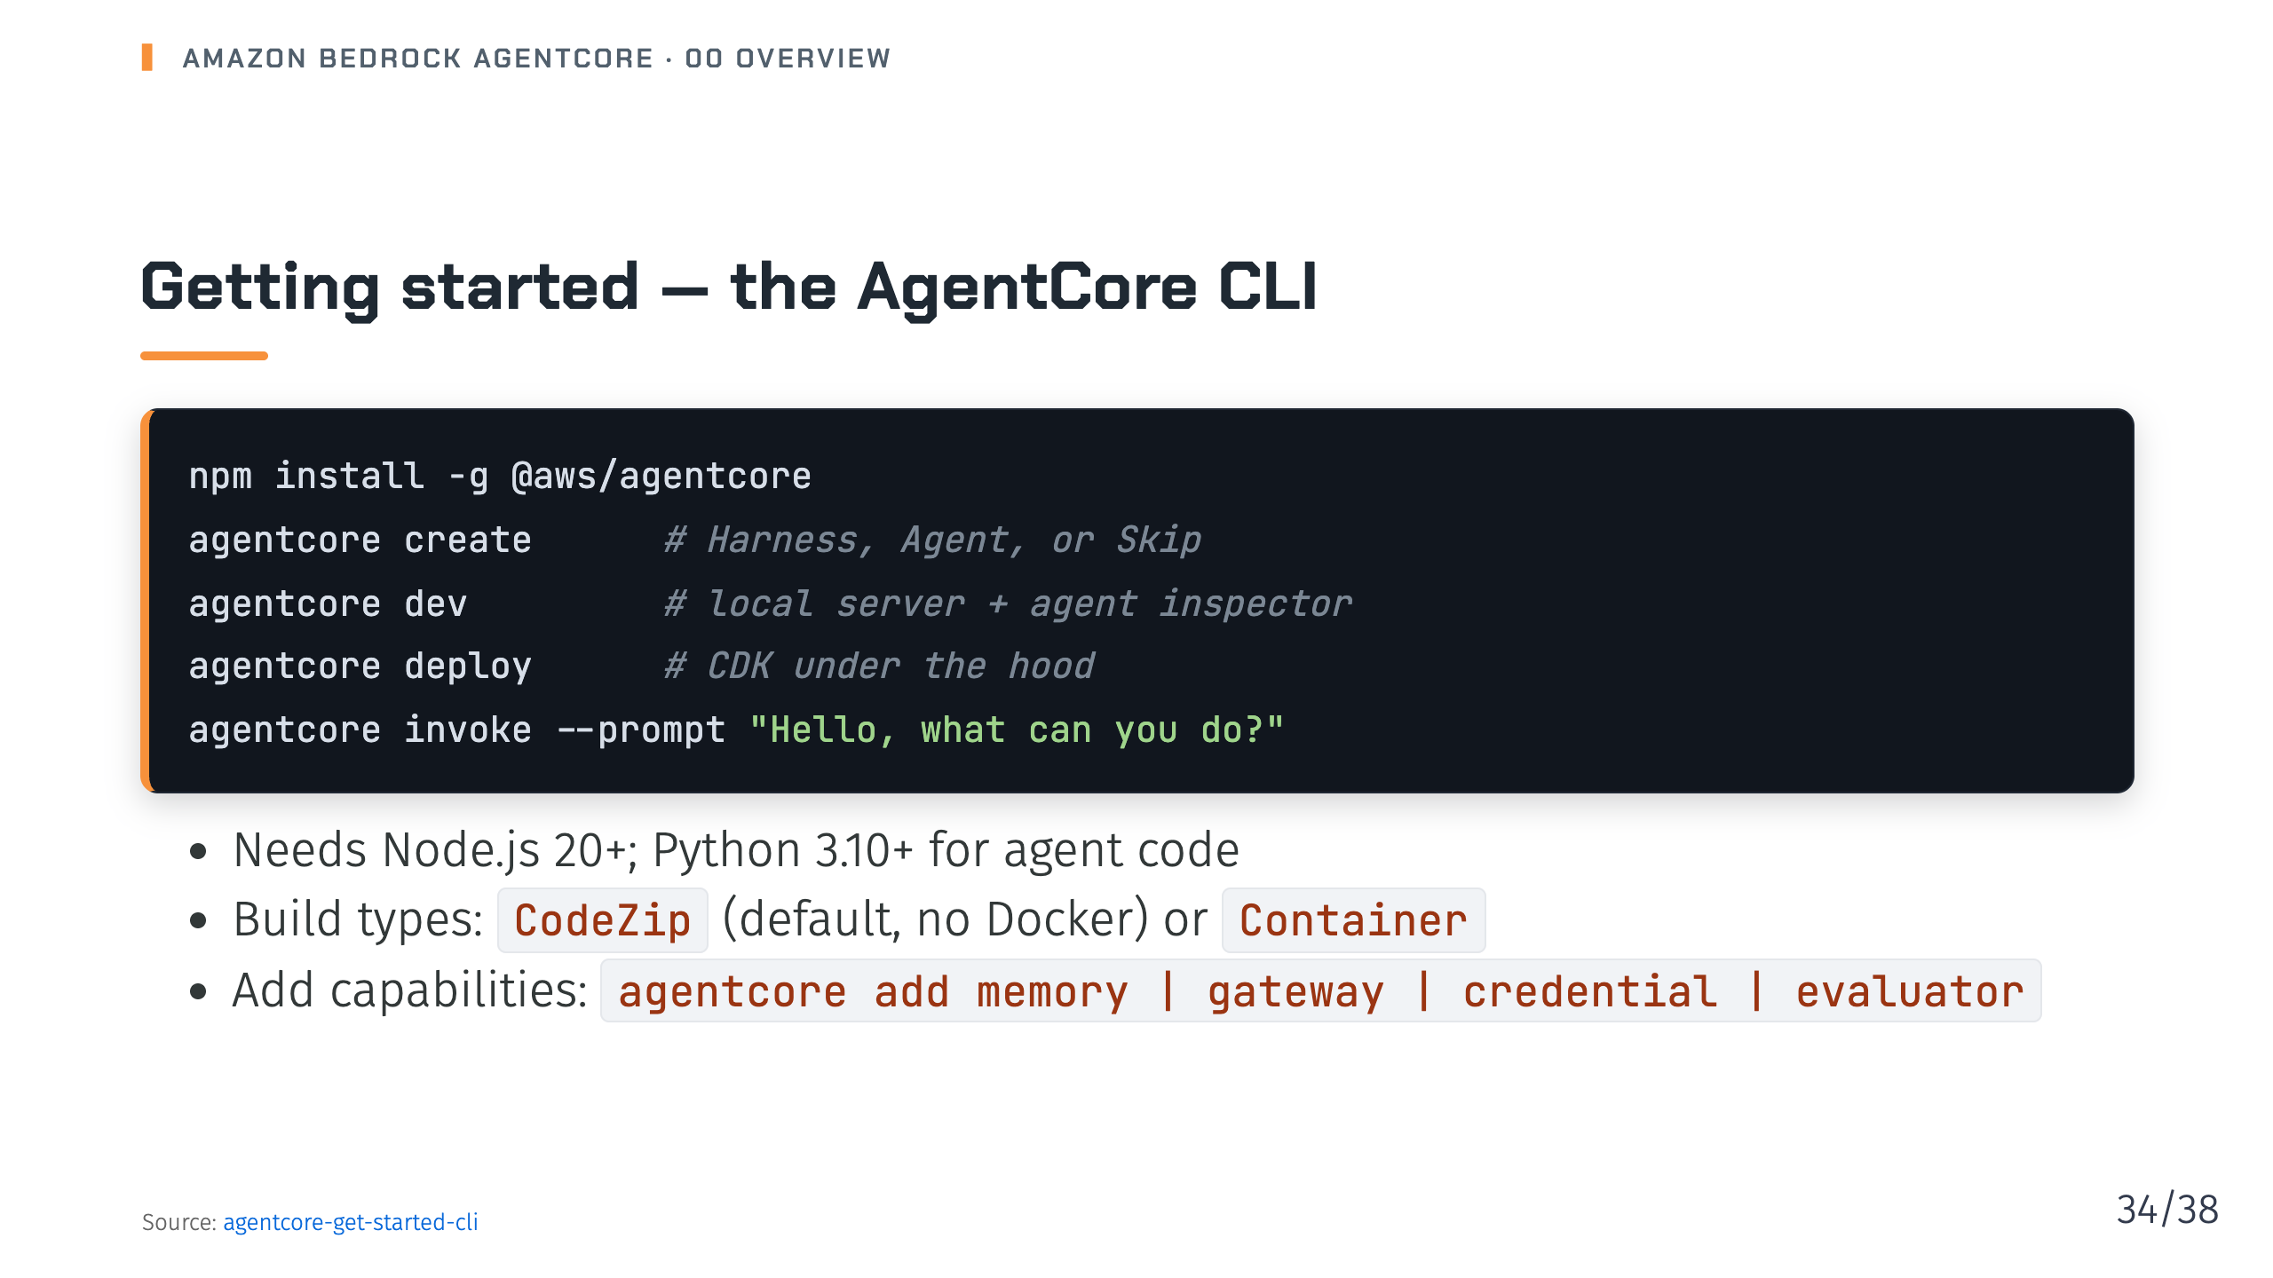
Notes:
Notes: That's the whole loop: create, dev, deploy, invoke. Code-based agents can use Strands, LangChain/LangGraph, Google ADK or OpenAI Agents SDK. Source: 03-agentcore-get-started-cli.md

Slide 35
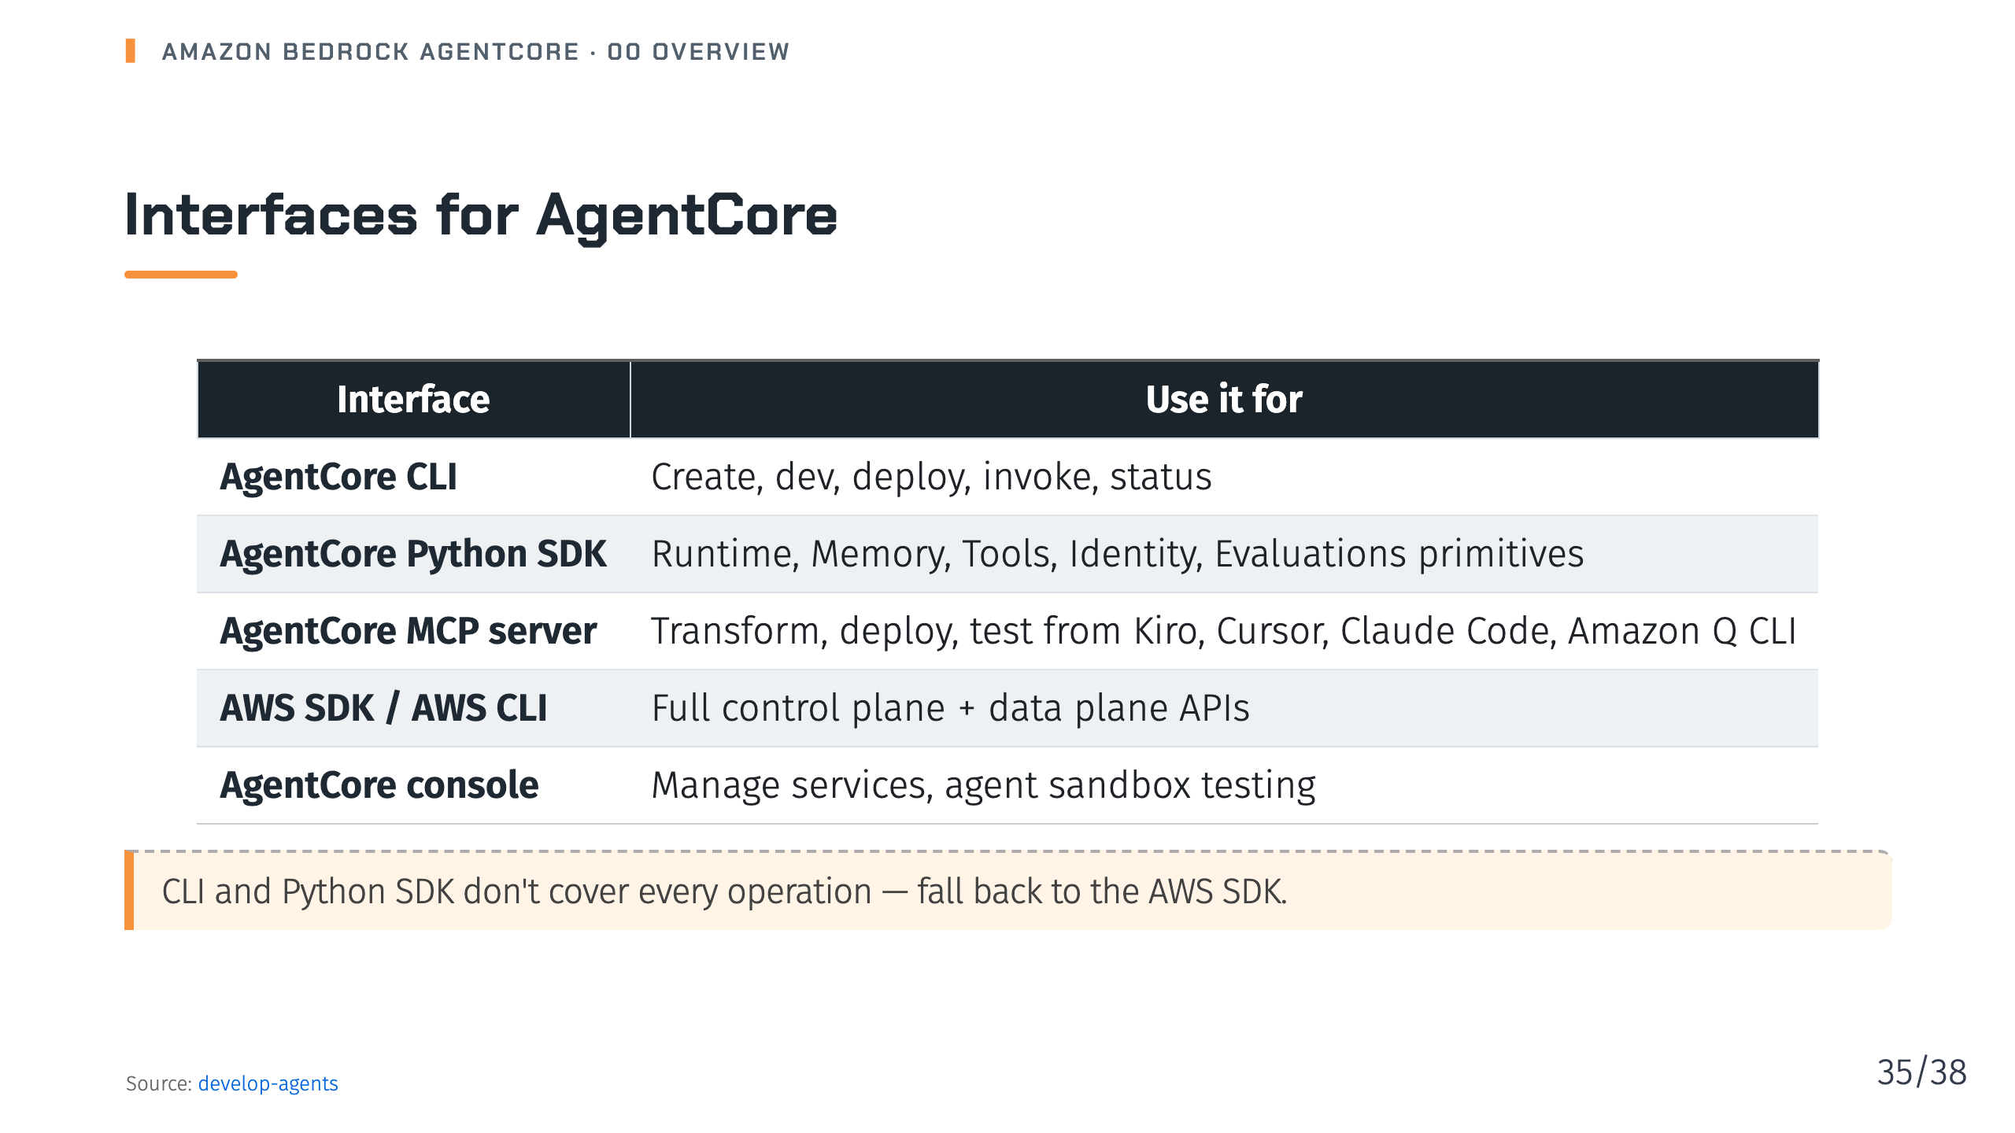
Notes:
Notes: Control plane APIs create resources like a Runtime or Memory; data plane APIs do runtime work like InvokeAgentRuntime or adding memory events. Source: 05-develop-agents.md

Slide 36
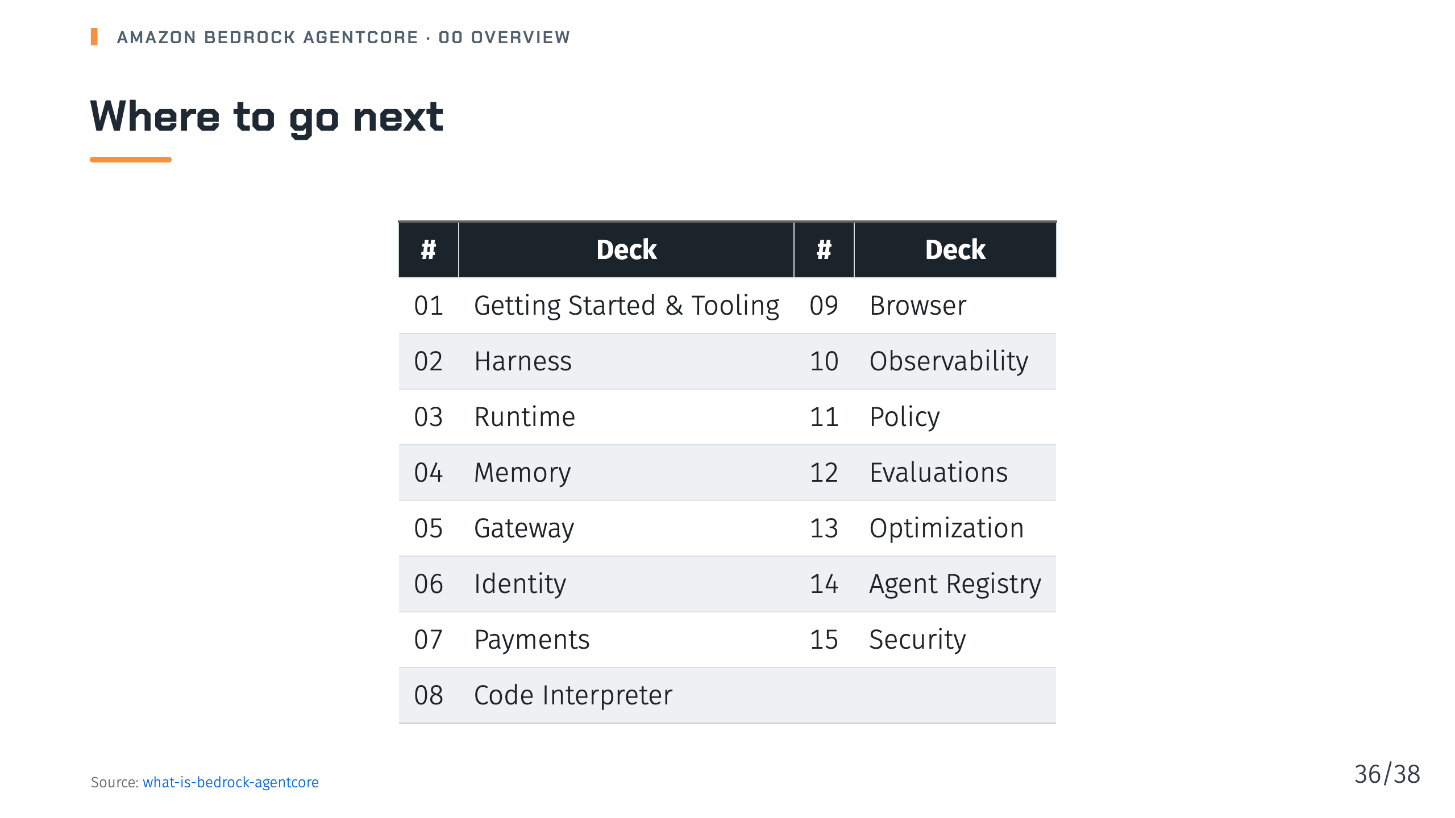
Notes:
Notes: Each topic deck goes deep on one service with examples from the docs. Suggested order for newcomers: 01, then 02 or 03, then 05 and 06. Source: 01-what-is-bedrock-agentcore.md

Slide 37
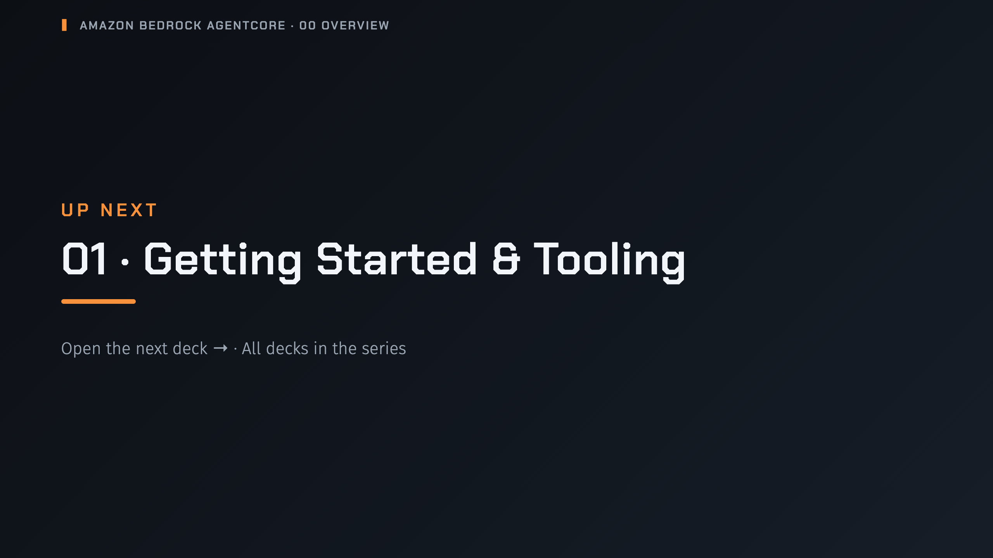
Notes:
nav:up-next
_transition: cover
Notes: That's the end of Overview. Next up is Getting Started & Tooling; the series page lists every deck in order.

Slide 38
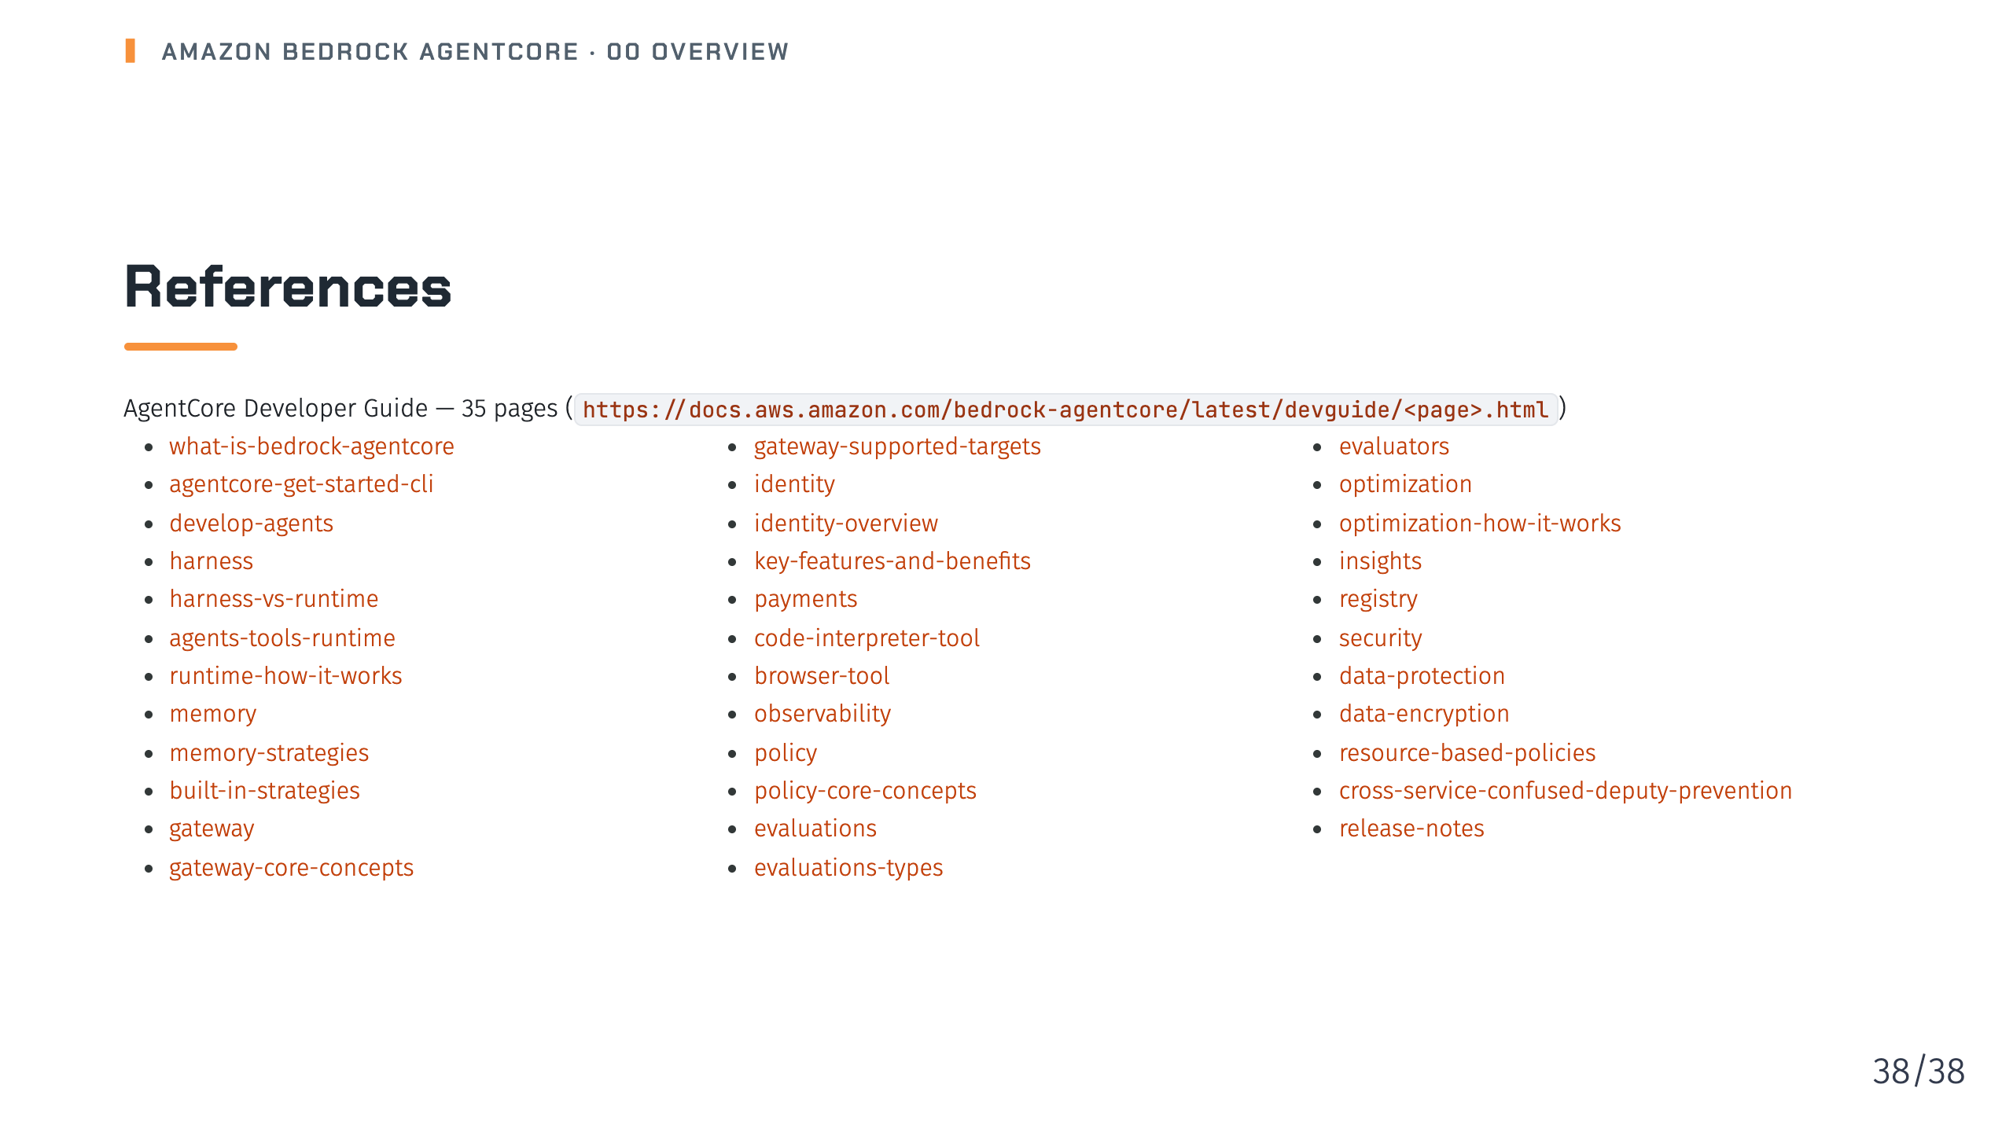
Notes:
Notes: References continue on the next slide. Source: all files cited in this deck

